Slide 1
Regional Centers for Workforce Transformation
Your Region 5 Team:
Pamela Wolff
Denise Anghel

Slide 2
Regional Centers for
Workforce Transformation
The RCWT goal is to advance the practice of the National Alliance for Direct Support Professionals’ (NADSP) Code of Ethics and the NYS Direct Support Professional (DSP) Core Competencies among New York State’s DSPs, assisting agencies in building DSP capacity in the changing service landscape within the field.
Notes:
This is a quick introduction of leads and RCWT

Slide 3
Goal 1: Putting People First
Goal 2: Building and Maintaining Positive Relationships
Goal 3: Demonstrating Professionalism
Goal 4: Supporting Good Health
Goal 5: Supporting Safety
Goal 6: Having a Home
Goal 7: Being Active and Productive in Society
Notes:
Ask audience if they are familiar with the NY State DSP Core Competencies and if they have been evaluated. Run through the Core Competencies pretty quickly (probably spend 1 or 2 minutes on this slide)

Slide 4
Objectives for today….
DSP Survey Results
What Self-Advocates Have to Say
Making Ethical Decisions
DSP Success Stories
Notes:
Today we are going to let you know what RCWT has heard from DSPs, as well as Self-Advocates. We will also talk about some of the ethical decisions you have to make and highlight some of the many successes of DSPs.

Slide 5
We value what you have to say!
Notes:
Last year at this event, we took the opportunity to get feedback from DSPs through a survey. What you have to say is important to us. We feel that if we can support you, you will in turn be able to support people and bring the Core Competencies into day to day practice. Let’s see what DSPs had to say...

Slide 6
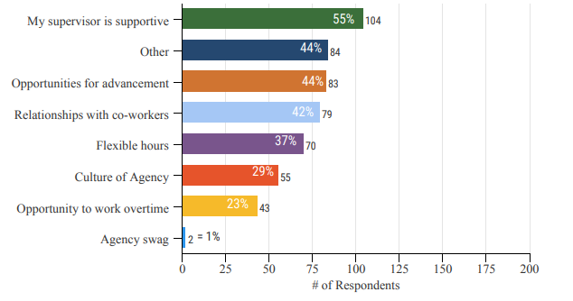
What are the top 3 reasons you stay in the role of a Direct Support Professional?
Notes:
(Across all Regions) When asked: What are the top 3 reasons you stay in the role of a DSP?, DSPs said:
My supervisor is supportive
Other:
*Because of the relationships with people I support
*Making a difference
*Giving back
Opportunities for Advancement
*Regional Results were a bit different (Top response first):
Capital: Other, My supervisor is supportive, Relationships with my co-workers
Hudson: Other, Opportunities for Advancement, My supervisor is supportive
Long Island: Other, My supervisor is supportive, Opportunities for Advancement
NYC: My supervisor is supportive, Other, Relationships with my co-workers
One of the focuses of RCWT has been to support Frontline Supervisors with skill development by providing trainings, workshops and other resources. Skilled Frontline Supervisors are better supports to all of you.

Slide 7
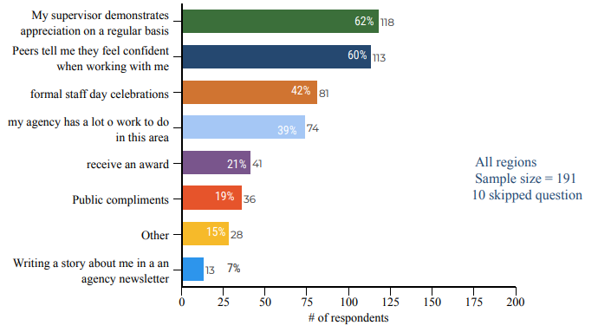
What are the three most valuable methods your agency uses to show their appreciation of you?
Notes:
(Across all Regions) When asked: What are the 3 most valuable methods your agency uses to show their appreciation of you?, DSPs said:
My supervisor demonstrates appreciation on a regular basis
Peers tell me they feel confident when working with me
Formal Staff Day celebrations
*Regional Results were a bit different (Top response first):
Capital: same preferences as across all regions
Hudson: My supervisor demonstrates appreciation on a regular basis, peers feel confident when working with me, my agency has some work to do in this area
Long Island: My supervisor demonstrates appreciation on a regular basis, peers feel confident when working with me, my agency has some work to do in this area
NYC: Peers tell me they are confident when they work with me, formal staff day celebrations, my supervisor demonstrates appreciation on a regular basis
Showing gratitude is important. Many agencies hold staff appreciation events, that are meaningful to DSPs. This event is held to celebrate you all. The survey information also tells us that appreciation from DSP to DSP really matters, so let’s keep showing it.

Slide 8
What would help you do your job better?
Better Salary/ Living Wage
More and Better Training
Childcare
Networking Opportunities
Better Supervision
Notes:
When asked: “What would help you do your job better?”, DSPs said (read slide):
Better Salary/ Living Wage
More and Better Training
Childcare
Networking Opportunities
Better Supervision
We know that the majority of DSPs are working second jobs to pay their bills. We know that DSPs need support, supervision, training and development. We shared this information with providers so that they know how to support you best. RCWT is able to provide our field with many resources and opportunities in these areas (give examples based on your region, e.g. FLs Supervisor Training Series - give supervisors the tools to be the best supports to DSPs and people we support, DSP focus groups, video training series/ webinars, monthly meeting, workshops).
We have a survey for you today. Please share your thoughts and ideas with us.

Slide 9
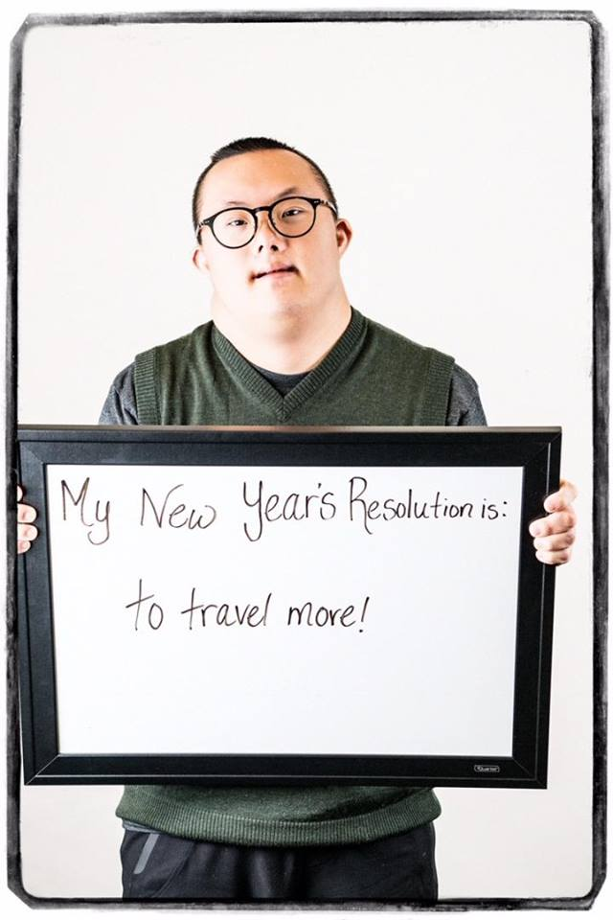
Hearing
from Self-Advocates
Notes:
Now that we have talked about hearing from DSPs, we are going to shift gears to hear what Self-Advocates have to say. After all, we are here to put people first (goal 1). We have been spending time with Self-Advocates across NY State with the goal of finding out what is important to them. We have had the pleasure of attending self-advocacy meetings in some of your agencies and are available to continue to do so. If we are going to put people first, we have to make a commitment to actively listen to each person we support. Let’s see what Self-Advocates have to say...

Slide 10
What do Self-Advocates Want?
Nothing about us without us!
This is my life, my meeting! And… We don't need a meeting for everything
Support me even when it’s hard
Treat me with respect
Listen to what I have to say
Notes:
When we asked Self-Advocates what they want from DSPs, they said: (Ask what each area means)
Nothing about us without us: All decisions should be made by the person and when a person requires more support, advocacy should take place alongside the person
This is my life, my meeting! at meetings: The person should determine the topics to be discussed, who will attend the meeting and can write an agenda in advance with support if needed.
Support me even when it’s hard
Treat me with respect: engage in adult/adult interactions
Listen to what I have to say: through words, actions and my way of communicating
This is feedback we received from people who are able to tell us what they want. We know there are many people out there that we support that can not discuss their feelings in words. Regardless of which ways people communicate, these are important concepts for all.

Slide 11
A Message from Tish Allcorn
Place video here
Notes:
Play video from Tish (we still need one)
Conclude with: Now that we have heard from Self-Advocates, how do we go about providing support? There are challenges. How do we know what to do? (next slide)

Slide 12
NADSP Code of Ethics
Person-Centered Supports: As a DSP, my first allegiance is to the person I support; all other activities and functions I perform flow from this allegiance.
Promoting Physical and Emotional Well-Being: As a DSP, I will commit to promote the emotional, physical, and personal well-being of the people I support. I will encourage growth and recognize the autonomy of those receiving support while being attentive and energetic in reducing the risk of harm.
Integrity and Responsibility: As a DSP, I will support the mission and vitality of my profession to assist people in leading self-directed lives and to foster a spirit of partnership with the people I support, other professionals, and the community.
Confidentiality: As a DSP, I will safeguard and respect the confidentiality and privacy of the people I support.
Justice, Fairness and Equity: As a DSP, I will affirm the human rights as well as the civil rights and responsibilities of the people I support. I will promote and practice justice, fairness, and equity for the people I support and the community as a whole.
Respect: As a DSP, I will respect the human dignity and uniqueness of the people I support. I will recognize each person I support as valuable and promote their value within communities.
Relationships: As a DSP, I will assist the people I support to develop and maintain relationships.
Self-Determination: As a DSP, I will assist the people I support to direct the course of their own lives.
Advocacy: As a DSP, I will advocate with the people I support for justice, inclusion, and full community participation.
Notes:
In addition to the NY State DSP Core Competencies, we have the NADSP Code of Ethics, which is a roadmap to making ethical decisions. (Quickly read through the 9 tenets)

Slide 13
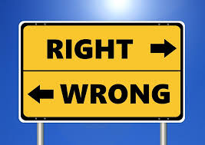
What would you do?
Notes:
We are going to present you with a few scenarios, situations that are likely to come up for you, as a DSP. Think about the NADSP Code of Ethics and what you would do in each situation.
Plickers questions to follow or next slides can be used in place of plickers.

Slide 14
You are supporting John and his Mom is visiting in the program. While the three of you are in the living room, John’s Mom lifts up his shirt to show you a bruise. How should you respond?
Do nothing
Ask John if he would you like to go to a private area where you can take a look
Inspect the bruise
Say “Are you kidding me?!” to John’s Mom

Slide 15
The answer is b.
Promoting Physical and Emotional Well-Being: As a DSP, I will commit to promote the emotional, physical, and personal well-being of the people I support. I will encourage growth and recognize the autonomy of those receiving support while being attentive and energetic in reducing the risk of harm.
Respect: As a DSP, I will respect the human dignity and uniqueness of the people I support. I will recognize each person I support as valuable and promote their value within communities.
Relationships: As a DSP, I will assist the people I support to develop and maintain relationships.
Notes:
Ask why the answer is b
We want to check the bruise (physical well being) and in a private area (emotional well-being & respect). We also want to treat John’s Mom with respect to support John’s relationship as well as our partnership.

Slide 16
While you are at a training, another DSP starts talking to you about a person you both support, Susan. Susan’s personal information is being discussed in front of the larger group. How should you respond?
Keep the conversation going
It’s ok to join in, you are only using Susan’s initials
Listen, but don’t respond
Remind your co-worker that this is not a private space and postpone the conversation

Slide 17
The answer is d.
Person-Centered Supports: As a DSP, my first allegiance is to the person I support; all other activities and functions I perform flow from this allegiance.
Confidentiality: As a DSP, I will safeguard and respect the confidentiality and privacy of the people I support.
Respect: As a DSP, I will respect the human dignity and uniqueness of the people I support. I will recognize each person I support as valuable and promote their value within communities.
Notes:
Ask why the answer is d.
Our first allegiance is to Susan, not the other DSP. We want to show respect for Susan and keep her information confidential. This may be a great conversation to engage in, in a different environment.

Slide 18
You are at a restaurant with Amy, a person you support. The server is directing all questions to you and is not communicating with Amy about what she would like to order. How should you respond?
You respond for Amy
Educate the server by saying “Amy can order for herself”
Turn to Amy and ask her if she wants to tell the server what she would like
Don’t tip!

Slide 19
The answer is c.
Person-Centered Supports: As a DSP, my first allegiance is to the person I support; all other activities and functions I perform flow from this allegiance.
Integrity and Responsibility: As a DSP, I will support the mission and vitality of my profession to assist people in leading self-directed lives and to foster a spirit of partnership with the people I support, other professionals, and the community.
Advocacy: As a DSP, I will advocate with the people I support for justice, inclusion, and full community participation.
Notes:
Ask why the answer is c.
We want to center this experience around Amy and foster growth of her relationships in the community. Amy should have the opportunity to advocate for herself.

Slide 20
Kenny, a person you support, is on a gluten free diet. You are at a party with Kenny and there are no gluten free options. How should you respond?
Order a gluten free pizza to the party
Order a gluten free pizza and next time plan ahead to bring a gluten free dish of choice
It’s a party. Kenny can eat what he wants
Leave the party

Slide 21
The answer is b.
Person-Centered Supports: As a DSP, my first allegiance is to the person I support; all other activities and functions I perform flow from this allegiance.
Promoting Physical and Emotional Well-Being: As a DSP, I will commit to promote the emotional, physical, and personal well-being of the people I support. I will encourage growth and recognize the autonomy of those receiving support while being attentive and energetic in reducing the risk of harm.
Self-Determination: As a DSP, I will assist the people I support to direct the course of their own lives.
Notes:
Ask why is the answer b.
When you are in the situation, you have to do the best you can to support Kenny in his choices. We have all been in these types of situations and have learned from them. If we have an allegiance to Kenny, this means we are going to think ahead and be proactive. By bringing a preferred gluten free dish, we are supporting Kenny’s physical well being, as well as his emotional well being. He will not feel left out at the party. Support Kenny in making informed decisions about what he would like to bring.

Slide 22
Wow! You are doing it!
Notes:
Regardless of the challenges and ethical dilemmas you face, you are doing great work. You are teaching people and supporting them to direct the course of their own lives. You are bringing the Core Competencies and Code of Ethics into what you do every day. Let’s look at some of your Wow moments...

Slide 23
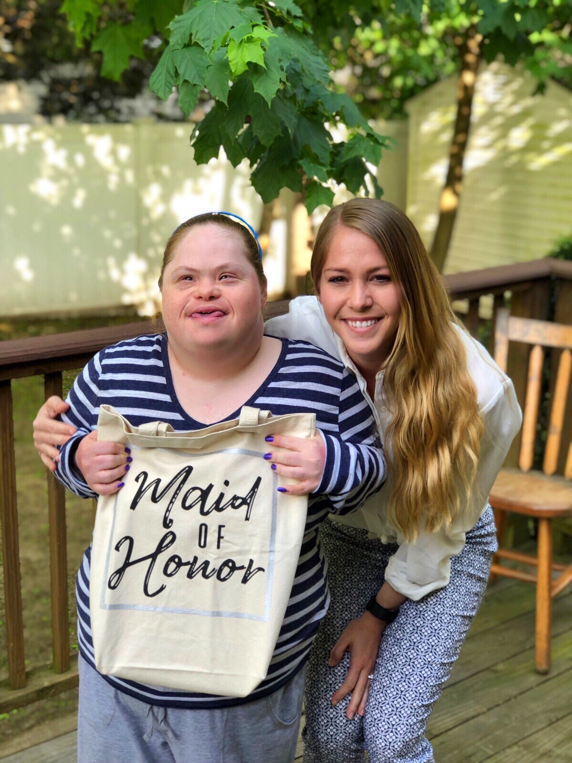
With the assistance and love from the residential staff and management, Jenny has grown to be a wonderful young lady. With the assistance of this team, Jenny will be one of the best Maid of Honors a sister could ask for.
Notes:
Which Core Competencies are shown in this Wow moment?

Slide 24
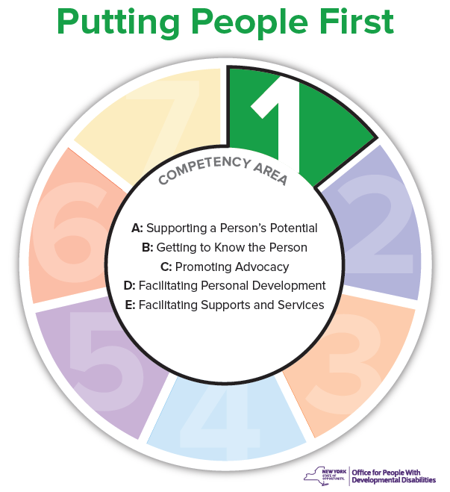
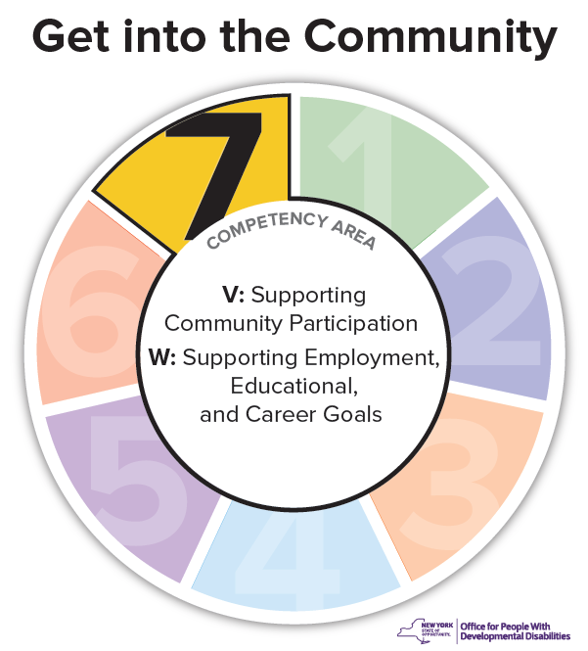
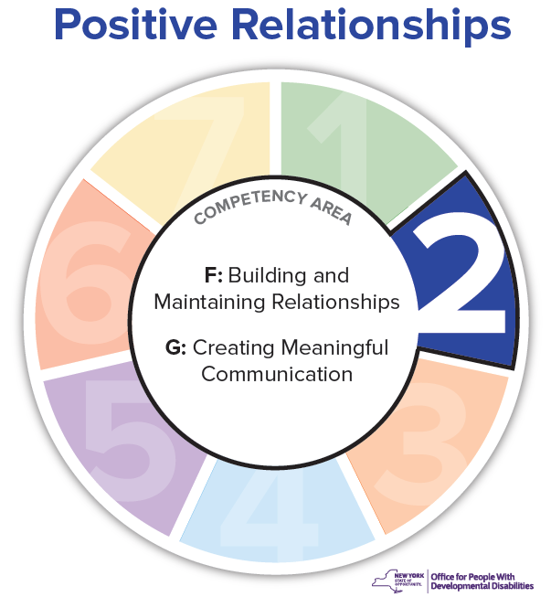
Notes:
- Jenny wants to be a part of her sister’ wedding party
- Her relationship will continue to grow and flourish with the support of DSPs
- Jenny will get to be a part of the bridal shower and even the bachelorette party with friends

Slide 25
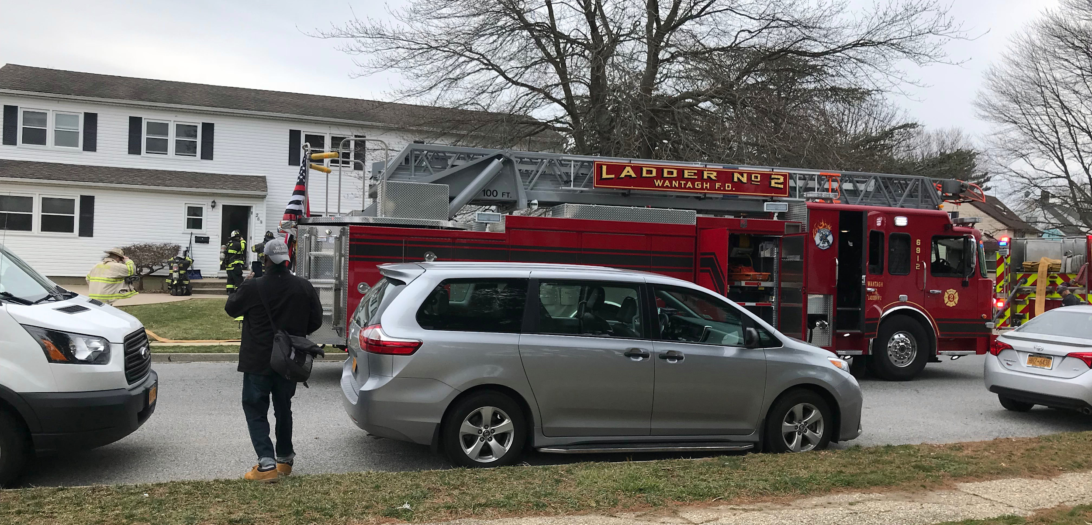
The bright spring day turned ominous when smoke alarms sounded throughout the rooms in the program. Staff leapt into action to make sure everyone was safely evacuated. Thanks to quick thinking and seamless coordination among staff, people are settling back into their routines after an electrical fire destroyed part of their home.
Notes:
Which Core Competencies are shown in this Wow moment?

Slide 26
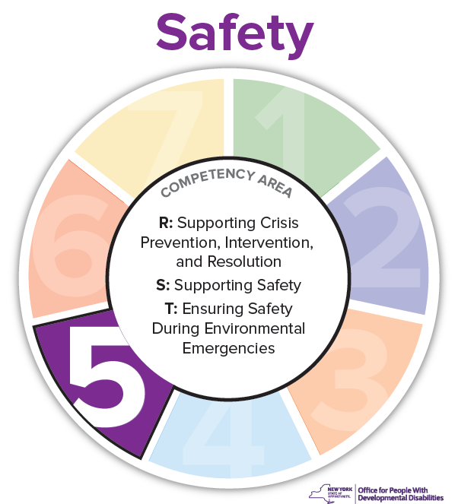
Notes:
Staff followed the emergency plans in place and were able to keep people safe
Because of the positive relationships built, DSPs were able to support people in relocating to a different place, while keeping each person’s unique capacities and personalities in mind

Slide 27
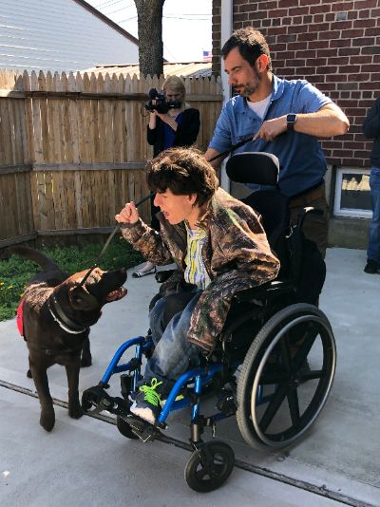
DJ receives very special visits from Molly, the therapy dog. With the support of Molly’s trainer and the DSP supporting DJ, he is able to spend time with Molly and feed her treats. Molly plays an important role in reducing stress and improving cognitive function for people.
Notes:
Which Core Competencies are shown in this Wow moment?

Slide 28
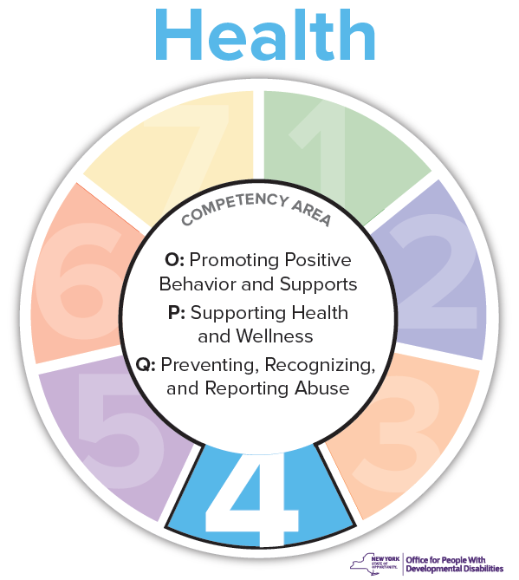
Notes:
DJ loves dogs
This is a way to support his emotional well being and health, while engaging in activities with a community member

Slide 29
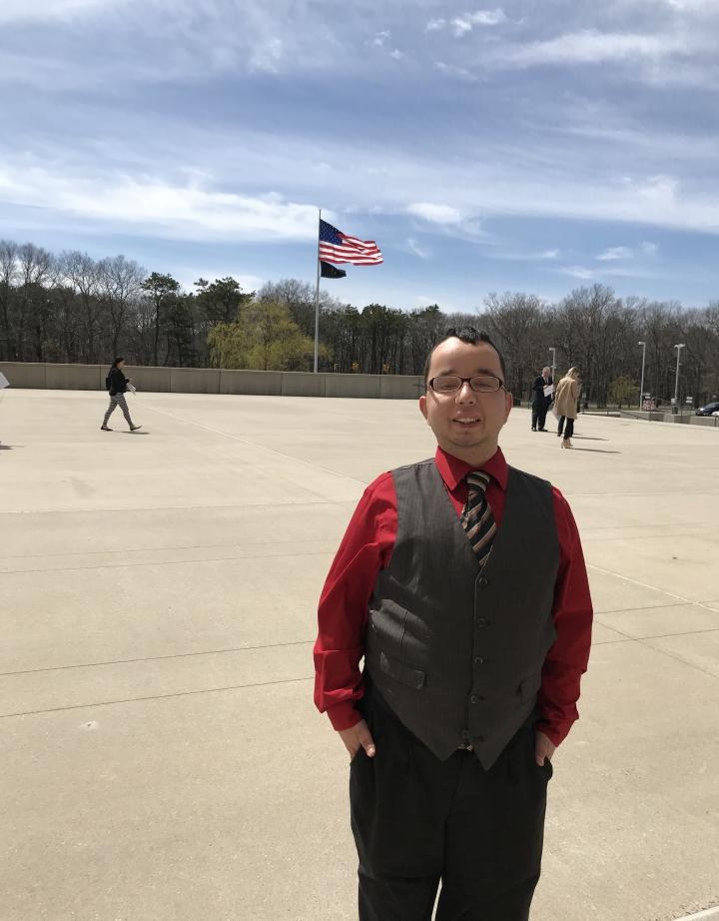
Congratulations to Alex, who was recently granted US citizenship! “I’m so excited to finally be a US citizen because this is my home, I want to live here forever!” Alex says “Thank you!” to the staff who helped him through the lengthy process.
Notes:
Which Core Competencies are shown in this Wow moment?

Slide 30
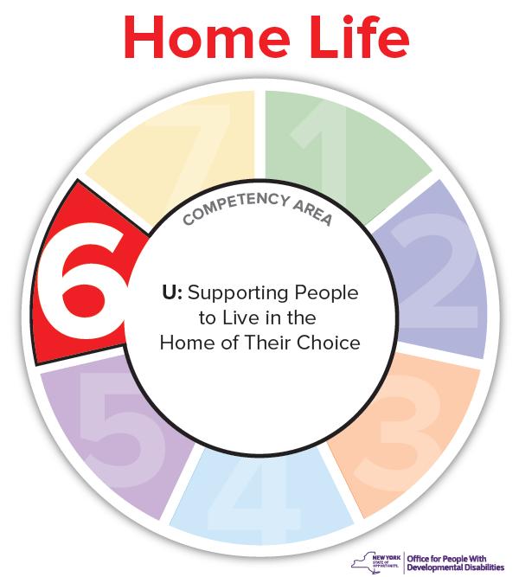
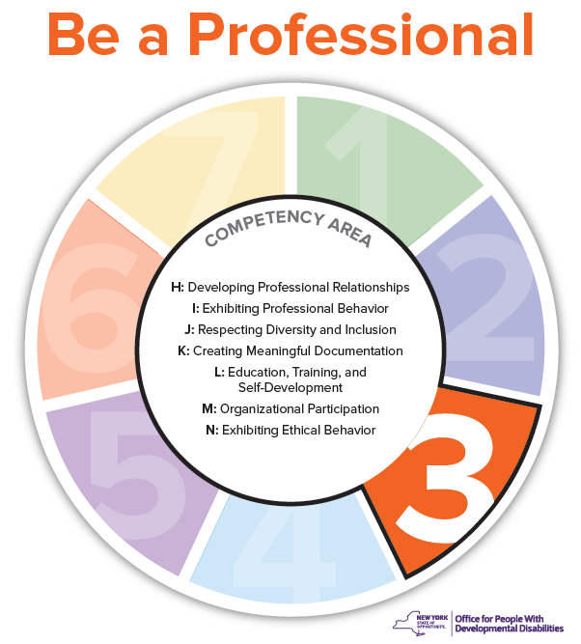
Notes:
Alex loves his home and has stated that he wants to live here forever
Staff supported Alex in advocating for himself to gain citizenship, while showing respect for diversity and inclusion

Slide 31
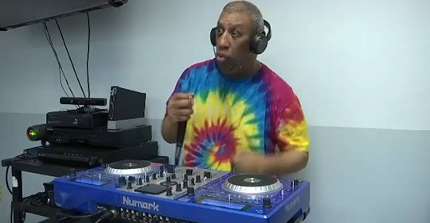
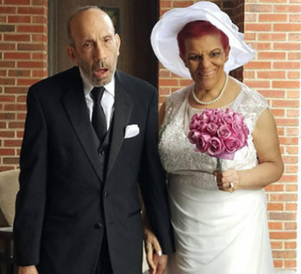
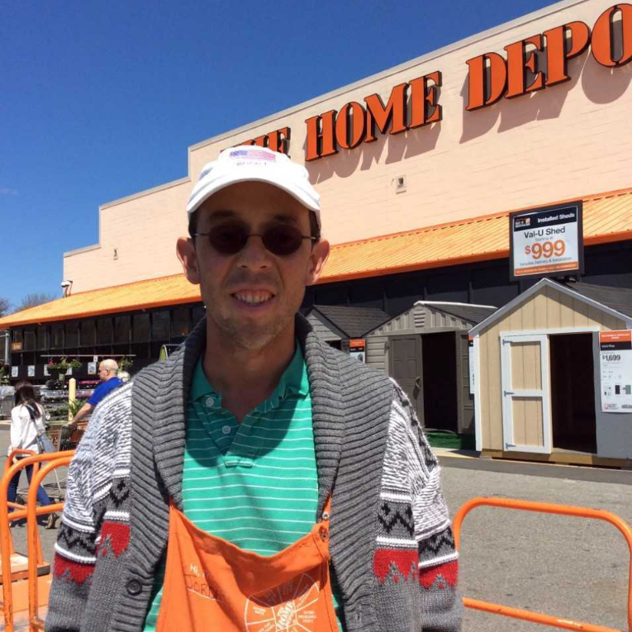
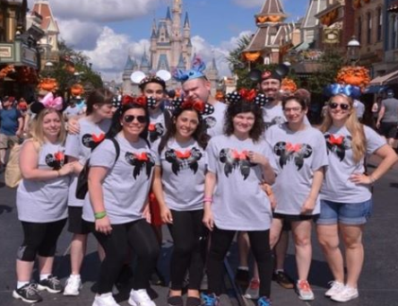
Notes:
You support people in doing so much: people are becoming DJs, Having relationships, getting jobs and going to Disney.

Slide 32
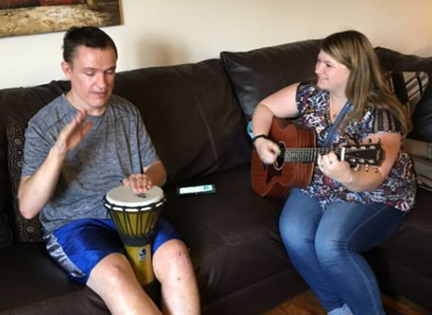
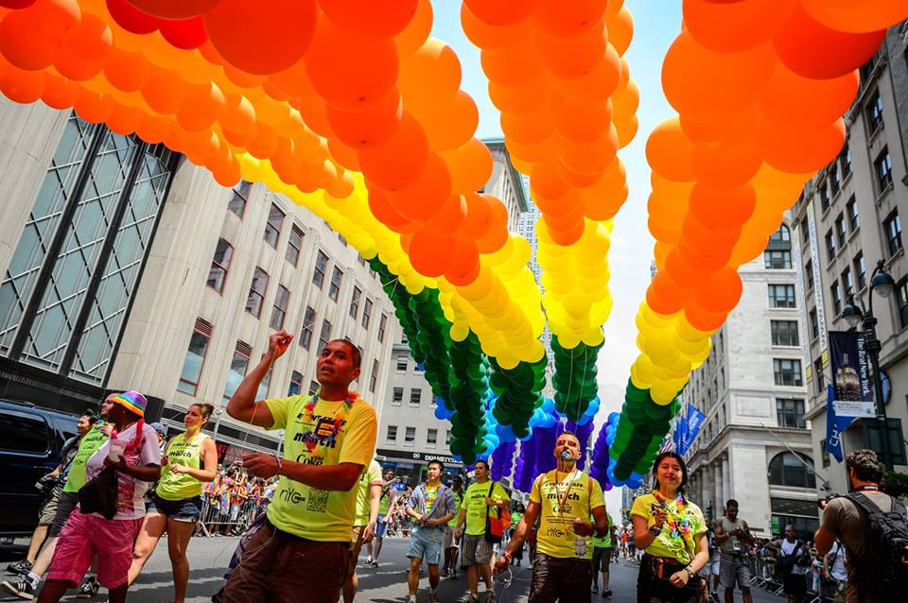
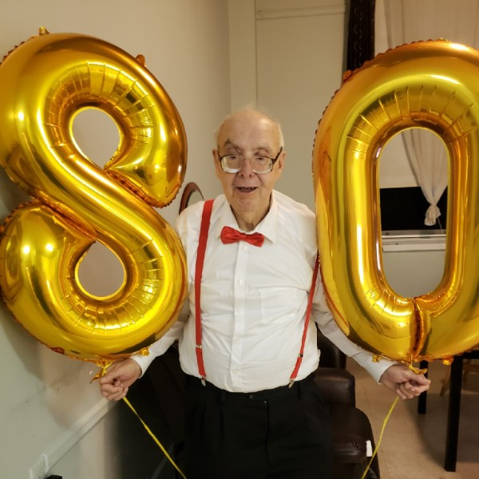
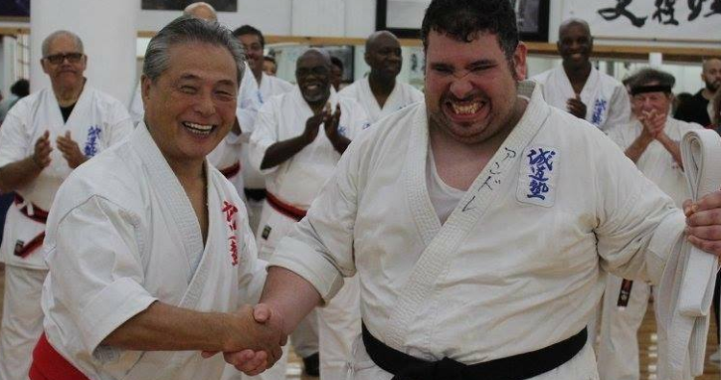
Notes:
People are becoming musicians, participating in pride parades, taking Karate and celebrating 80th birthdays with family and friends.

Slide 33
Thank you for all that you do!
Notes:
You are the people that spend the most time with people we support. Thank you for all that you do!

Slide 34
Questions??
Please connect with us!
Friend us on DSP Connect or Facebook
Subscribe to the website
Attend a regional workshop/meeting

