Slide 1
Creating Safe Spaces for the LGBTQ+ Community

Slide 2
Objectives
What is a safe space?
Defining the acronym
Beyond the binary
Respecting gender identity and pronouns
How to support someone who is coming out

Slide 3
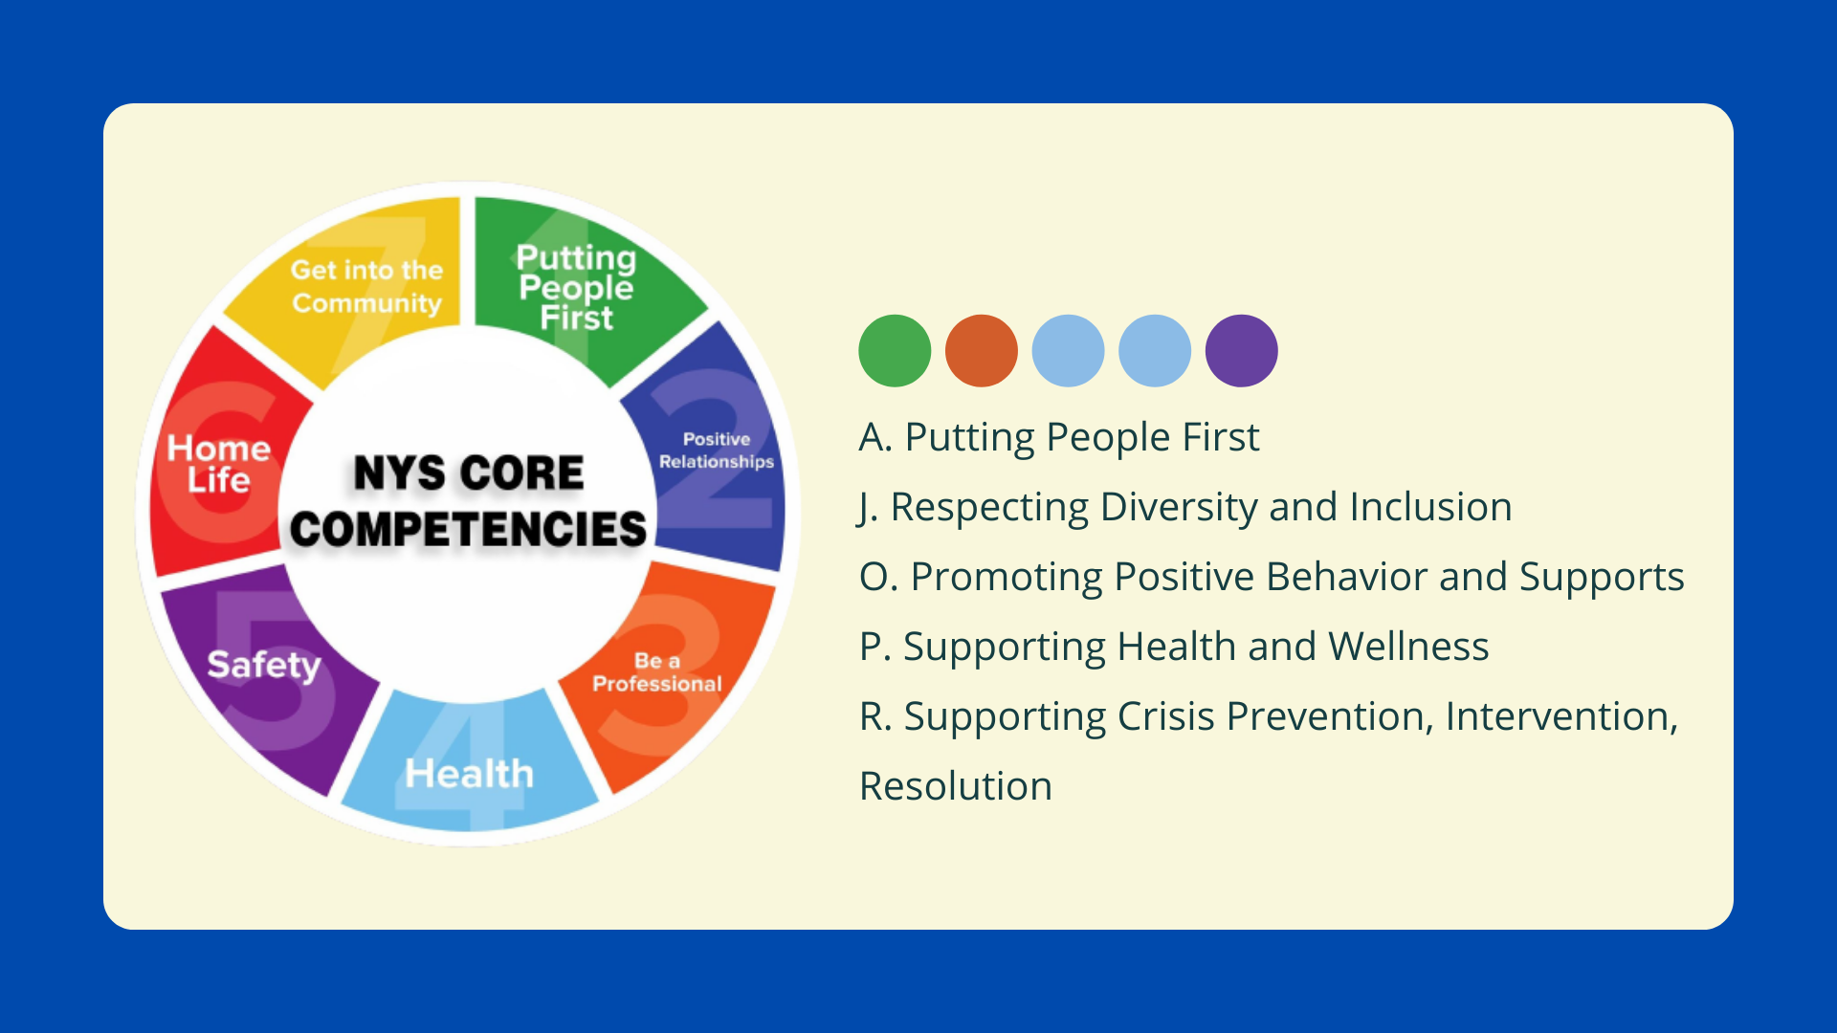

Slide 4
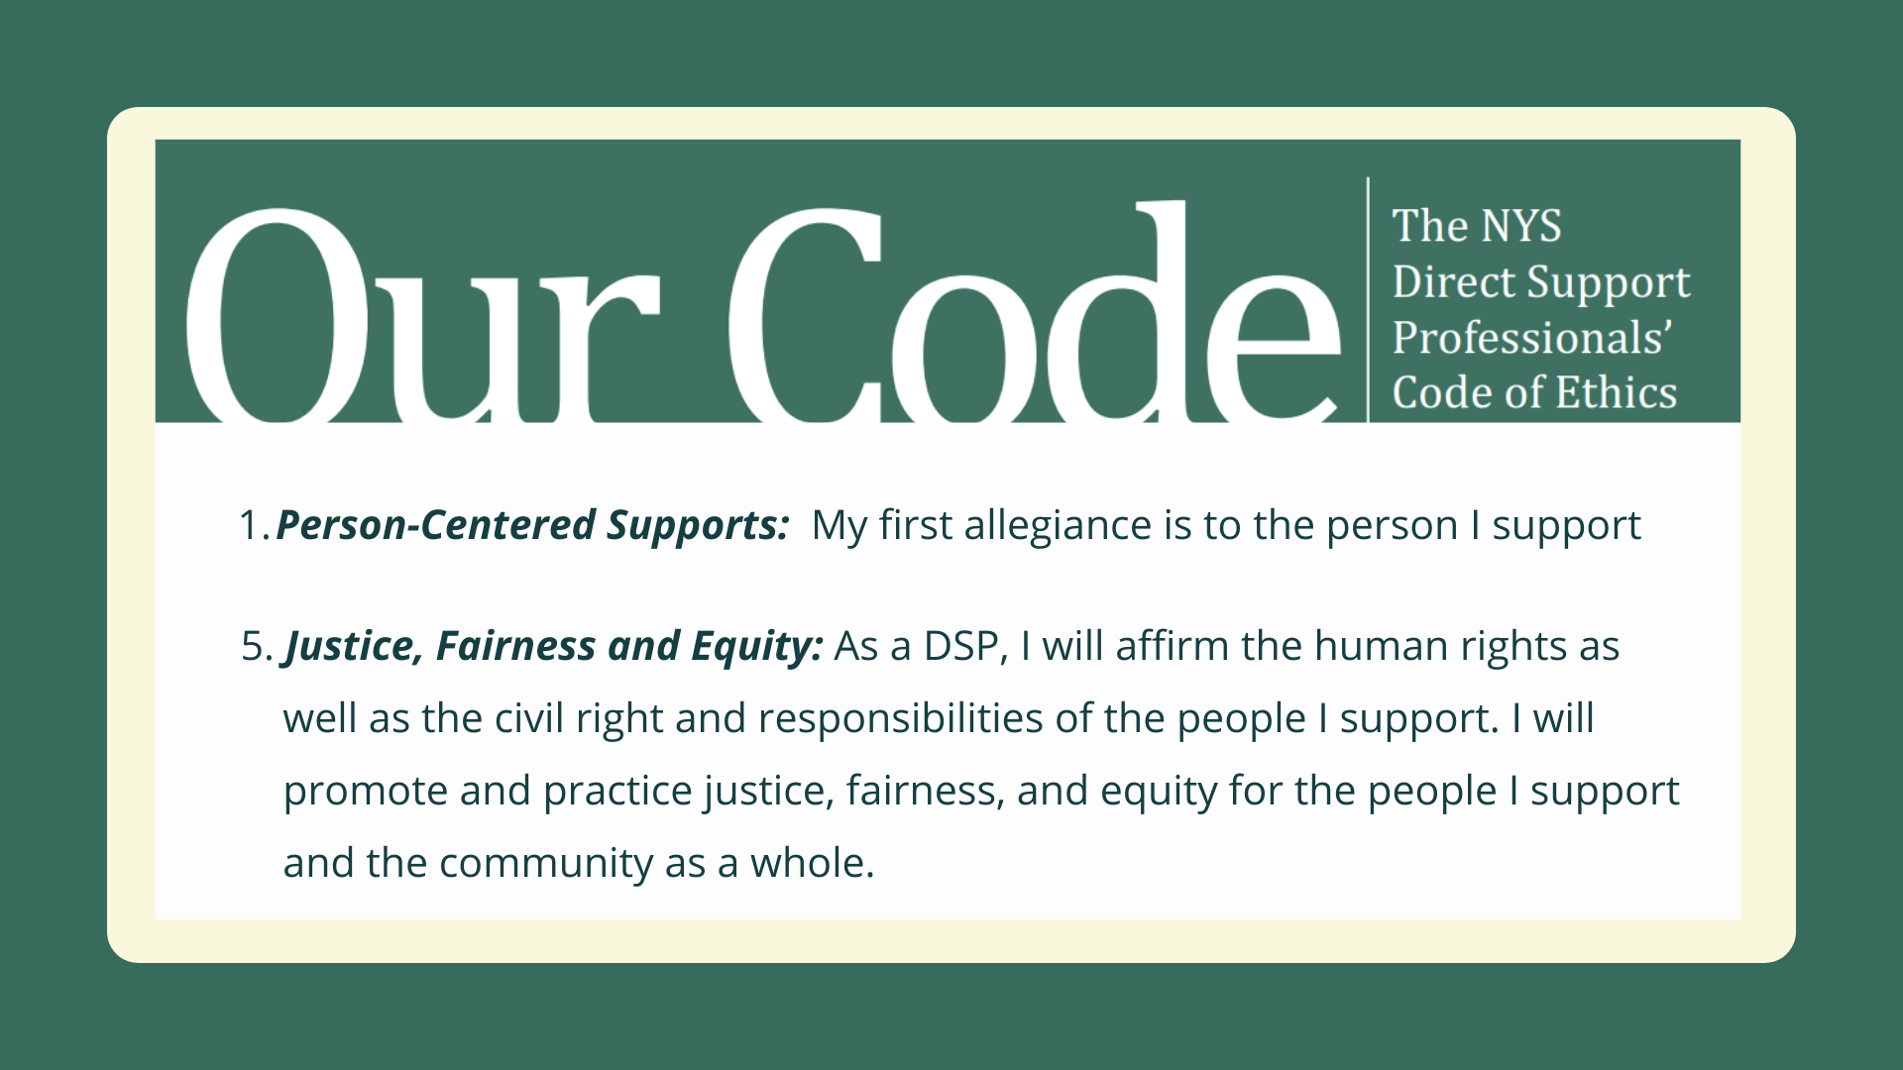

Slide 5
What is a safe space?
A safe, inclusive place for all
Recognizes people for who they are
Not exclusively, but explicitly LGBTQ+
Awareness of the discrimination LGBTQ+ people face on many different systematic levels
A forgiving space of grace and understanding
For our coworkers and people we support
An agency-wide culture

Slide 6
How to create a safe space
Listen attentively and actively
Be open to change
Be vulnerable to challenge and push past internal stereotypes
Put people first- remember that every person is the expert of their own lives.

Slide 7
The Acronym

Slide 8
LGBTQIA +

Slide 9
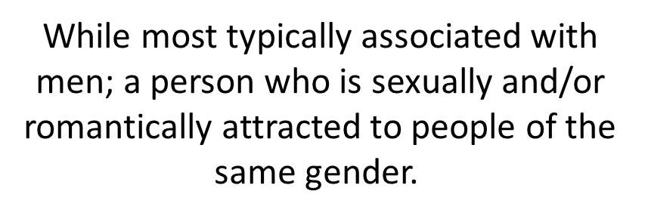
LGBTQIA +

Slide 10
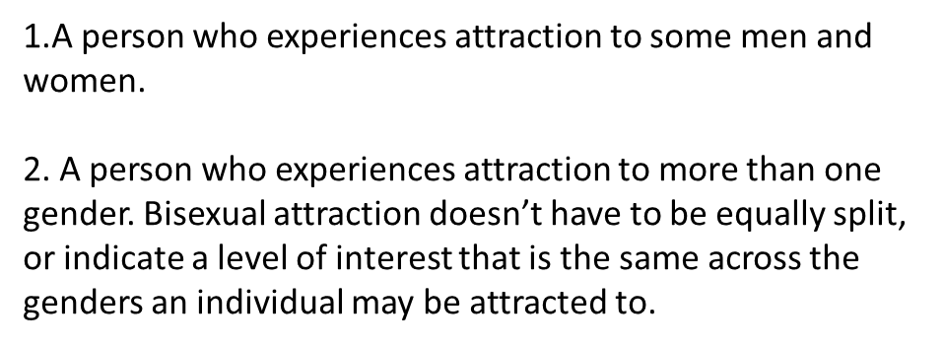
LGBTQIA +

Slide 11
LGBTQIA +

Slide 12
LGBTQIA +
An adjective used by some people whose sexual orientation is not exclusively heterosexual.

Slide 13
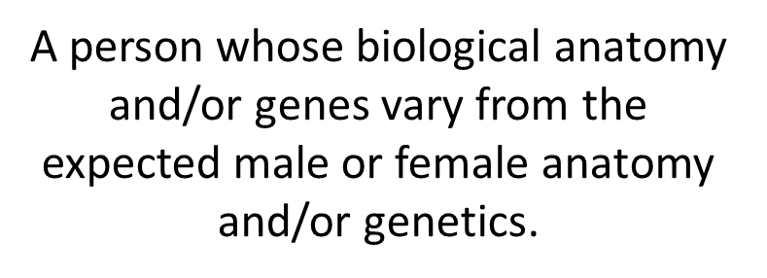
LGBTQIA +

Slide 14
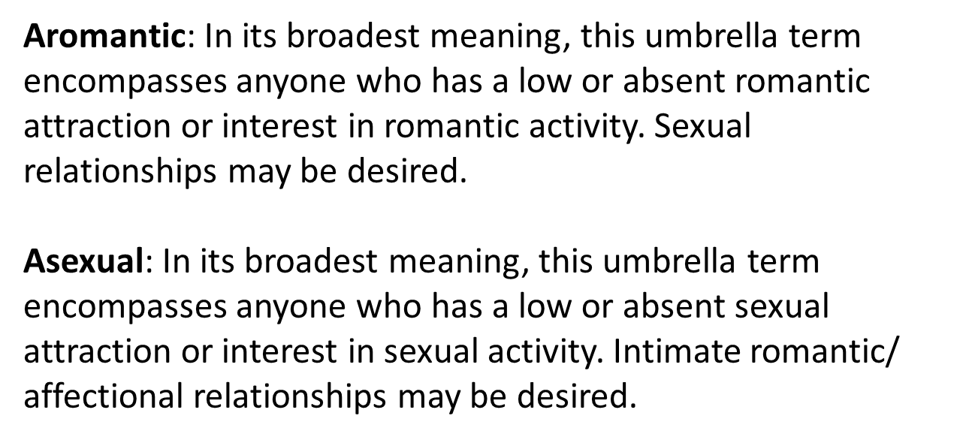
LGBTQIA +

Slide 15
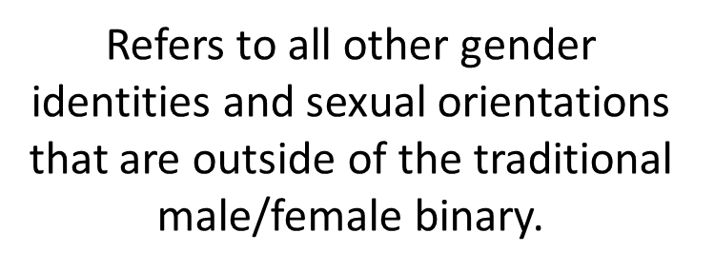
LGBTQIA +

Slide 16
LGBTQIA +
Pansexual
A person who is attracted to people of any gender identity. This attraction is inclusive of cisgender, transgender, and gender nonconforming people.
Polyamorous
A form of ethical non-monogamy that involves committed relationships between two or more people.

Slide 17
LGBTQIA +
Pansexual
A person who is attracted to people of any gender identity. This attraction is inclusive of cisgender, transgender, and gender nonconforming people.
Polyamorous
A form of ethical non-monogamy that involves committed relationships between two or more people.

Slide 18
Beyond the Binary
Gender expression- the way in which a person expresses their gender identity, typically through their appearance, dress, and behavior.
Gender identity- the personal sense of one's own gender. Gender identity can correlate with a person's assigned sex at birth or can differ from it

Slide 19
Gender Identity
Non-Binary: a gender identity that is not exclusively masculine or feminine.
Assume “they/them” pronouns until someone shares their gender identity.

Slide 20
Components of Gender, Sex, and Sexuality

Slide 21
Pronouns

Slide 22
Pronouns
One way that we express our gender is the pronouns we use.
Providing opportunities for everyone to share pronouns gives people an opportunity to define themselves.
It is also an explicit way to show you are being inclusive
Merriam Webster in 2019 began recognizing the singular form of “they” in the context of nonbinary gender identity.
Lead by example- we all use pronouns

Slide 23
Pronouns

Slide 24
Misgendering
Sometimes a person’s appearance looks different than the gender they identify with. It can be understandably uncomfortable when they are called the wrong gender
If you make a mistake and accidentally call someone by the wrong name, gender, or pronoun, apologize and move on without drawing more attention to it.
Keep doing the work to get it right next time. Keep your intentions strong

Slide 25
The world is not binary.

Slide 26
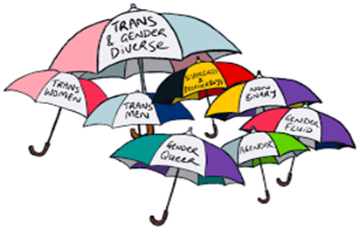
Transgender facts

Slide 27
Transgender facts
The terms “transgender” and “trans” are umbrella terms that can include lots of gender expansive identities.
They are adjectives, not nouns. “Trans people” not “the transgender”
A trans woman is male to female. A trans man is female to male. It is never the other way around.
Mirror language: Use the pronouns that the person identifies. Don’t always assume based off appearance.
Do not ask questions about physical characteristics

Slide 28
Practice ungendering your language and avoiding gender binary terms.

Slide 29
Becoming an Ally

Slide 30
Becoming an Ally

Slide 31
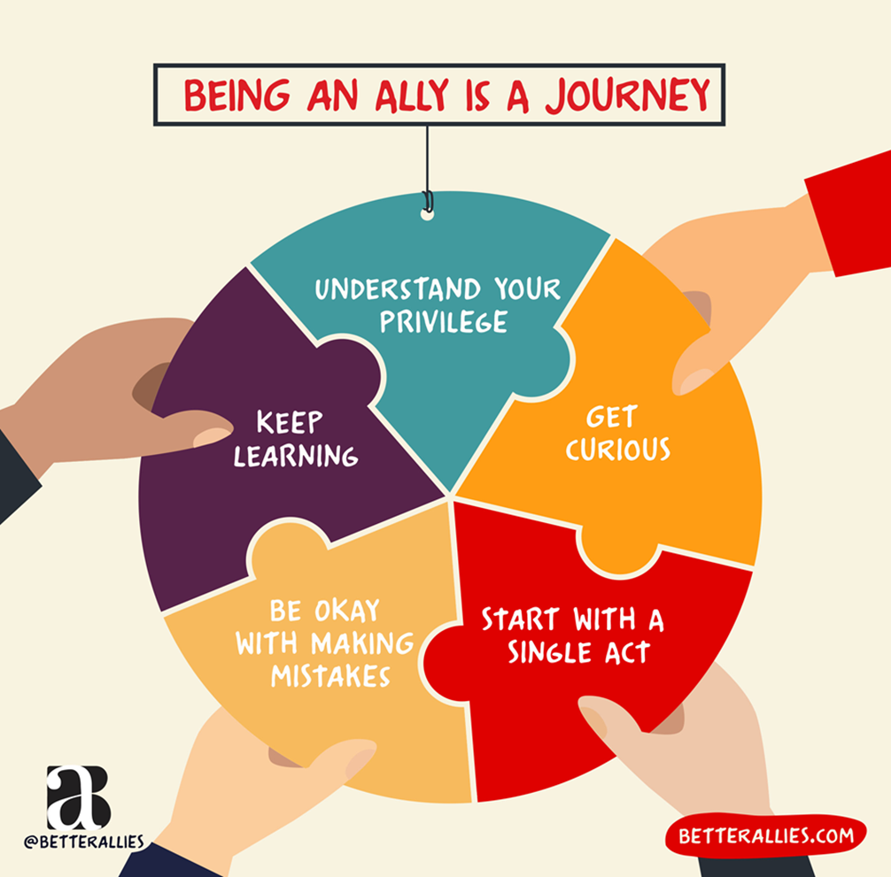

Slide 32
Cass Model-6 Stages of Coming Out
1. Confusion
2. Comparison
3. Tolerance
4. Acceptance
5. Pride
6. Synthesis

Slide 33
How to support someone in coming out
Listen, and meet them where they are at.
Thank them- validate that you are indeed someone they can trust and someone who they can reach out to.
Find out who else knows: it may not be safe for that person to be out in certain environments. Ask if that’s the right name and pronoun you want to use in private or around others.
Ask what it means for them. Just because someone identifies a certain way, doesn’t mean that they will fit the perfect definition of it. This is unique to everyone themselves
Be an active ally= ask what you can do to support. Continue to look for ways you can support. Attend pride, check in with them, be a resource or just someone they can talk to.

Slide 34
Avoid the following:
“How long did you know?”
“It doesn’t matter to me”- This minimizes the person’s feelings. It took a lot of courage for them to come out.
“I had a feeling”, “I always knew”, “I was waiting for you to come out”—this can invalidate and downplay the significance of them coming out.
Do not out them to others
Do not ask them what they looked like pre-transition, or to see an old photo.

Slide 35
Avoid the following:
Do not ask a person who is trans if they are going to have surgery. This is part of everyone’s journey and taking a medical route doesn’t make anyone more or less trans.
“What’s your real name?”
Don’t ask a million questions- let the person share what they want when they are ready.
Pressuring the person to tell others in their life, they may not be ready.

Slide 36
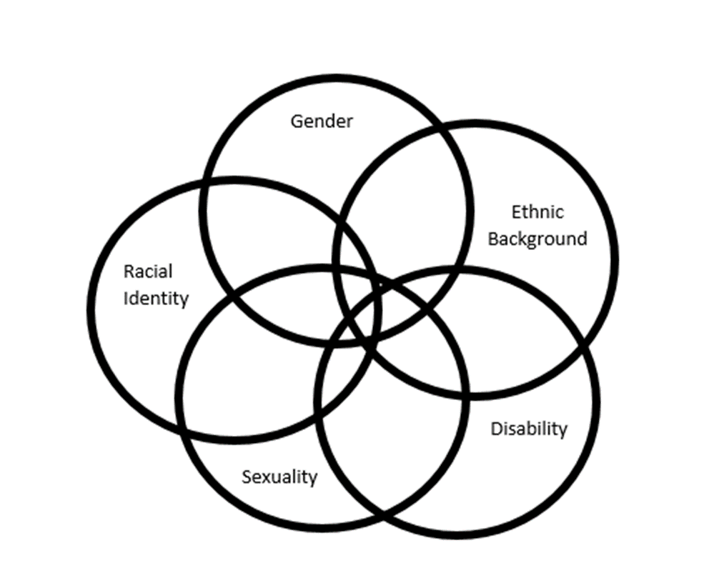
People with I/DD in the LGBTQ+ community are marginalized.
People can face discrimination from outside their community, but also from those who are inside their community.
For example, people may struggle to fit in with the LGBTQ+ community because they have a disability. They may feel like it’s hard to relate to others with a disability, because they are LGBTQ+

Slide 37
The Intersectionality of I/DD and LGBTQ+
Feelings of shame, confusion, fear.
Rejection/pushback from various systems in their life.
(family, staff, peers)
Ableism- this amplifies questioning the validity of the person’s experience, and the stereotypes of “going through a phase”
Limited social experiences making boundaries difficult
Lack of access to LGBTQ+ places
Lack of social support
Generational differences and Privilege

Slide 38
Supporting someone with I/DD
Provide opportunities for inclusion in the community by bringing someone to LGBTQ+ friendly places.
Connect with local LGBTQ+ organizations and support groups.
Find movies, books, Netflix shows with LGBTQ+ characters.
Practice social skills, role play scenarios where the person may be questioned about their sexuality.
Role- play coming out to others. Give them an opportunity to practice what they want to say.
Teach online dating etiquette
Prepare them for difficult outcomes.

Slide 39
Positive messages of affirmation
Sometimes the best support we can offer someone is a kind word. Here are some examples:
“It’s a joy to get to know the real you”
“I’m so glad you‘re here”
“Your life is meaningful and valuable”
“You deserve to feel safe”

Slide 40
Remember:
Treat others the way you want to be treated.
Everyone’s journey is unique
Be open to learning and open to change
Amplify the voices of the people we support
Challenge yourself to make your workspace safe and inclusive
Make yourself a visible ally
We don’t have to understand everything, we do have to treat everyone with dignity and respect

Slide 41
Thank you!
workforcetransformation.org
Brian Potvin
bpotvin@arcmonroe.org

