Slide 1

Building a Network for Community Mentoring at Transition and Beyond

Slide 2




My role for today –
And
Our Role as Mentors and Community Support

Slide 3
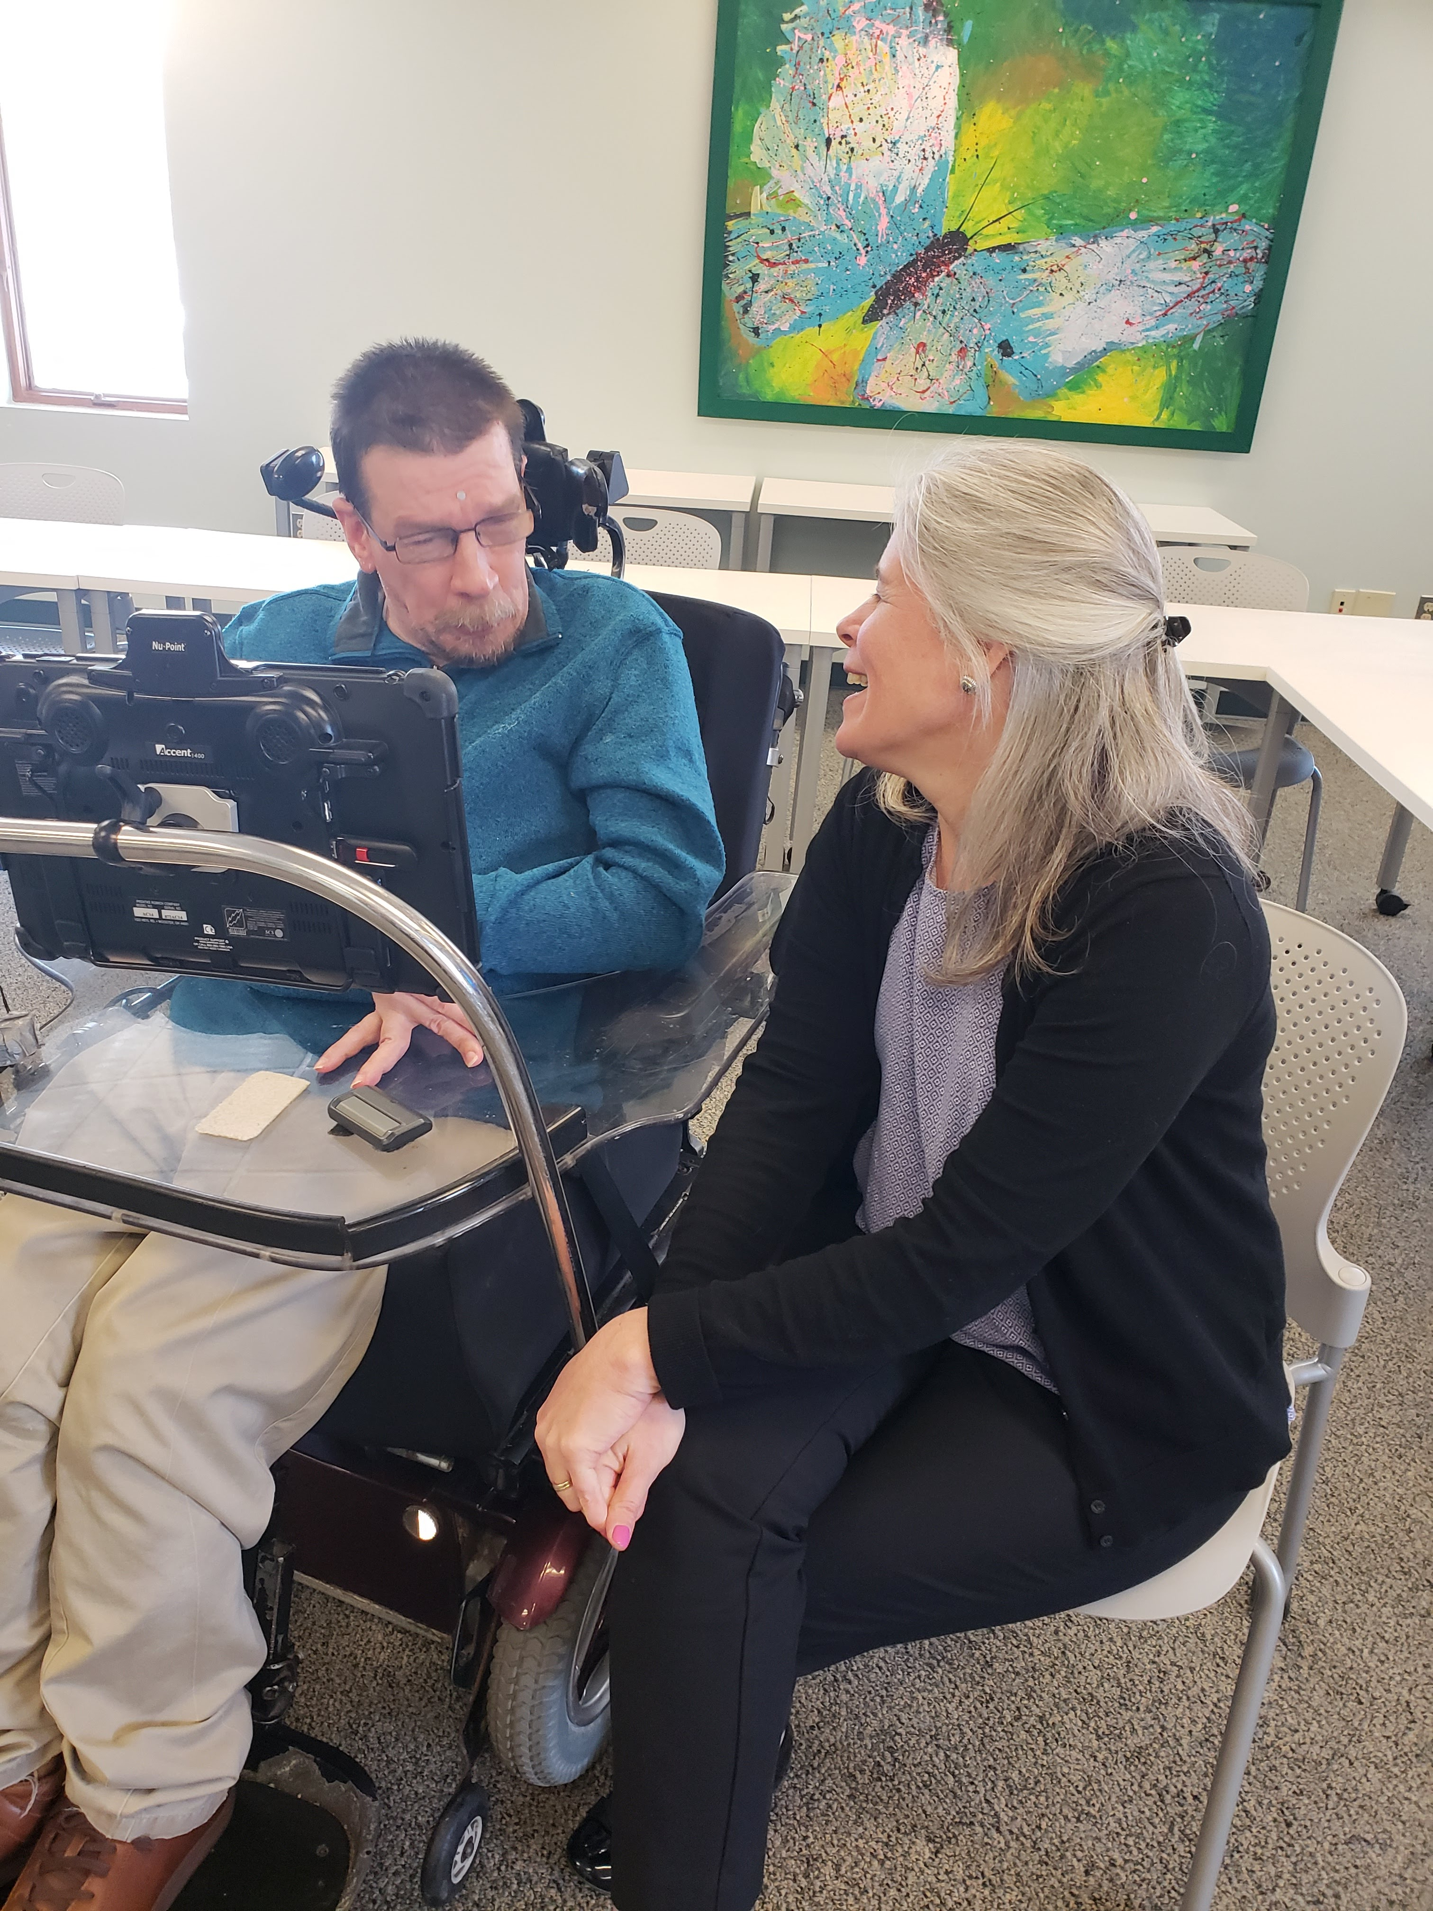
We are supporting
people
Notes:
Talk about PCT and PCP trainings throughout the year

Slide 4
What does it mean to Listen ?
“If you are going to work with me.. You have to listen to me. And you can’t just listen with your ears because it will go to your head too fast. If you listen slow, with your whole body, some of what I say will enter your heart.”- Christine Meyers

Slide 5

Supporting people to make informed choices and a plan reflects those choices.

Slide 6
Power Over
Power With
Fixing vs. Supporting
Notes:
PURPOSE: Time: 5 Minutes animated slide https://www.facebook.com/specialbooksbyspecialkids/
To provide a visual while you help people have a conversation about the differences between fixing and supporting.
SCRIPT:
Yesterday we discussed how to identify what is important to people and for people and the desired balance between.
Now we will take some time to think thru what is meant by support.
Most of us don’t recognized the support we get and the support we need - usually because we have the illusion we are competent adults..and your partner is more likely to suggest something to fix you rather than support you.
For Example:
Some of us probably had not getting up on time as a characteristic of a bad day
If your partner suggests say setting 3 alarm clocks to go off at 15 minute intervals to ensure you get up...your partner is trying to fix you---
Conversation with the group:
How many of you have felt a pressure to address difficult situations as demands to “fix it”? Where is the power if we are “fixing” ? Fixing has a coercive quality, it is more about power over than power with.
For example: Remember yesterday we talked about environments -Toxic; Tolerated: Supportive; Healing. What type of environment would you be most likely to find “fixing” as the predominant form of help?
What is most likely to happen to our suggestions that fix it? Right, they are most likely to be ignored. People just don’t work this way; good solutions are not found this way.
However supporting you when late means recognizing that support means different things for different people…
How many of you want people to go aha! Late again!..OR
Act as if you are not late and let you slide into work-OR
Give you an opportunity to vent…
Which one feels better? Which one might help you get thru the frustration?
TLC-PCP www.learningcommunity.us

Slide 7
Each of us want lives where we are
supported by & contribute to
our communities
Have our
own dreams and our own journeys
Have opportunities to meet new
people; try new things; change jobs; change who we live with & where we live
Have what/who is important to us in everyday life; people to be with; things to do, places to be
Stay healthy & safe (on our own terms)
Notes:
Purpose: Time : 5 minutes
To provide a conceptual framework for looking at the relationship between health and safety, having what is important to and dreams
A segue to the “Terminal Irritation” exercise
SCRIPT:
This triangle is another way of looking at what we are trying to do
First - It is about people not “disability” – it is true for all of us
We all need and receive support
We all contribute, not just via our jobs, but by how we spend time and through relationships
We all want to have control over our lives – to journey towards our dreams.
How many of you have known someone whose dream is to live in a place where they feel safe? For some people, the dream at the top of the pyramid and the base level need are one and the same. Ask how many of you have people with disabilities who you love in your life? What would happen if they moved away? Would there be a hole in your life and your heart? The relationship is the contribution. This is the kind of contribution we are going for.
The triangle – Walk through from bottom to top
Have any of you ever had a time in your life when you didn’t feel safe? The focus of your “dream” then was to be safe
Had a sudden health crisis- and getting healthy consumed you?
The segue – Ask these questions (and wait for the answers) –
How many of you eat or drink something fattening after you have a bad day?
What would happen if you had a bad year? Would you become a bigger person?
What if, in the middle of that bad year, I came and said that we had been graphing your weight and were putting you on a 1,200 calorie diet. Would the bad year have gotten better or worse? Would you follow the diet? We would then move to food restriction. Things would escalate…
TIPS: Emphasize how having what is ‘important to’ relates to being healthy and safe. When things that are important to you are missing, we often act in ways contrary to what is important for us.

Slide 8
Importance Of Environments
Toxic
Tolerated
Healing
Supportive
Power Over
Power With
Notes:
SCRIPT
Toxic –When an environment is toxic (offensive, harmful, extremely unpleasant) what is present or absent causes people to complain about the environment with their behavior. The typical emotional response to a toxic environment is either anger or depression. What is seen or observed is aggression or withdrawal and is typically labeled as dysfunctional. By paying attention to how people react, by listening to their behavior, we can learn about what is dissatisfying and must change. While there are some things that are toxic to everyone there are other things that are toxic to some people but not others. Consequently, there are some settings toxic to all (e.g. - places where abuse or violence are common) and there are settings toxic to some individuals but not others. While one person may find a setting with much commotion, loud talkers, loud music or TV, and constant activity very toxic, another person may find it satisfying, comforting or stimulating..
By paying attention to what a person does, and interpreting it differently, we can learn about what is dissatisfying and must change.
Interventions designed to increase a person’s tolerance of toxic settings without changing the setting should be unacceptable (and considered unethical). Critical aspects of what is important to the person are absent and make the person less healthy and less safe (adversely affects important for).
Tolerated – In a tolerated environment activities and interactions are endured, withstood, or ‘put up with.’ Complaints about the setting are less dramatic but withdrawal and depression are still common. A key indicator is that growth is also absent. People languish when they live by simply tolerating what’s around them. If depression and withdrawal are adaptive responses to the setting then the use of medication to treat the depression is simply addressing the symptom and not the cause. Often the withdrawal is an expression of helplessness, or despair at the lack of control or authority to change the unacceptable. Paid employees in these environments often see their role as caretaker with cooking, cleaning and paperwork more of a priority than building supportive relationships that promote learning for the person.
Supportive – In a supportive environment interactions between people are encouraging, reassuring and empathetic. What is important to as well as what is important for the person is largely present and balanced. In these environments there is recognition that no one willingly attends to issues of health and safety unless there is some aspect of it that is “important to” them. People who are in supportive settings experience significant growth. For people without significant clinical issues this setting is good enough. People who have been in toxic settings and do not have significant clinical issues can “blossom” in these settings.
Healing – Where people have been wounded by prior experiences such as physical or sexual abuse or neglect or abandonment; where people have a significant mental health issue; an environment that promotes healing is needed. In a healing environment, interactions between the people present are restorative and focused on developing wellness. A healing environment represents the marriage (reliable blending) of good person centered practices with sound clinical practices.
Supportive environment works for most people. Healing – most important for people have experienced significant trauma or have significant mental health issues
TIPS:
Make clear the fact that this is not about “placement” but rather about “environment”. One’s own home can be toxic. The key question – where does the power lie?
Slide is animated.
SCRIPT
Toxic –When an environment is toxic (offensive, harmful, extremely unpleasant) what is present or absent causes people to complain about the environment with their behavior. The typical emotional response to a toxic environment is either anger or depression. What is seen or observed is aggression or withdrawal and is typically labeled as dysfunctional. By paying attention to how people react, by listening to their behavior, we can learn about what is dissatisfying and must change. While there are some things that are toxic to everyone there are other things that are toxic to some people but not others. Consequently, there are some settings toxic to all (e.g. - places where abuse or violence are common) and there are settings toxic to some individuals but not others. While one person may find a setting with much commotion, loud talkers, loud music or TV, and constant activity very toxic, another person may find it satisfying, comforting or stimulating..
By paying attention to what a person does, and interpreting it differently, we can learn about what is dissatisfying and must change.
Interventions designed to increase a person’s tolerance of toxic settings without changing the setting should be unacceptable (and considered unethical). Critical aspects of what is important to the person are absent and make the person less healthy and less safe (adversely affects important for).
Tolerated – In a tolerated environment activities and interactions are endured, withstood, or ‘put up with.’ Complaints about the setting are less dramatic but withdrawal and depression are still common. A key indicator is that growth is also absent. People languish when they live by simply tolerating what’s around them. If depression and withdrawal are adaptive responses to the setting then the use of medication to treat the depression is simply addressing the symptom and not the cause. Often the withdrawal is an expression of helplessness, or despair at the lack of control or authority to change the unacceptable. Paid employees in these environments often see their role as caretaker with cooking, cleaning and paperwork more of a priority than building supportive relationships that promote learning for the person.
Supportive – In a supportive environment interactions between people are encouraging, reassuring and empathetic. What is important to as well as what is important for the person is largely present and balanced. In these environments there is recognition that no one willingly attends to issues of health and safety unless there is some aspect of it that is “important to” them. People who are in supportive settings experience significant growth. For people without significant clinical issues this setting is good enough. People who have been in toxic settings and do not have significant clinical issues can “blossom” in these settings.
Healing – Where people have been wounded by prior experiences such as physical or sexual abuse or neglect or abandonment; where people have a significant mental health issue; an environment that promotes healing is needed. In a healing environment, interactions between the people present are restorative and focused on developing wellness. A healing environment represents the marriage (reliable blending) of good person centered practices with sound clinical practices.
Supportive environment works for most people. Healing – most important for people have experienced significant trauma or have significant mental health issues
TIPS:
Make clear the fact that this is not about “placement” but rather about “environment”. One’s own home can be toxic. The key question – where does the power lie?
Slide is animated

Slide 9

Culture . . . It’s a Big Topic!
CULTURE

Slide 10

A Culture Of One
In Person-Centered Practice we avoid making assumptions about people’s preferences related to their culture.
Every person has their own beliefs, values, and preferences.
Each person has a culture of one (Individual or Family).

Slide 11
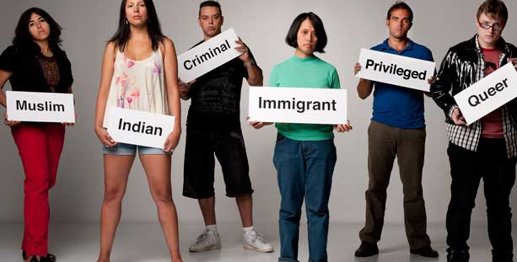

Implicit Bias
“are attitudes or stereotypes that affect our understanding, actions, and decisions in an unconscious manner. These biases, which encompass both favorable and unfavorable assessments, are activated involuntarily and without an individual’s awareness or intentional control”
~Kirwan Institute for the Study of Race and Ethnicity, 2015, para 1

Slide 12
Rituals and Routines
Rituals guide us through our days and bring consistency, comfort and control
Morning
Going to bed
Mealtimes
Transition
Birthday
Cultural/Holiday
Spiritual
Vacation
Comfort
Celebration
Grief/Loss/Illness
Notes:
SCRIPT:
Engage people by asking over and over – how many of you…
Going to Bed- …check the door and windows before you go to bed?
Mealtimes- …eat dinner at the same time every Sunday? … have a particular way to set the table?
Transition – … have to organize your day before it starts?
Birthday – … think it should be a national holiday? … hope that no one notices?
Cultural/Holiday Traditions – What is your favorite holiday? What food has to be on the table for it to be that holiday?
Spiritual – Are religious services, prayer, or meditation important?
Vacation – Are there things that need to be present in order for it to be a real
vacation? When does the ritual start – talking and planning in advance or not
until it actually begins?
Comfort for a bad day – What helps you feel better when you are having a bad day? How many of you find… exercise… shopping… chocolate… a drink…comforting. How many of you find cleaning comforting? How many would find it punishment?
Celebration – What do you enjoy or need to have happen to feel that
you have celebrated?
Not feeling well – How do you cope with not feeling well? How many of you are like a cave bear and hide when you are ill? Leave me alone and throw food in once in awhile? How many of you want to be taken care of, want to be babied?
Grief and loss – When you have experienced a significant loss how long did it take you to work your way through it?
Tips:
You could spend all day on this. You need to move through them within the 6 minutes allotted. If you have more time you can go into more detail. E.G. -
Grief/loss – What are all the rituals for coping with grief and loss- that are in the room? Methodist upbringing –service in the church sanctuary, luncheon in the church basement; as opposed someone who is IRISH Catholic -sit up late tell stories and have an adult beverage (or many)…Jewish -Sitting Shiva…for 7 days…Others -cover the mirrors…stop the clock…bring comfort food when they visit…parade of callers…24 hour candle lite at anniversary of someone's death…
Time: 6 minutes
PURPOSE:
Remind participants that there are other rituals besides morning rituals
help them close the discussion of routines and rituals
act as a future reference for people who will want to address another ritual
TLC-PCP www.learningcommunity.us

Slide 13
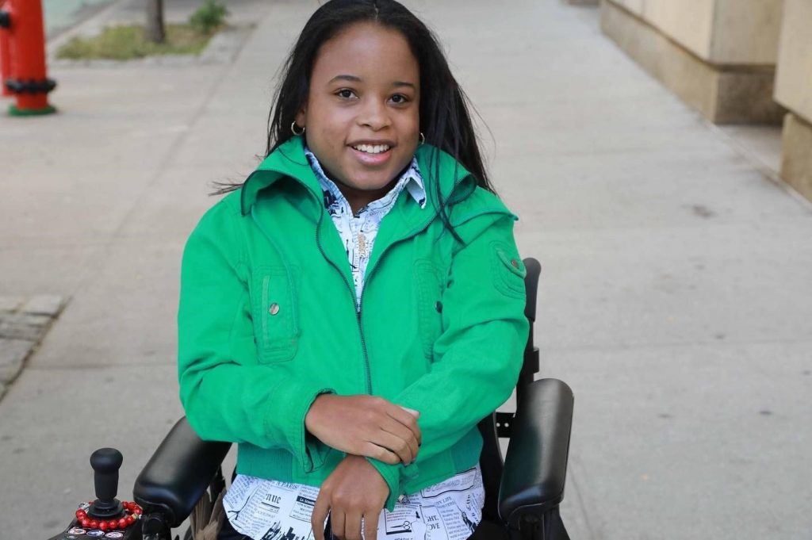
Did you know only 6 to 7 % of people with disabilities graduate from college?
Did you know only 65% of students with disabilities graduate high school?
1 in 3 people with disabilities have a job

Slide 14
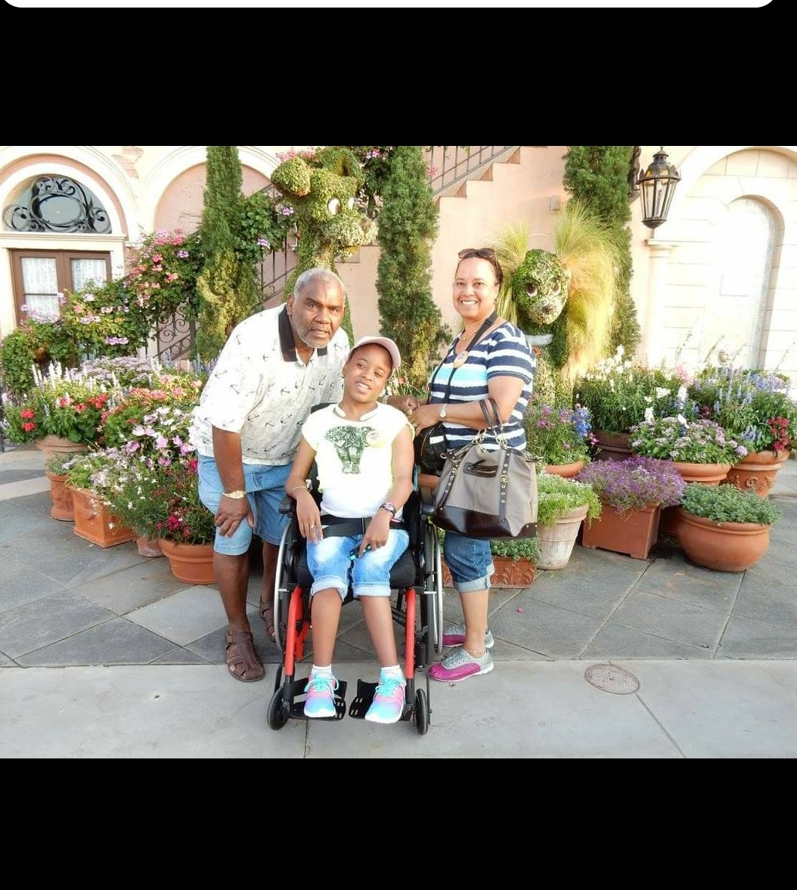
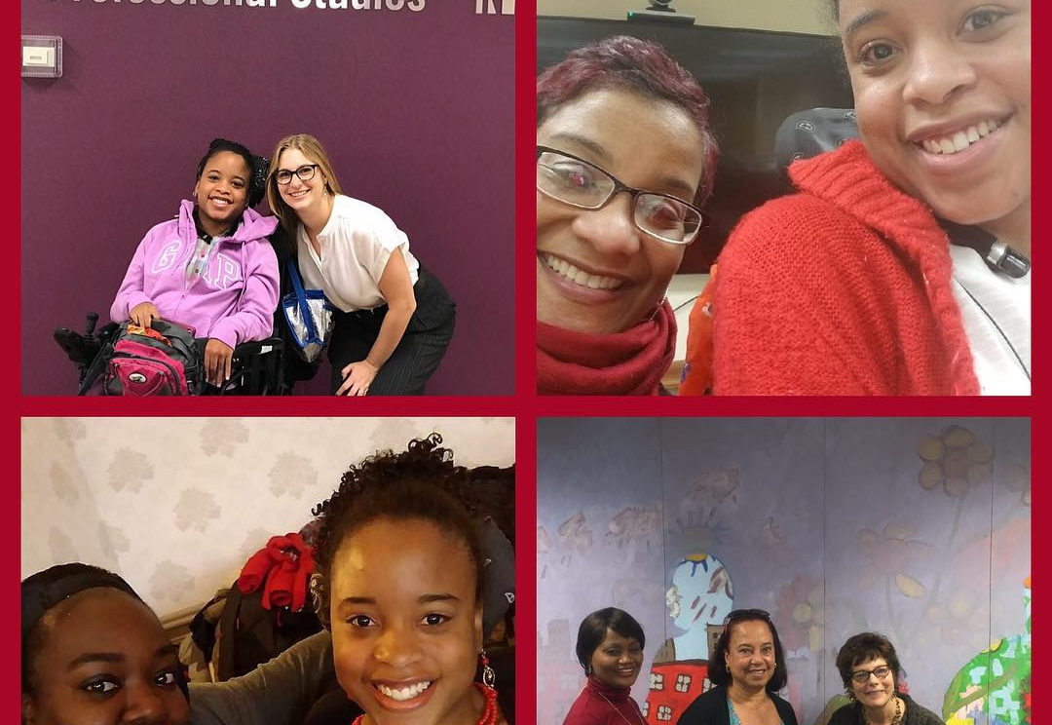
Circle of Support

Slide 15
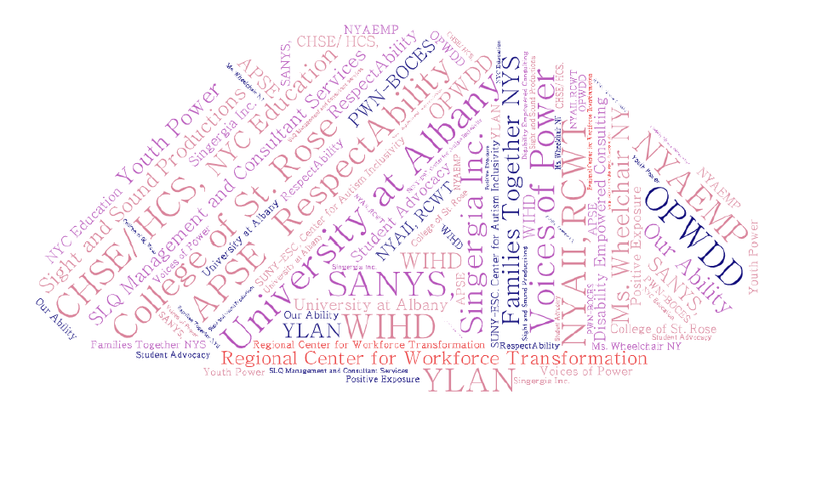
Collaboration is Imperative

Slide 16

The Relationship Map
Family
People whose job is to support me at home and other places
People who support me at work or school
Friends

Slide 17

Important To Important For
A good person-centered plan
describes the balance from the person’s perspective,
and describes the supports and services that can help the person have
that balance in their life.
By permission of TLCPCP (www.tlcpcp.com) and SDA , LLC 2019

Slide 18

All Choice with No Responsibility
Important
For
Important
To
People
Status &Control
Things To Do
Routines
Pace Of Life
Things To Have

Slide 19

Health & Safety Dictate Lifestyle
Important
To
Important
For
Health & Safety
Being Valued

Slide 20

Finding the Balance
Important
For
Important
To
People
Status &Control
Things To Do
Routines
Pace Of Life
Things To Have
Health & Safety
Being Valued

Slide 21
Choice has Boundaries for Everyone
Imposed by society
  Laws
  Expectations/values
My values
  What is and is not OK for me and those I trust
Ripple effect - One choice creates boundaries on other choices
  My relationships
  The work I do
  Where I live
Resource Driven
  Financial – how much time or money I have available
Risk involved
Notes:
Process the Susan story??

Slide 22
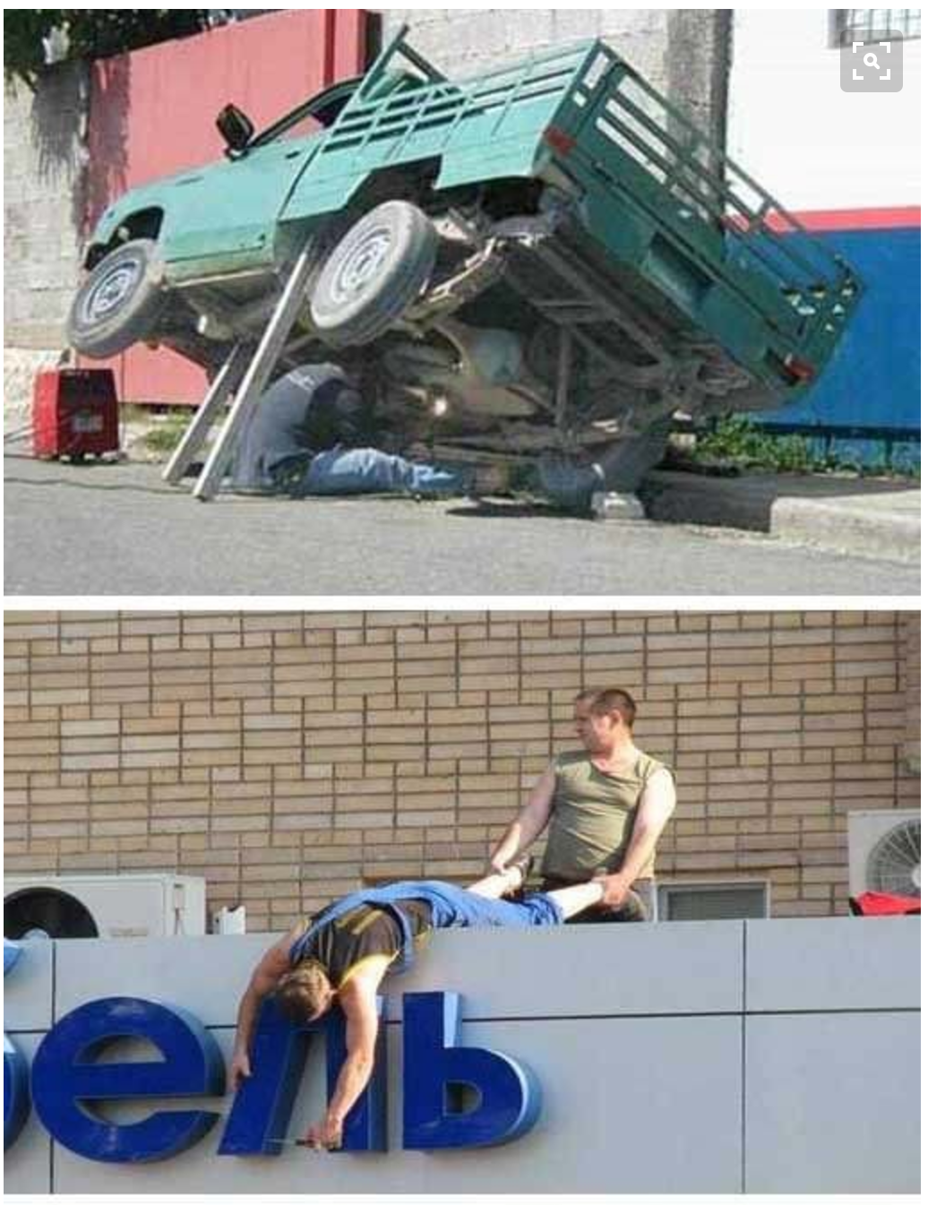
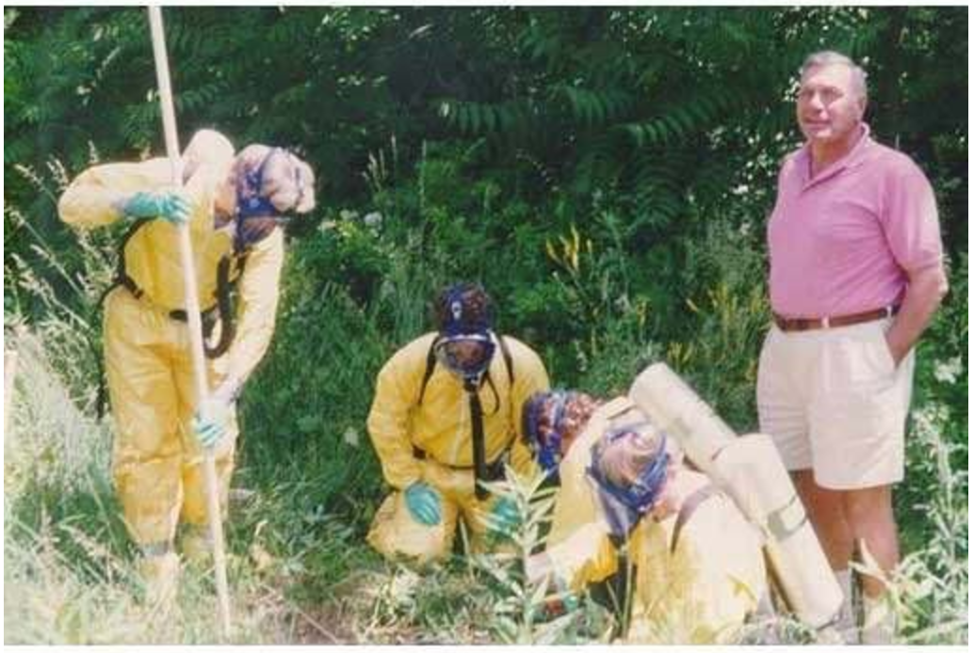
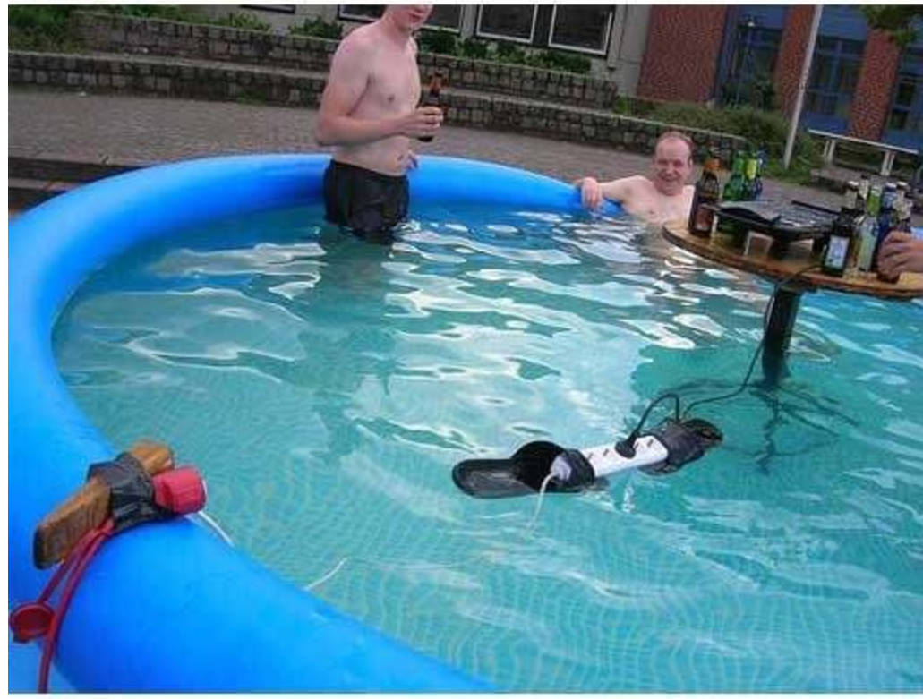
Of course, some risk is just not okay
©TLCPCP 2016 www.tlcpcp.com

Slide 23
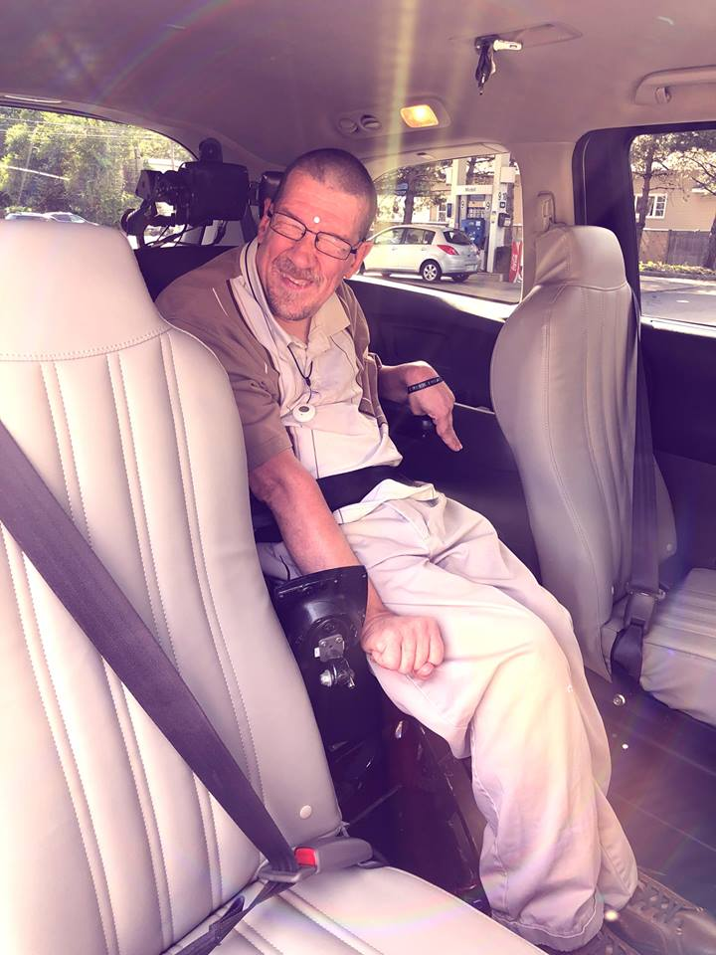
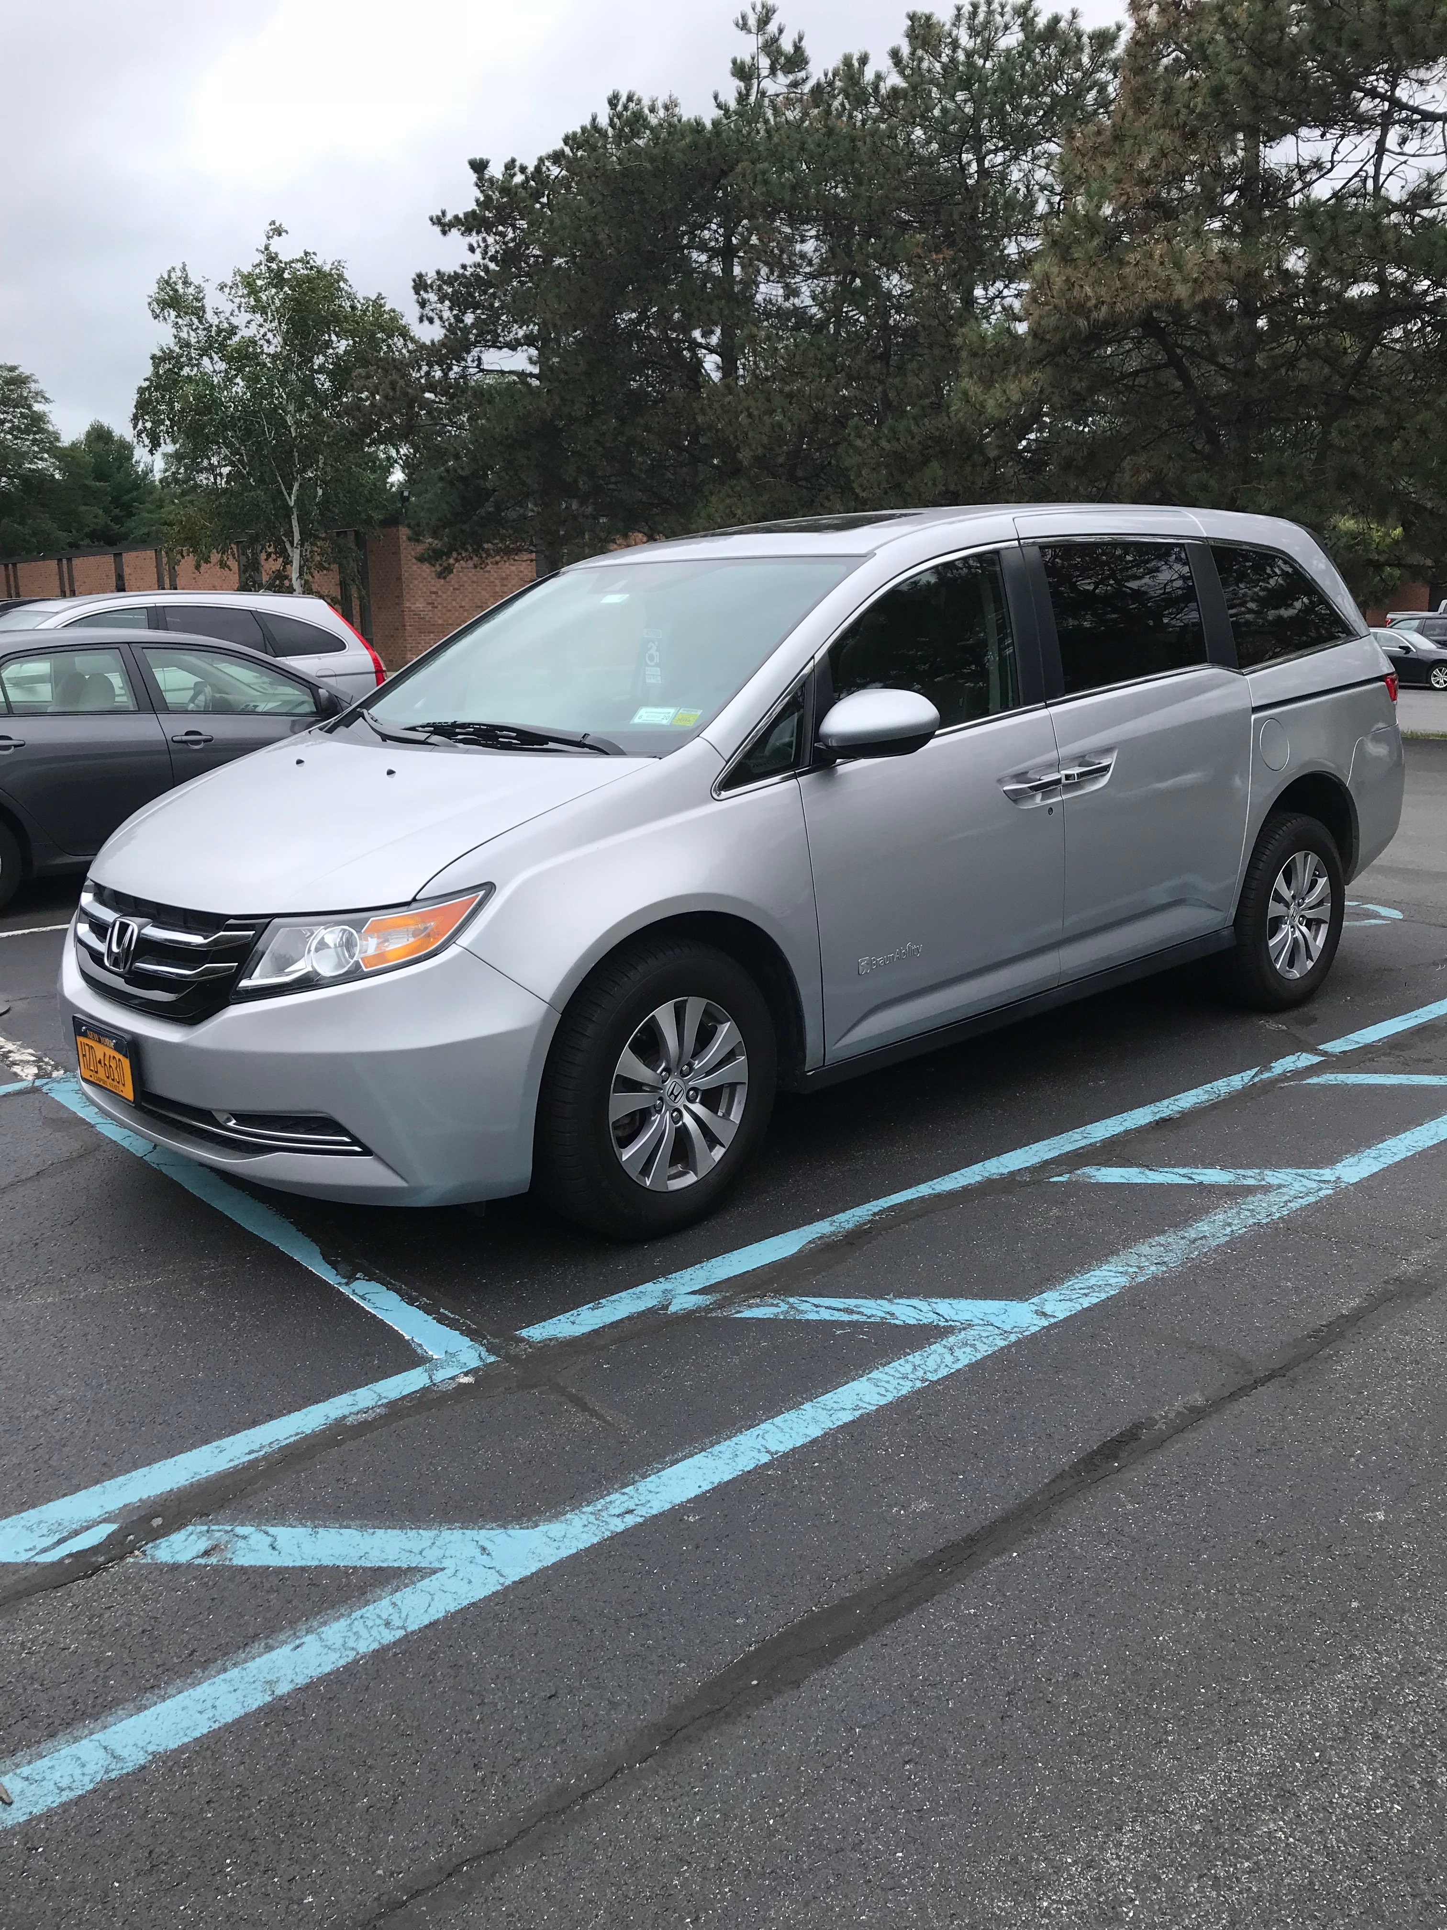

Slide 24

Ed Skydiving
https://www.facebook.com/ed.bartz/videos/10204384510642312/

Slide 25

Thank You!
Kirsten Sanchirico
ksanchirico@nyalliance.org
Notes:
PURPOSE:
Closing slide
Provide your contact information to your audience
TIPS:
Leave this slide up as people are gathering their belongings and leaving.
TLC-PCP www.learningcommunity.us

