Slide 1

NYS DSP Core Competencies and NADSP Code of Ethics
Presenter: Kirsten Sanchirico
Notes:
TEMPLATE SLIDE

Slide 2




About Us
Established in 2013, Regional Centers for Workforce Transformation (RCWT) is a nonprofit organization focused on developing the Direct Support Professional workforce through skill-building, empathy, and empowering ethical and informed decision-making. The RCWT recognizes the impact Direct Support Professionals make in the lives of the people they support, and we aim to develop the workforce to be able to make the most meaningful, quality and person-centered impact.
To develop the professionalism and capacity of the Developmental Disabilities Workforce in NYS by educating and empowering Direct Support Professionals and Frontline Supervisors in validated competency and ethical stands.
Our vision is to create a stable and sustainable DSP workforce in New York State – one that is ethical, competent, professional, and effective in helping people with intellectual and developmental disabilities live the lives they want to their fullest potential.
Our Mission
Strategies for implementing sustainable change:
  Develop workforce champions in all regions
  Increase provider engagement and collaboration
  Support organizational commitment to the DSP Core Competencies and Code of Ethics

Slide 3
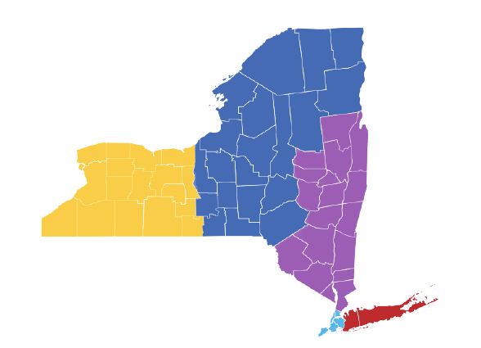
Regional Map & Team of Professional Experts
19 REGIONAL LEADS
4 SUBJECT MATTER EXPERTS
2 DIRECT SUPPORT PROFESSIONALS
5 ADMIN SUPPORTS
Notes:
Dianne
19 leads total
NYC – sara joann ashely Nicole Eliciana (5)
LI- Pam, Denise,Lori,Dori,Heather
Region 3- ken, Rachel, Chris

Slide 4
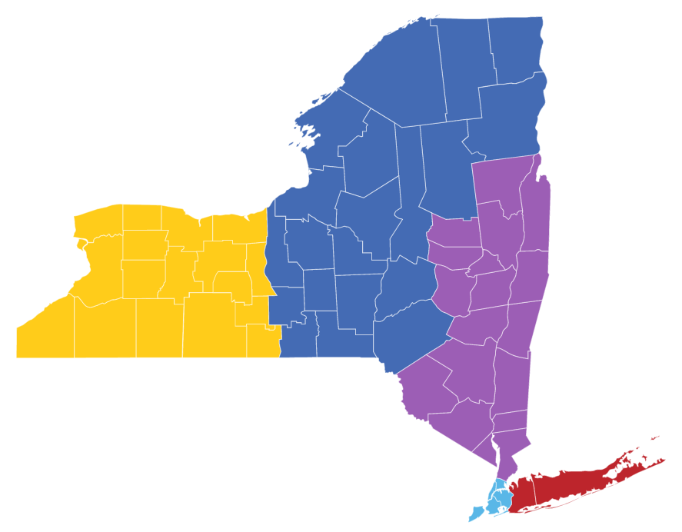
Growth of the RCWT Team
Project Director: Kirsten Sanchirico
The New York Alliance for Inclusion and Innovation
Region 2 Leads:
Jennifer Vogt
Dylan Brown
Tish Comstock-Allcorn
Derek Vladescu
Region 3 Leads:
Rachel Jacob
Chris Fortune
Kenny Burr
Region 1 Leads:
Erica Belois-Pacer
Theresa Buick
Melody Johnson
Region 5 Leads:
Denise Anghel
Pam Wolff-Stackowitz
Heather Thorgensen
Lori LaRocco
Doriann Adams
Region 4 Leads:
Sara Schacter-Erenburg
Joanne Cropper
Asheley Blaise
Eliciana Caro
Nicole Wan
Ketrina Hazell
Anthony Ismael

Slide 5
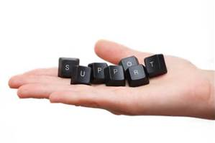

Workforce Transformation……
Not Just a Training
The goal of OPWDD’s Workforce
Transformation agenda is to help staff transform from caregivers to support professionals through a Workforce Development Program.

Slide 6
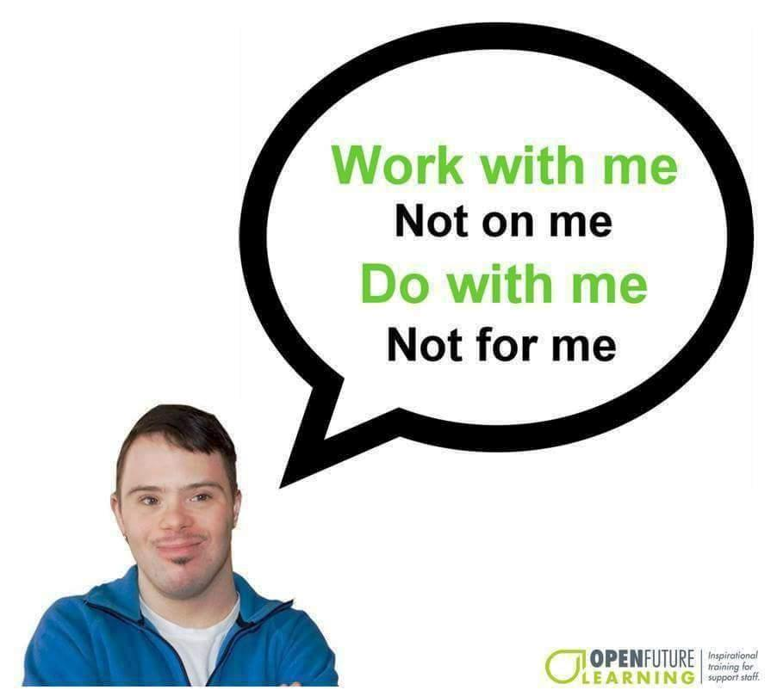

Slide 7
Key Elements: The Why!
Staff are the cornerstone of operations. They have a great impact upon the quality of life for the people they support.
Staff are faced with ethical challenges daily.
Staff often work independent of direct supervision and therefore must exercise good judgment.
A code of ethics can serve as a tool for direction and support.
Knowing how to resolve ethical dilemmas in the workplace can increase your decision-making effectiveness while keeping you and your organization on the right side of the law and is just the right thing to do.
Notes:
Ask: True or False after each statement (all responses will be true)

Slide 8
Changing the way staff work with the people they support
From:
Caregiver Way
Staff who are doing things for the people that they support.
To: Direct Support Professional Way
Staff who are teaching people how to do the things that they want to know.
*
8

Slide 9


Slide 10
NYS DSP Core Competencies
The NYS DSP Core Competencies, combined with the Code of Ethics for Direct Support Professionals, are values-based competencies and skills that are the foundation of person-centered supports for people with I/DD
These competencies are part of New York State’s Workforce and Culture Transformation initiative
  What’s the “transformation” all about?
  From “Care Giver” to Direct Support Professional
  From Compliance to Competency
The Competencies are broken down into seven goal areas covering all aspects of life for people with developmental disabilities, while also including the professionalism of direct support
Notes:
Read the slide.

Slide 11
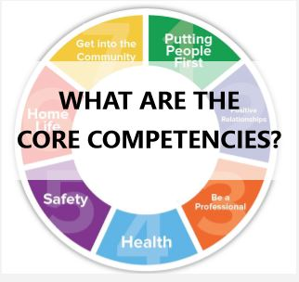

DSP Core
Competencies Are…
  Learned Skills
  A demonstration of applied knowledge
  Seen, measured and evaluated
  Applicable to ALL Direct Support Professional’s
  Based upon and built from the NADSP Code of Ethics for Direct Support Professionals
  Values-based skills and the foundation of person-centered supports
  A Statewide culture transformation process
  The DSP “pathway” to professionalism and quality for the people being supported

Slide 12

DSP Core
Competencies Are NOT….
  Annual Checklists
  A simple “training program”
  Something that can be learned quickly

Slide 13
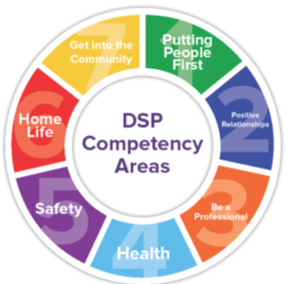
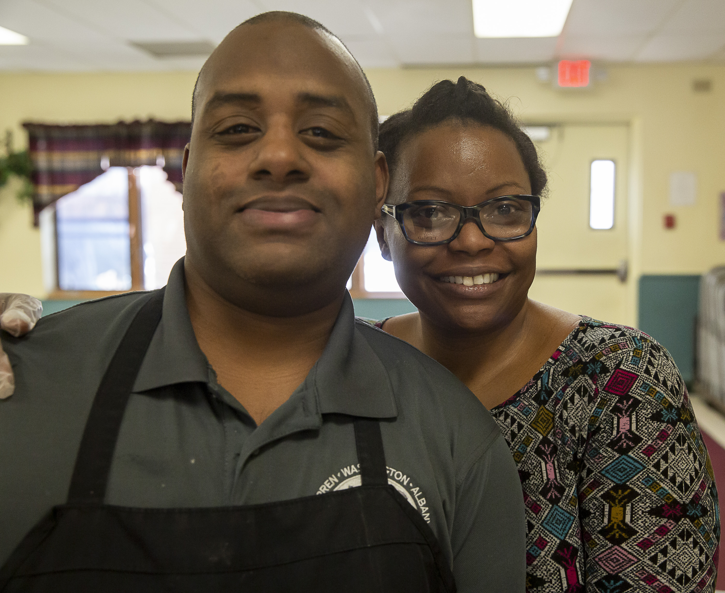
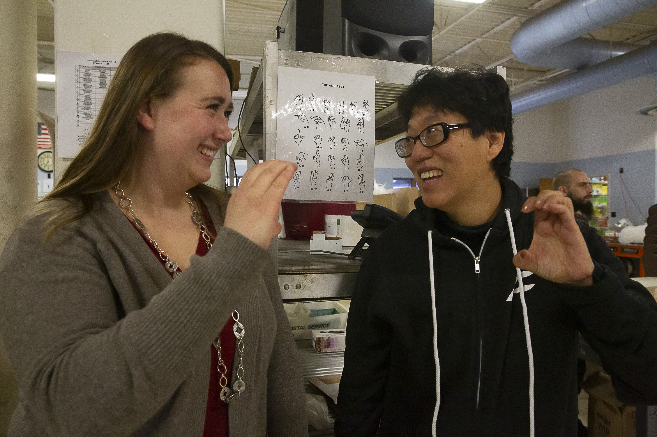
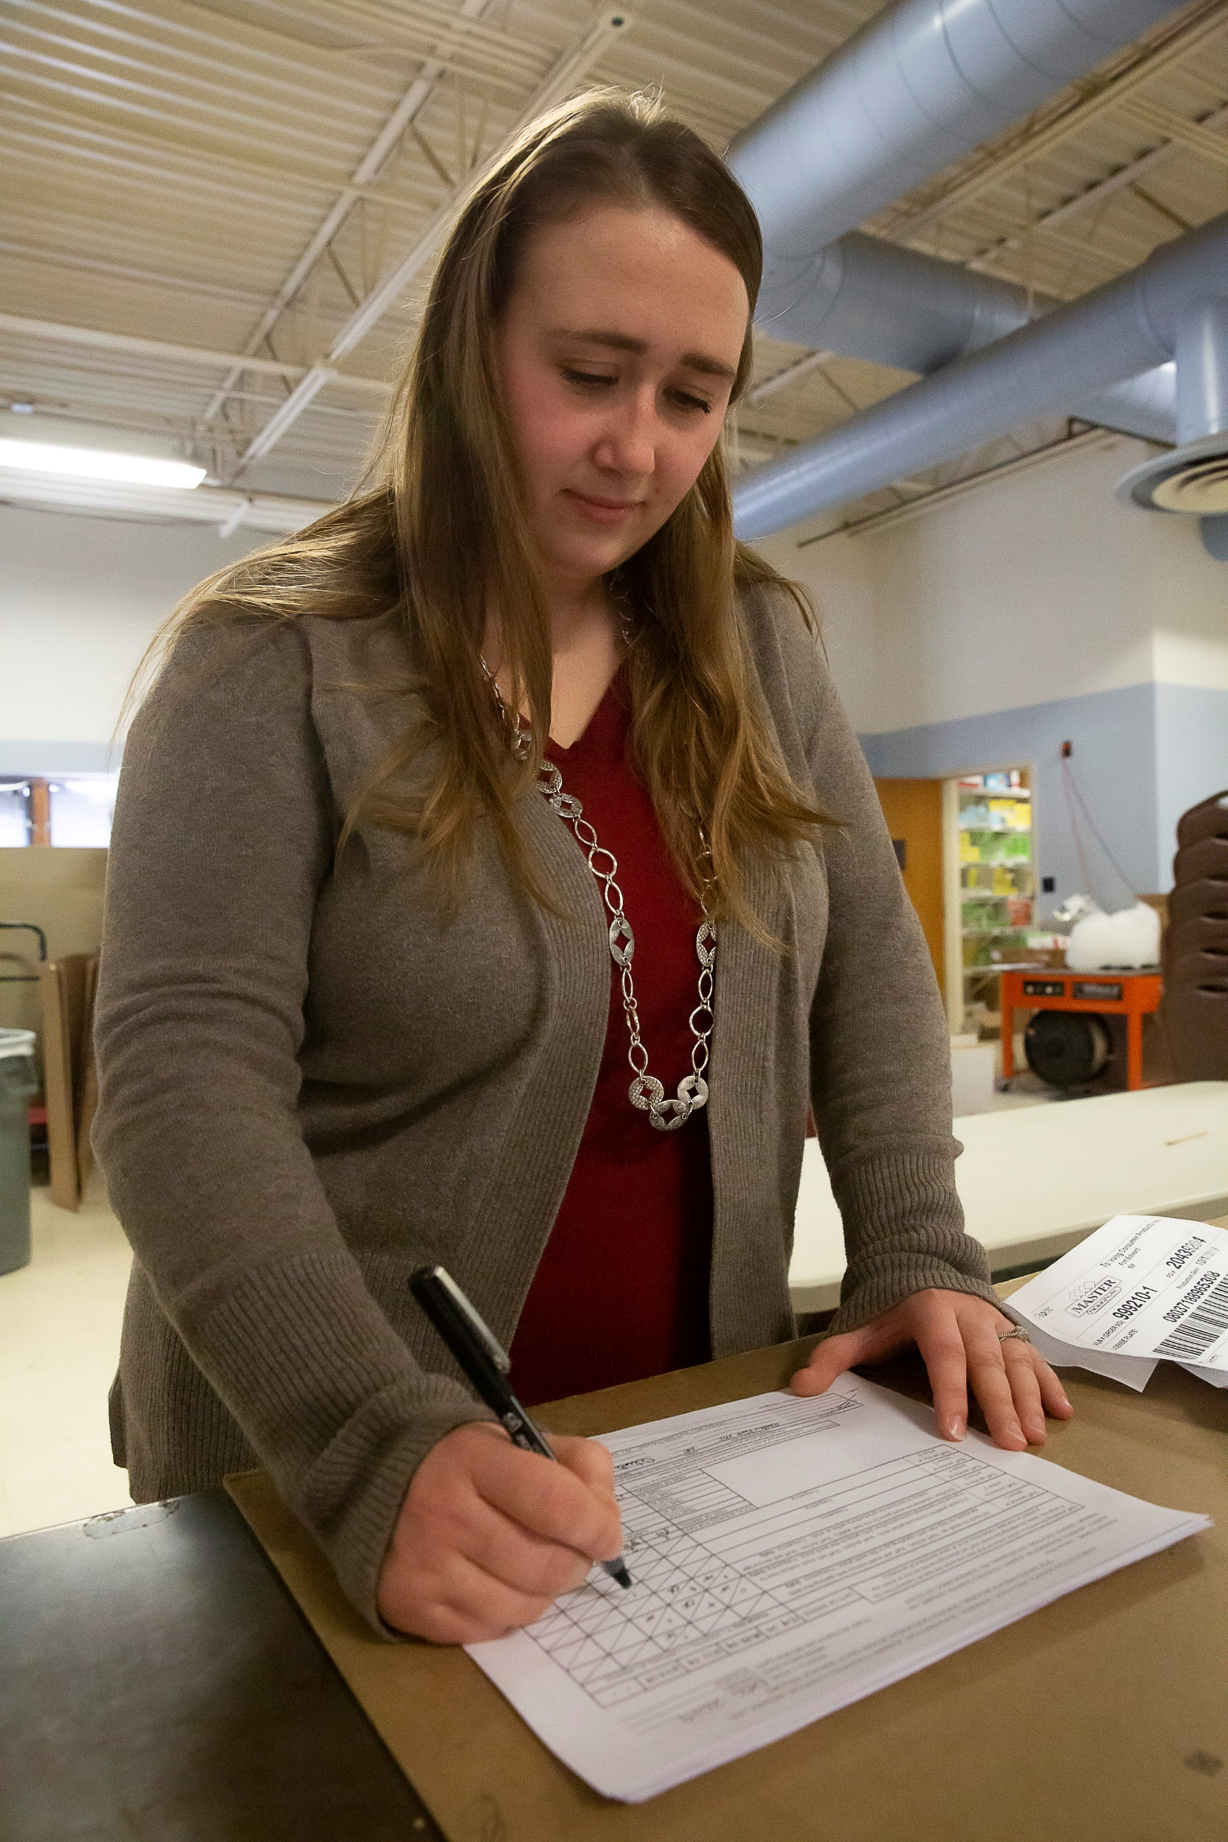
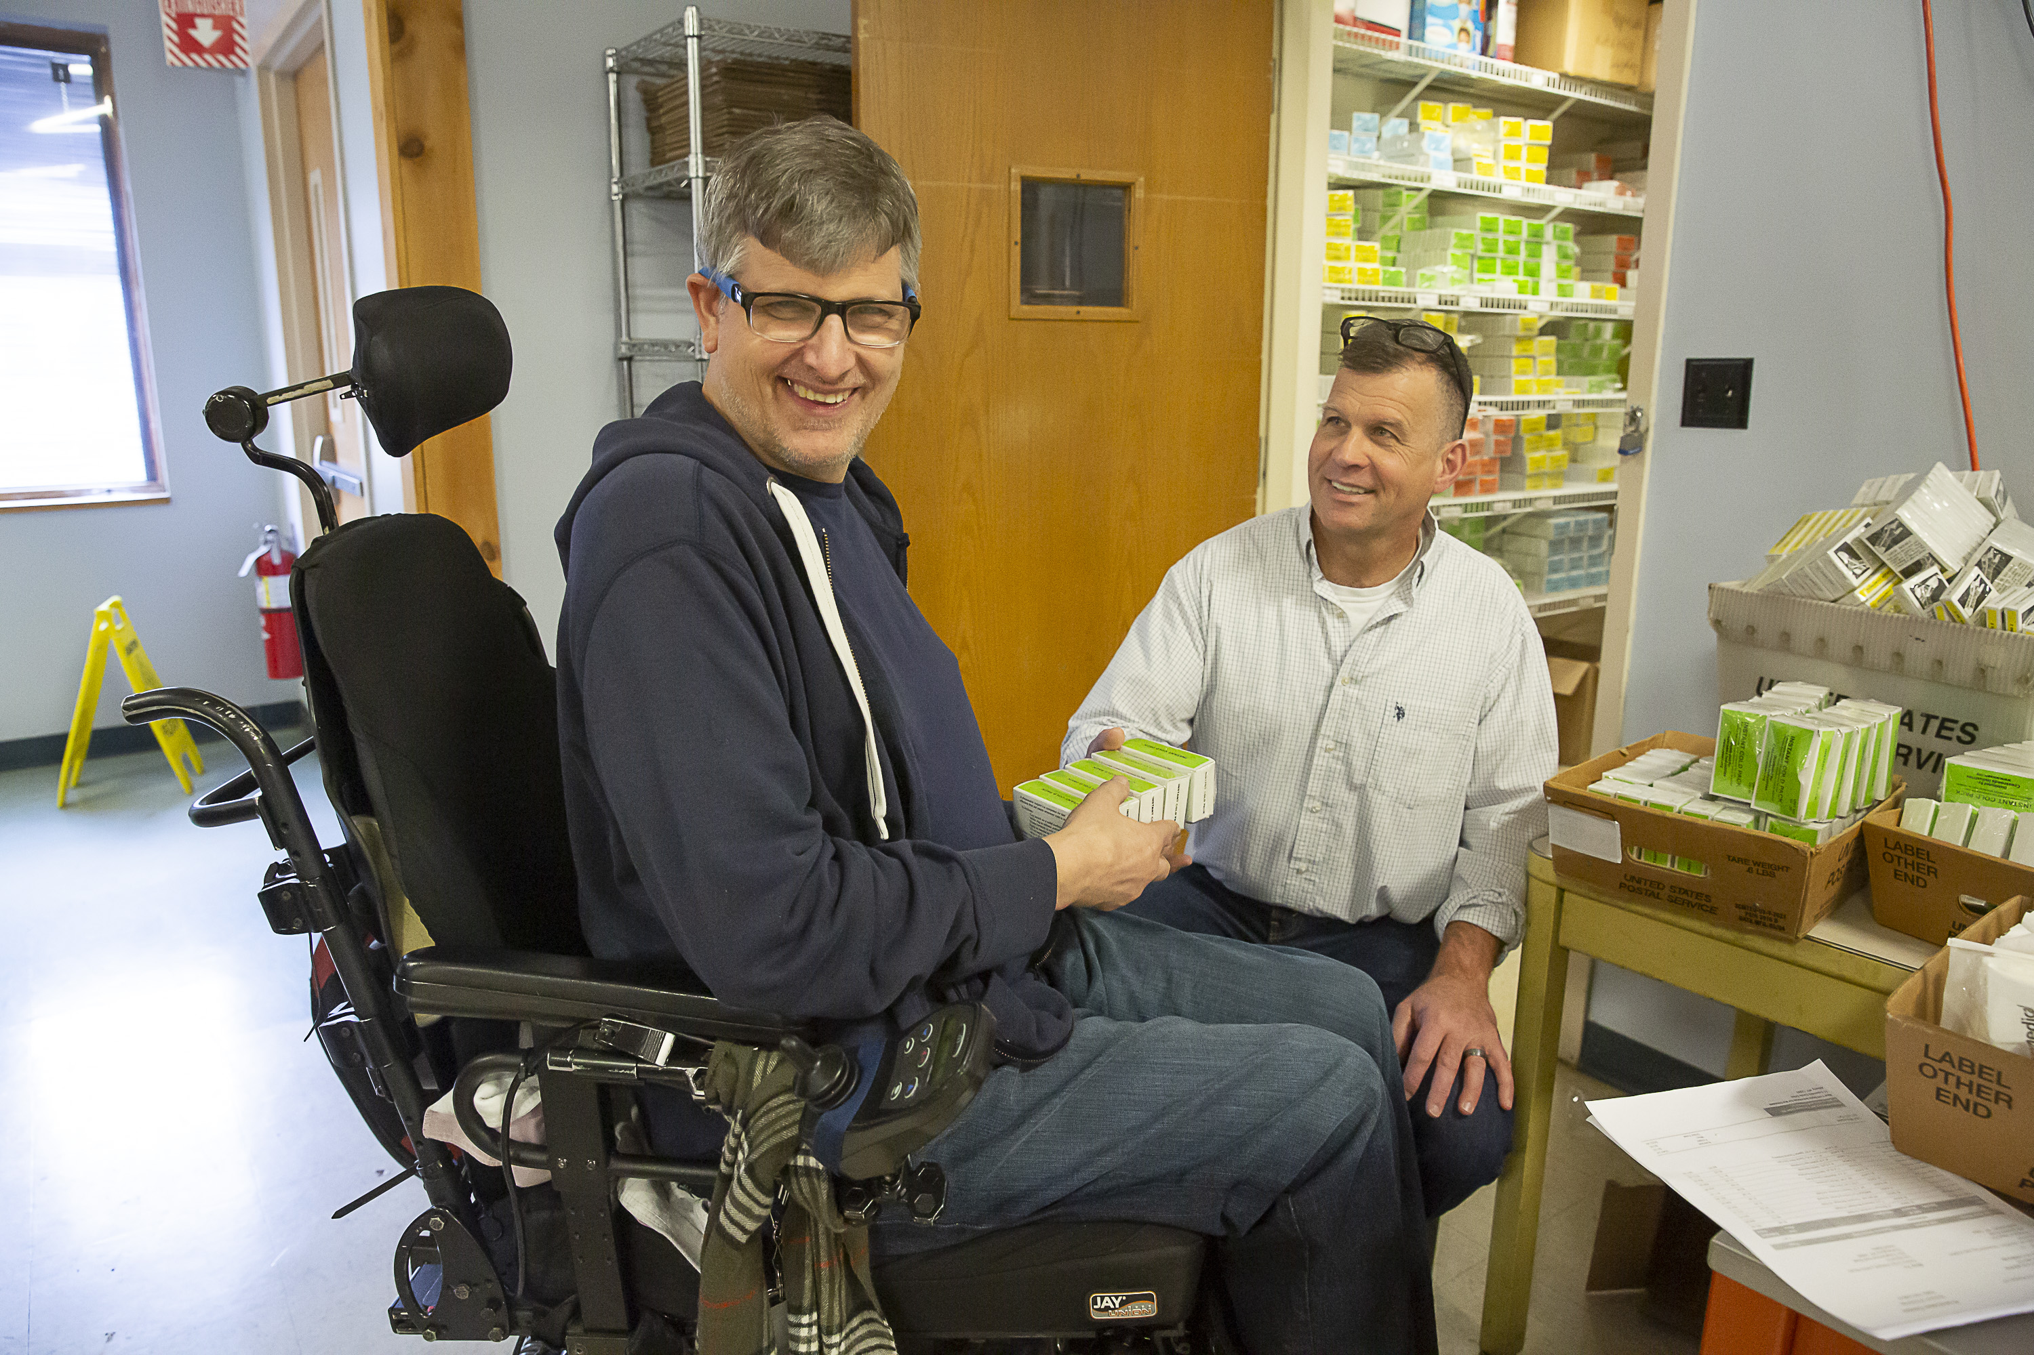
The Role of the DSP:
All 7 Goal Areas and 23 Competencies
Notes:
Explain this a little bit. Why does this course have all 7 goals and 23 CCs?
Every part of the DSP position can be seen in the wheel. The wheel.
Explain the wheel.

Slide 14
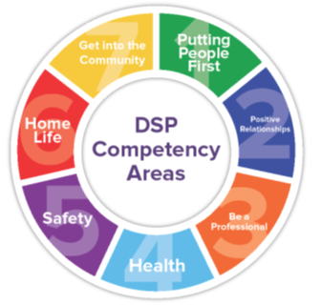
23 DSP Competencies
V: Supporting Community Participation
W: Supporting Employment, Educational, and Career Goals
A: Supporting a Person’s Potential
B: Getting to Know the Person
C: Promoting Advocacy
D: Facilitating Personal Development E: Facilitating Supports and Services
F: Building and Maintaining Relationships
G: Creating Meaningful Communication
U: Supporting People to Live in the Home of Their Choice
H: Developing Professional Relationships
I: Exhibiting Professional Behavior
J: Respecting Diversity and Inclusion
K: Creating Meaningful Documentation
L: Education, Training, and Self- Development
M: Organizational Participation
N: Exhibiting Ethical Behavior
R: Supporting Crisis Prevention, Intervention, and Resolution
S: Supporting Safety
T: Ensuring Safety During Environmental Emergencies
O: Promoting Positive Behavior and Supports
P: Supporting Health and Wellness
Q: Preventing, Recognizing, and Reporting Abuse
Notes:
We have DSP webinars (23) on each and every one of these CCs.
www.workforcetransformation.org / webinars / From Compliance to Competency
And learn more! We have webinars and activities for each one.
We will watch one of these and do the activity as practice a little later.

Slide 15
Where did the DSP
Core Competencies come from?
The DSP Core Competencies were built on are based upon the National Alliance for Direct Support Professionals (NADSP) Code of Ethics for DSPs
In 2011, OPWDD adopted the NADSP Code of Ethics and from that, created the OPWDD DSP Core Competencies

Slide 16
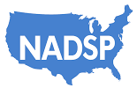
National Alliance for Direct Support
Professionals (NADSP) Code of Ethics
NADSP’s Vision:
A world with a highly qualified and professional direct support workforce that partners with, supports and empowers people with disabilities to lead a life of their choosing.
NADSP’s Mission
To elevate the status of direct support professionals by improving practice standards, promoting system reform, and advancing their knowledge, skills and values.
NADSP’s Values:
NADSP values the full participation of people with disabilities in all aspects of community life through the provision of person-centered supports.
Notes:
OPWDDs DSP CC are built upon and based on the NADSPs COE.
Developed in 1996 by JFK jr. now run by Mr. Joe Macbeth.
Joe is a leader in the disabilities field specifically in DSP development, DSP credentialing and more.
He and his team have played a HUGE role in the development of the DSP position not only for NYS but the whole Nation.

Slide 17
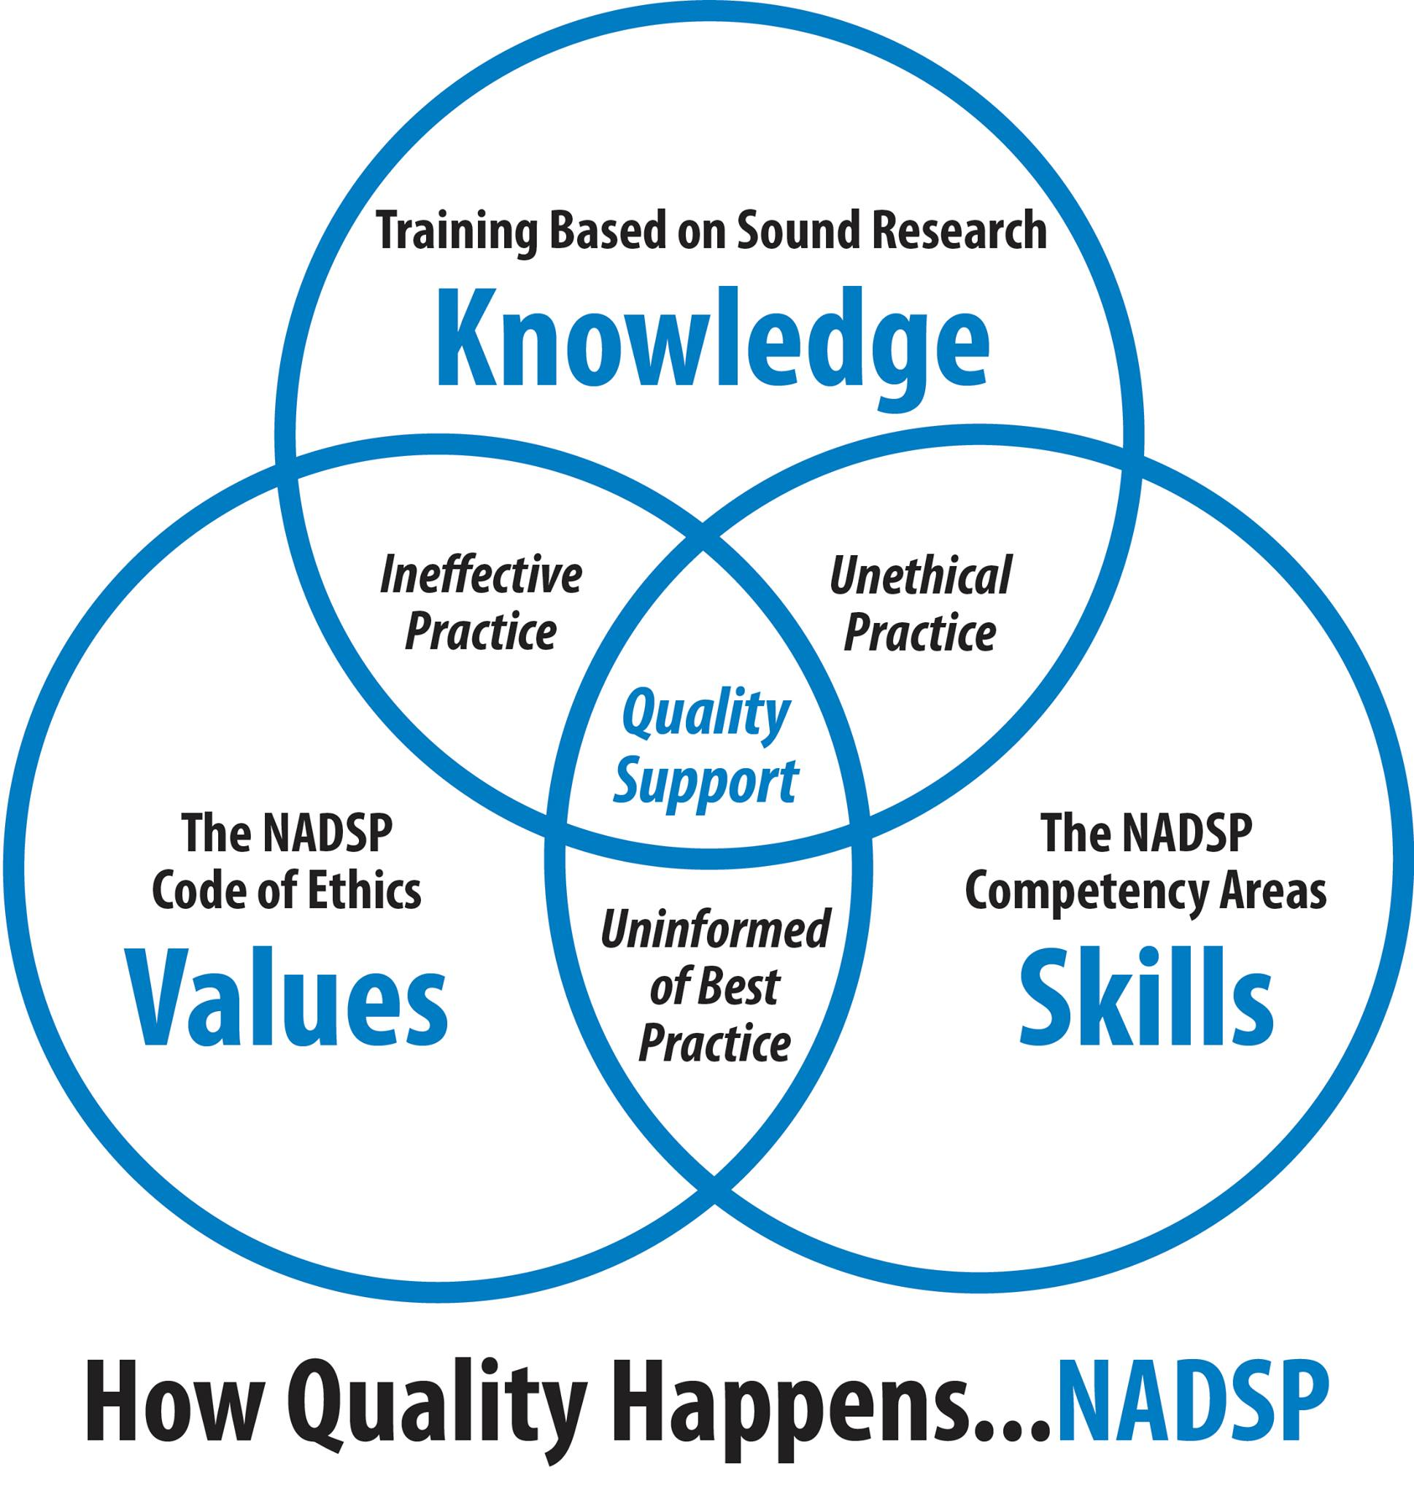
How NADSP
Defines
Quality
Values, Skills and Knowledge
“The knowledge and skills of community support practice must be joined with the ethical principles to create the environment needed to fully support people in making life choices”.
NADSP, 2020
Notes:
Explain this Ven Diagram

Slide 18
Code of Ethics for
Direct Support Professionals
While supporting people as they direct the course of his or her own life, DSP’s will face ethical decisions. They may feel conflicted when the person has set goals for themselves then make choices and decisions that are not in line with those goals.
The National Alliance for Direct Support Professionals (NADSP) Code of Ethics outlines standards of conduct and professionalism that guide DSP’s everyday work.
Notes:
Read slide
Show Video: Breaking the Code

Slide 19
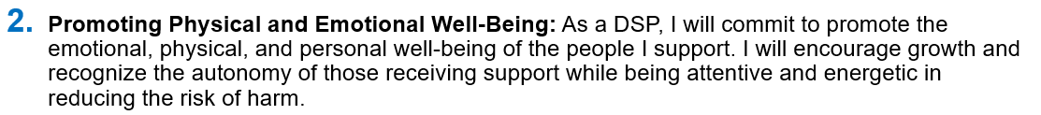
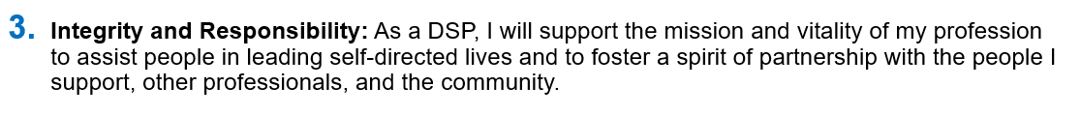
The Nine Tenets of the Code of Ethics
Notes:
Read this quote and then explain it in simpler words. What does this mean?

Slide 20
The Nine Tenets of the Code of Ethics
Notes:
Read this quote and then explain it in simpler words. What does this mean?

Slide 21

The Support Model
As the role of the “staff person” evolved towards the standard of the DSP we moved from taking care of people to supporting people to lead the life of their choice
The role of the DSP moved from the system having total control over the person to handing control over to them
Rather than caregivers we became teachers, mentors and supporters
As the gentlemen on the right is pointing out, the relationship between the person and the DSP has evolved into a partnership and moved away from the caregiver role

Slide 22
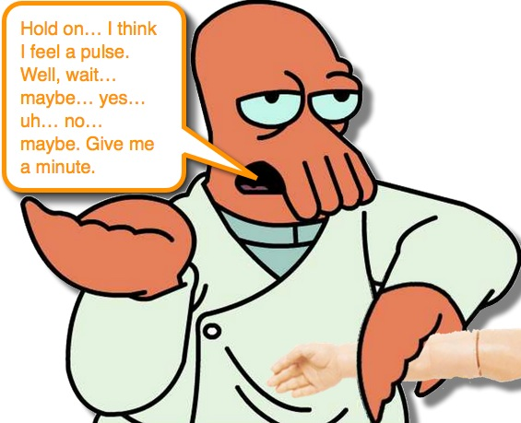
Person Centered Language
What is it?
Why it is important?
Lets check the pulse….
This Photo by Unknown Author is licensed under CC BY-SA-NC
Notes:
Person Centered Language is the use of language that speaks first of the person supported…not defining them by their disability. It is a language that does not discriminate – it equalizes.
Our words represent our thoughts and when we define people through use of words that are meant to differentiate, it demonstrates a lack of equality. Think of a less that optimal trait of yourself….would you want to be defined by that trait? (ie – the fat lady, the loud man, etc) Using words to define people only works to categorize and separate people. It doesn’t demonstrate capabilities and strengths. It’s not unifying – and can often be hurtful.
Transition to Plickers Quiz….review and debrief each question after answer is revealed.

Slide 23
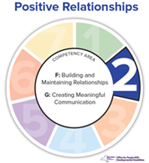
Where does this fit in?
Building and Maintaining Relationships
Area G: Creating Meaningful Communication
- Modifying communication to ensure understanding
- Recognize the impact of possible discrepancies between the person’s
chronological age and developmental age when communicating.
Tenant #1
Person Centered Supports: As a DSP, my first allegiance is to the person I support; all other activities and functions I perform flow from this allegiance.

Slide 24
When supporting someone to use the bathroom, this can also be referred to as toileting
A) True
B) False

Slide 25
When supporting someone to use the bathroom, this can also be referred to as toileting
A) True
B) False

Slide 26
A person who doesn’t talk could also be referred to as:
A) Non-Verbal
B) Someone who doesn’t use words to communicate
C) Mute
D) Profound

Slide 27
A person who doesn’t talk could also be referred to as:
A) Non-Verbal
B) Someone who doesn’t use words to communicate
C) Mute
D) Profound

Slide 28
Feeding is an acceptable term to use when describing dinner for people we support ?
A) True
B) False

Slide 29
Feeding is an acceptable term to use when describing dinner for people we support ?
A) True
B) False

Slide 30
A person who doesn’t use words to communicate, requires 10 minute visual checks and total support with every day living skills is ___________
A) Low- functioning
B) Slow
C) In need of extra support
D) Severely retarded

Slide 31
A person who doesn’t use words to communicate, requires 10 minute visual checks and total support is ___________
A) Low- functioning
B) Slow
C) In need of extra support
D) Severely retarded

Slide 32
A person who has a job, drives a car and lives in an apartment with minimal support is considered ­­­­­­­­____________
A) Normal
B) High functioning
C) None of the above
D) All of the above

Slide 33
A person who has a job, drives a car and lives in an apartment with minimal support is considered ­­­­­­­­____________
A) Normal
B) High functioning
C) None of the above
D) All of the above

Slide 34
When someone takes a trip to the mall, this is called:
A) An outing
B) An Activity
C) Going out into the community
D) A trip to the mall

Slide 35
When someone takes a trip to the mall, this is called:
A) An outing
B) An Activity
C) Going out into the community
D) A trip to the mall

Slide 36
The appropriate term for when someone doesn’t want to do something is:
A) A behavior
B) Non-compliant
C) A refusal
D) None of the above

Slide 37
The appropriate term for when someone doesn’t want to do something is:
A) A behavior
B) Non-compliant
C) A refusal
D) None of the above

Slide 38
Using the term “my Guys” or “our guys” is a very person-centered term
A) True
B) False

Slide 39
Using the term “my Guys” or “our guys” is a very person-centered term
A) True
B) False

Slide 40
Which of these is the best option for use?
A. Residents
B. Individuals
C. People we serve
D. People we support

Slide 41
Which of these is the best option for use?
A. Residents
B. Individuals
C. People we serve
D. People we support

Slide 42
Follow up
How to address tough PCT situations
  Peers
  Community members
  Supervisors
  Family members
Notes:
It’s important to recognize that MOST people are not lacking use of Person Centered Language intentionally, but that they have developed their habitual language through exposure to those that speak in a similar manner. There has been an evolution to language in many areas of our life, and this evolution is important to tactfully address as well.
The best way to address each situation is to reflect/rephrase back to the person your understanding of what they’ve said.
“The new guy seems really high-functioning….” A good response may be, “yes – he is really bright”
(provide other examples)
Should you be in a mentoring role of teaching others – its important that you include corrective language. It is helpful to point out that you are certain the persons intent was not meant to be hurtful, but that another approach may be received better if delivered in another way.

Slide 43
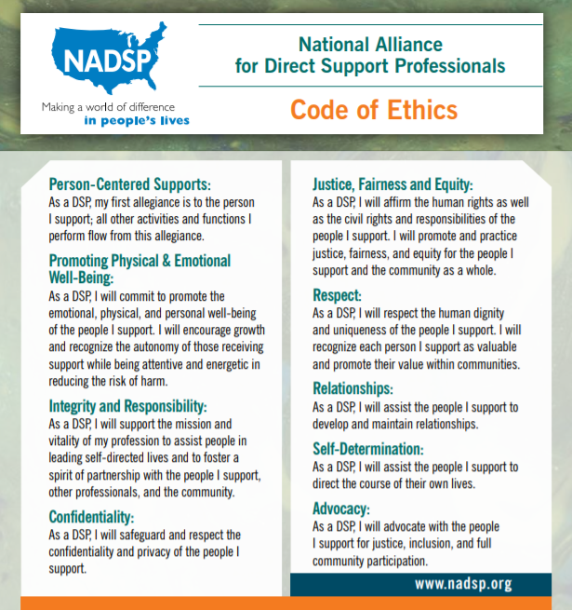
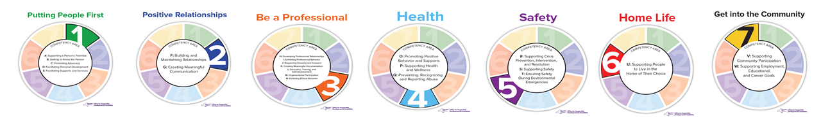
NY State’s DSP Core Competencies
and the NADSP Code of Ethics
Keep the DSP Core Competencies
And the NADSP Code of Ethics in your “tool belt” all the time!
Notes:
TEMPLATE SLIDE

Slide 44


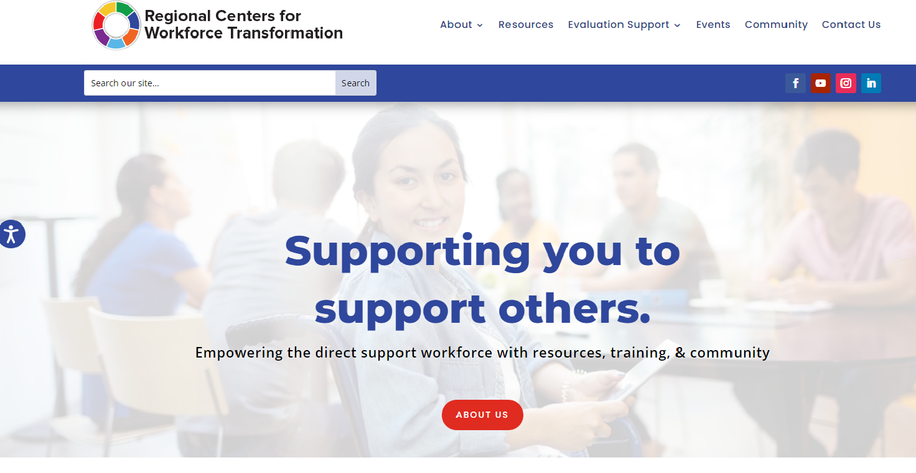




Find us Online
Facebook
Instagram
YouTube
Notes:
TEMPLATE SLIDE

Slide 45
Thank you for all that you do!
Notes:
TEMPLATE SLIDE

