Slide 1
Person Centered Culture
Christopher Fortune
May 9, 2022

Slide 2
Organizational Culture
What any organization actually does vs what it says it believes
Kind of an organizational “walk the talk”

Slide 3
Willowbrook Geraldo Rivera Letchworth Village
History of Serving People with Developmental Disabilities

Slide 4
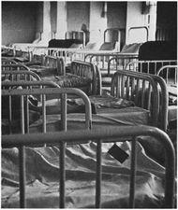
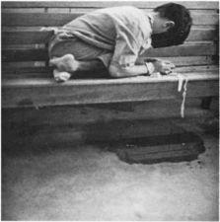
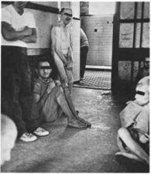
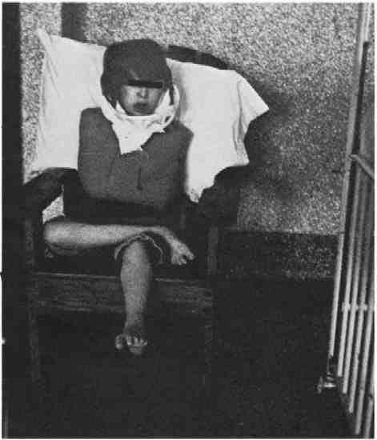
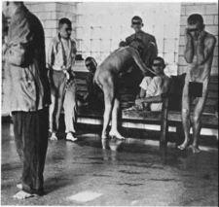
THINGS ARE NOT AS THEY WERE
Christmas in Purgatory - Burton Blatt and Fred Kaplan; written and photographed in 1965
Notes:
Before we look at where the field is going let’s spend a few minutes looking at where it’s been. How many have been?
If you haven’t ever visited a big intuition you should look for an opportunity
Not like this anymore, but still, life-deadening places
Story of the egg. No stronger human emotion that the desire to be in charge of their own life – that’s what we steal from people when we put them in places where their lives are not their own.

Slide 5
Deinstitutionalization

Slide 6
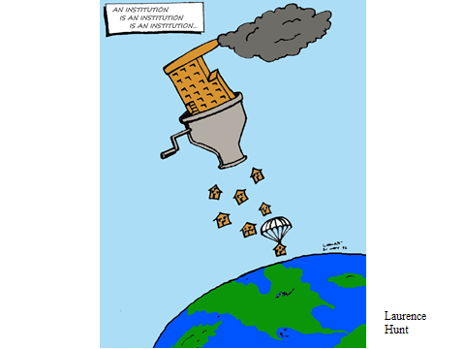
Deinstitutionalization
The intention of everyone working to make deinstitutionalization a reality was that people leaving the institution would new have the opportunity to live a life in the community
Group homes and day programs were developed in the community with the intention of people having the opportunity to participate in community life
While intentions were good, the result was not
People with disabilities still ended up being segregated from mainstream society
People lived in group homes, took special transportation to separate day programs
The illustration on the right shows that even though our intentions were good we created mini-institutions and people led segregated lives

Slide 7
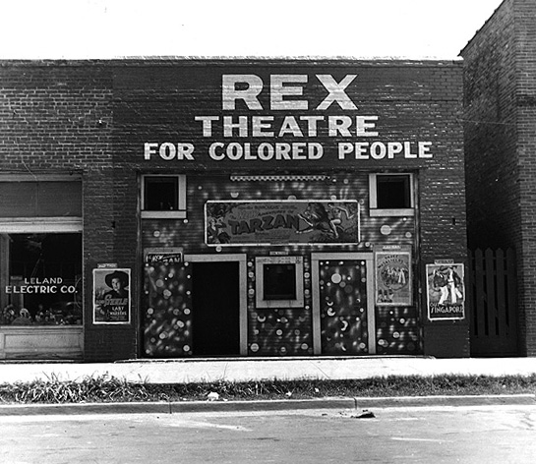
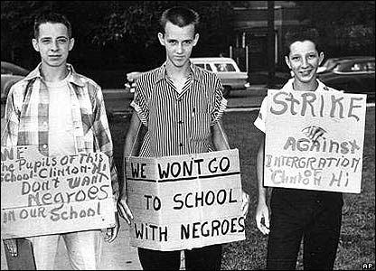
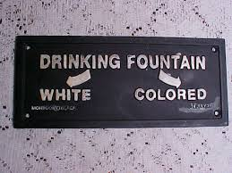
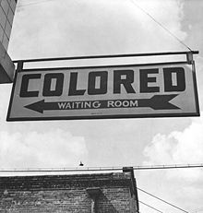
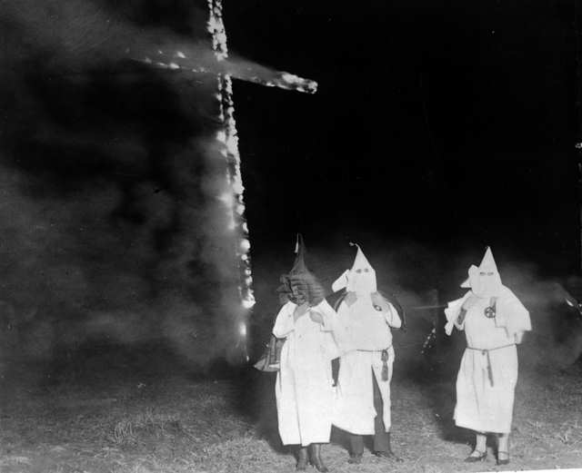
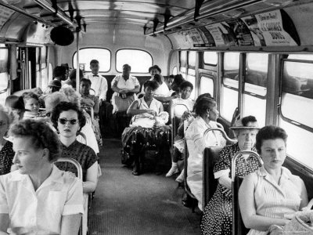
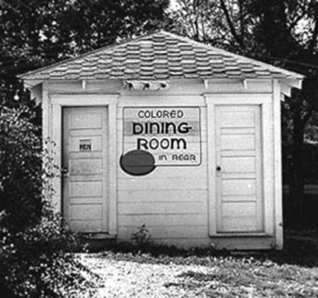
IF WE WOULDN’T TOLERATE THIS ..….

Slide 8
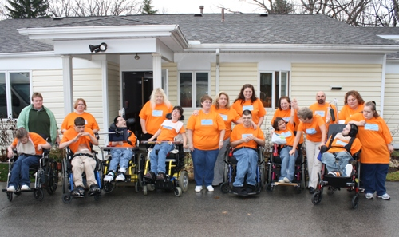
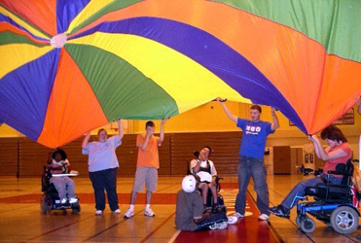
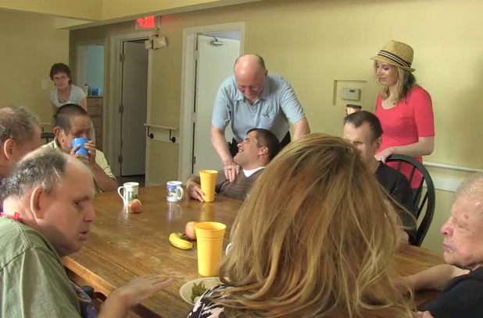
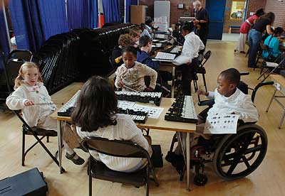
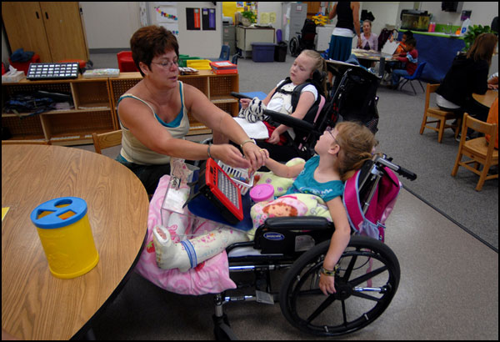
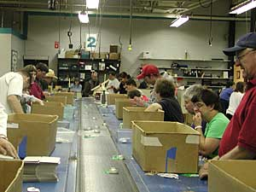
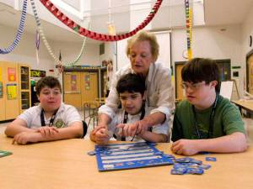
WHY THIS?
Notes:
We use the words “special” or “Specialized” rather than segregated but it’s the same thing
And size isn’t the issue – ran small 3-4 person group homes … staff person said, “line up, dinner’s ready”

Slide 10
The Custodial Model vs the Support Model

Slide 11
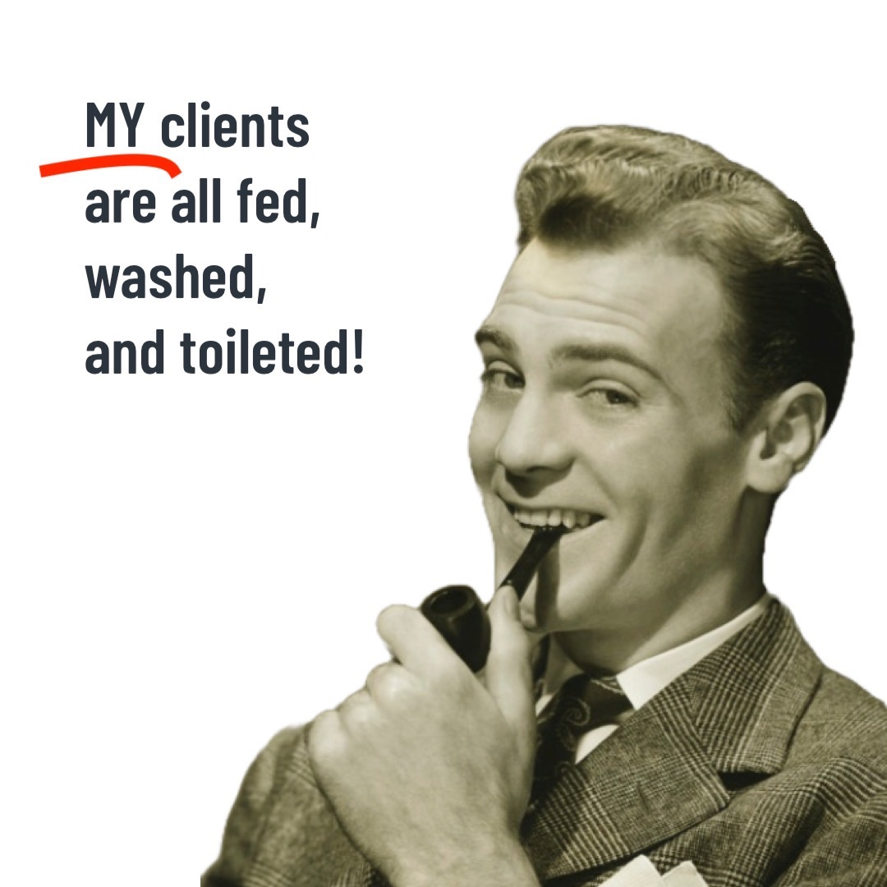
The Custodial Model of Supporting People with Disabilities
The “custodial model” really emerged during the deinstitutionalization period. People were supported outside the institution but were not fostered to become part of the community
The emphasis was to “take care” of the people rather than look at the overall quality of life
Skill development centered around self care, household chores and specific tasks
Development of relationships and community roles were not a priority
The picture on the right illustrates the role at this time. A good days work was done when everyone had a shower, used the bathroom and was safely in bed

Slide 12
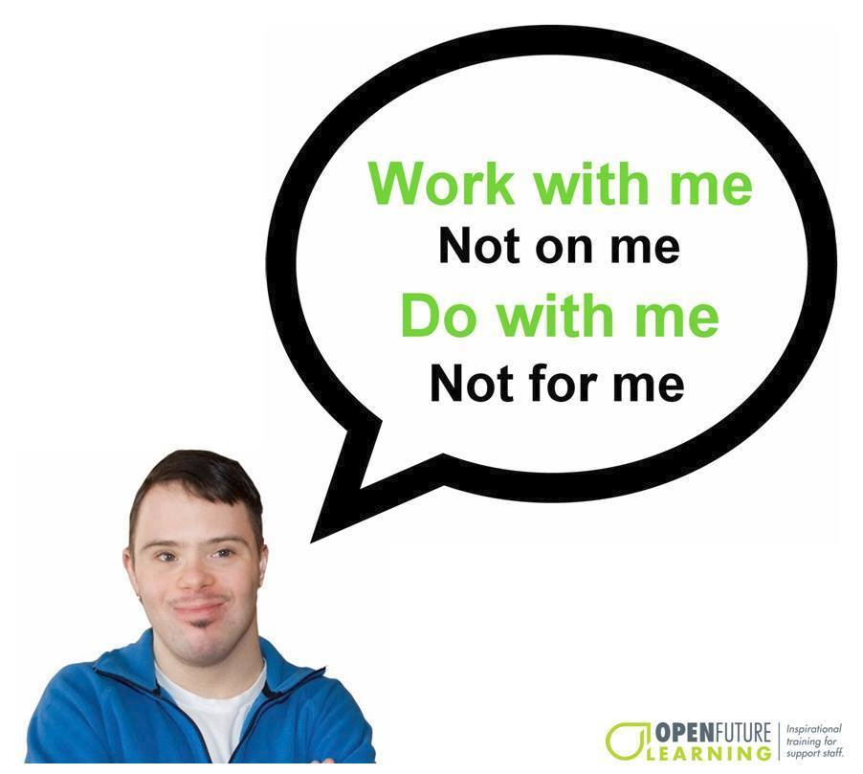
The Support Model
As the role of the “staff person” evolved towards the standard of the DSP we moved from taking care of people to supporting people to lead the life of their choice
The role of the DSP moved from the system having total control over the person to handing control over to them
Rather than caregivers we became teachers, mentors and supporters
As the gentlemen on the right is pointing out, the relationship between the person and the DSP has evolved into a partnership and moved away from the caregiver role

Slide 13
Values and Person Centered Principles
Values
Dignity
Respect
Equal Citizenship
The dignity of Risk
Family and Friends
Person Centered Principles
Build on Capacities
Freedom to make choices
Ability to exert control over one’s life
Community Membership and Inclusion
Relationships
Positive Routines
Person First Language

Slide 14
Choice

Slide 17
Choice Conversation
What choices have you already made today prior to this workshop starting?

Slide 18
Choice
Routine Choices
Coffee or Tea
When to Eat
What to Eat
What to Watch
What to Wear
Bedtime
Snacks
Soda
Not so Routine Choices
Select a Doctor
Apply for a Job
Where to live
Join a Church
Join a Gym
Go to School

Slide 19
Think about what is “Important for and Important to the person”
Michael Smull

Slide 20
Control
Control Scenarios

Slide 21
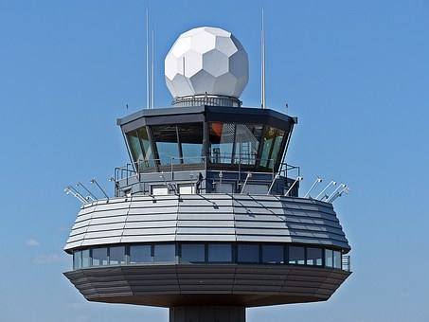

Slide 22
Areas of Control
Money $$
Routines
Community Membership
Friends/Relationships
When/How
Alone/Together

Slide 23
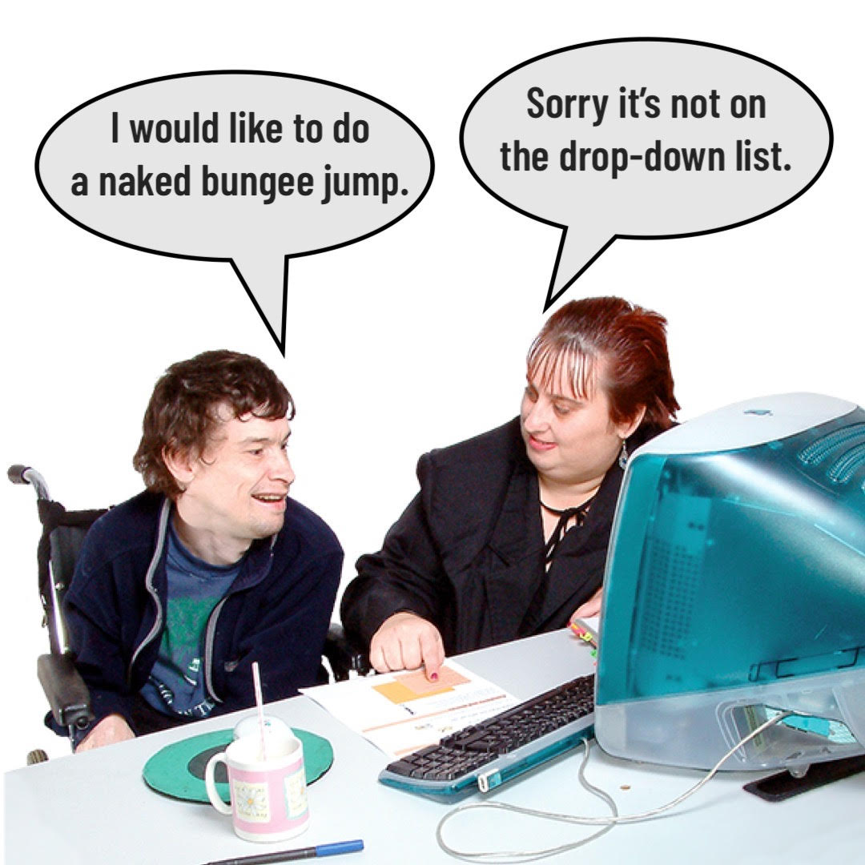

Slide 24
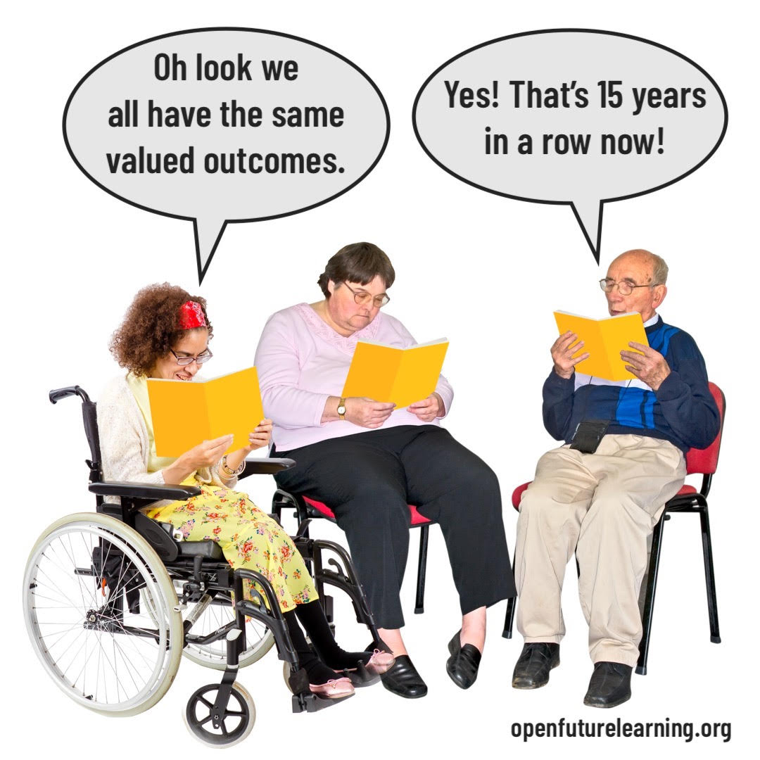

Slide 25
Guardianship vs Supported Decision Making

Slide 26
Capacity Thinking

Slide 27
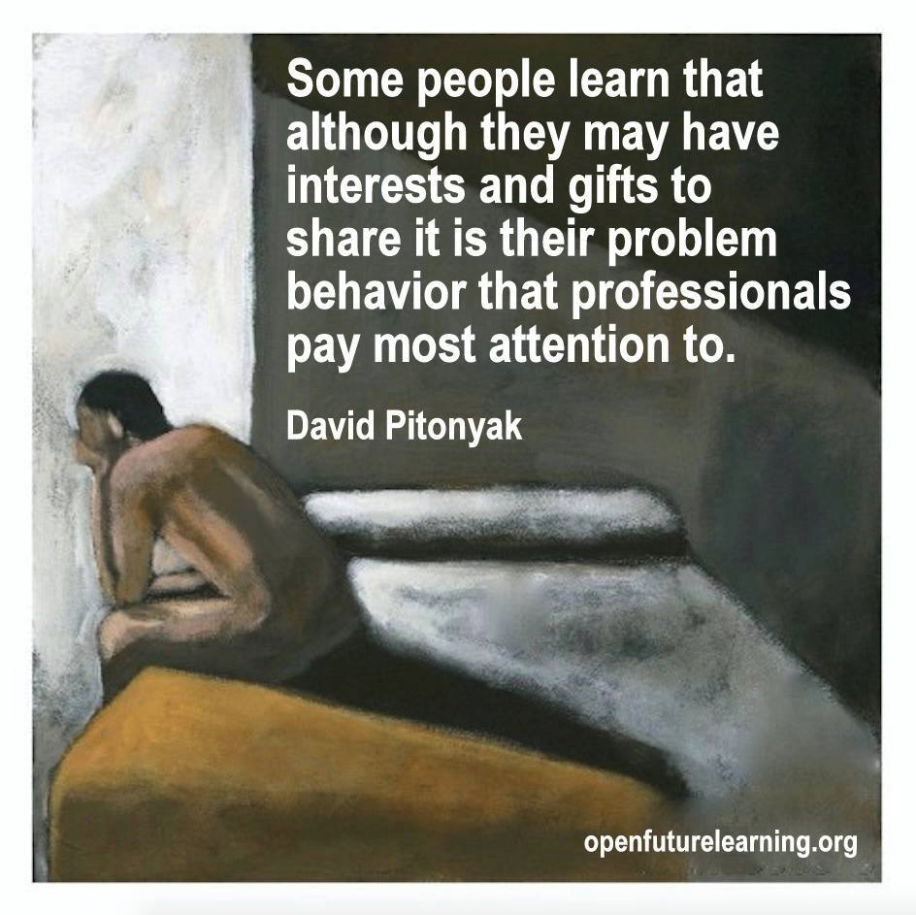

Slide 28
Capacity Vs Deficit Based Thinking
Most Lifeplans focus on Deficits
Clean Bedroom
Laundry
Cooking
Social Skills
“Behavior”
Needs to be more of a focus on Building upon Capacities

Slide 29
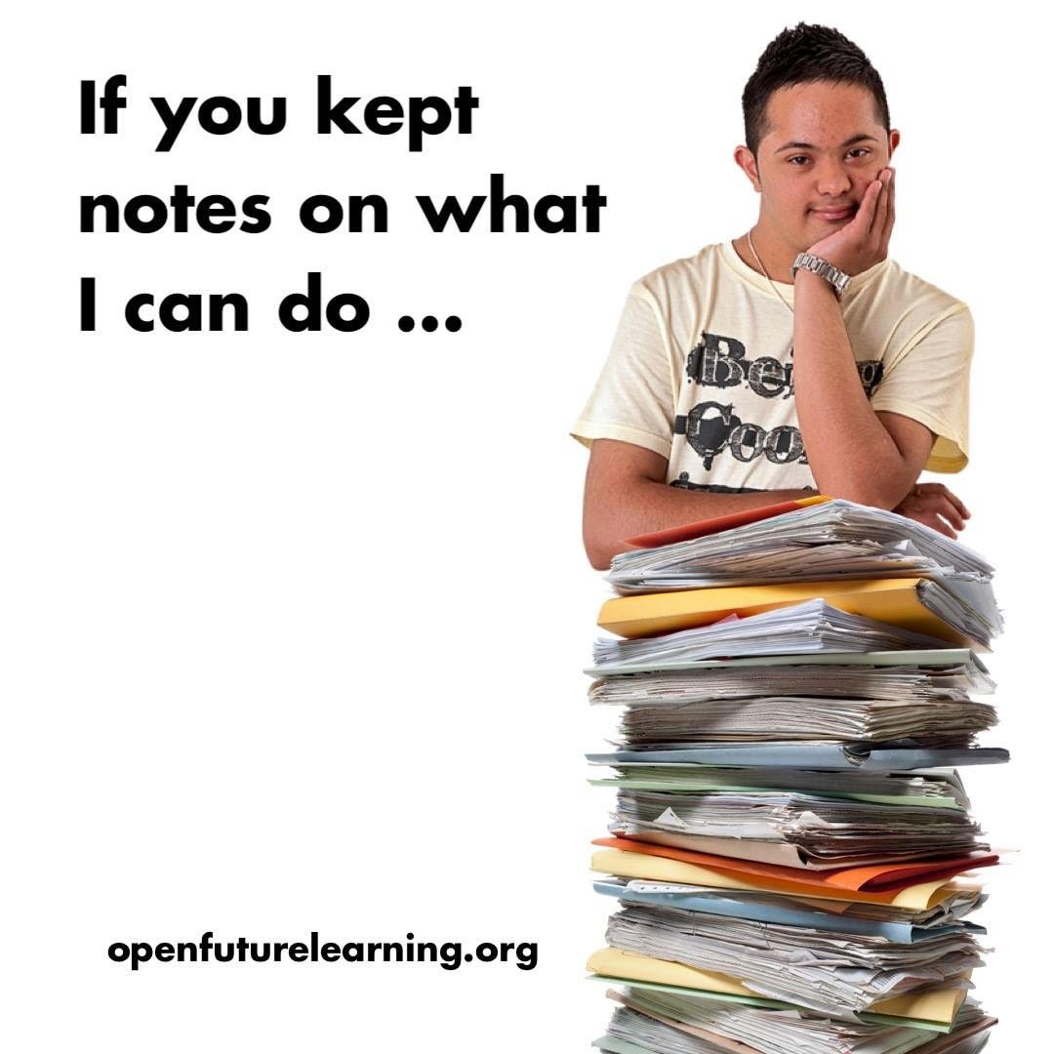
Capacity Based Thinking
The system that supports people with disabilities often focuses on what people can’t do rather than focusing on their capacities
People with disabilities spend time working on meaningless goals, often that they did not choose, in the name of skill development and independence
We all like to be recognized for what we are good at, it is a positive thing to foster the skills and abilities we all have
People with disabilities are no different
Many are organized, knowledgeable in areas, funny, talented, social and gifted
Planning for people needs to take these capacities into account
DSPs are an invaluable source of this information

Slide 30
Capacity Scenarios
Person with a Severe Reputation
Carmella
Person with a Severe Reputation #2

Slide 31
Getting Ready
People with disabilities may spend their whole live “getting ready” for the next step in their lives
Metaphor “A Goldfish is not a Cat”

Slide 32
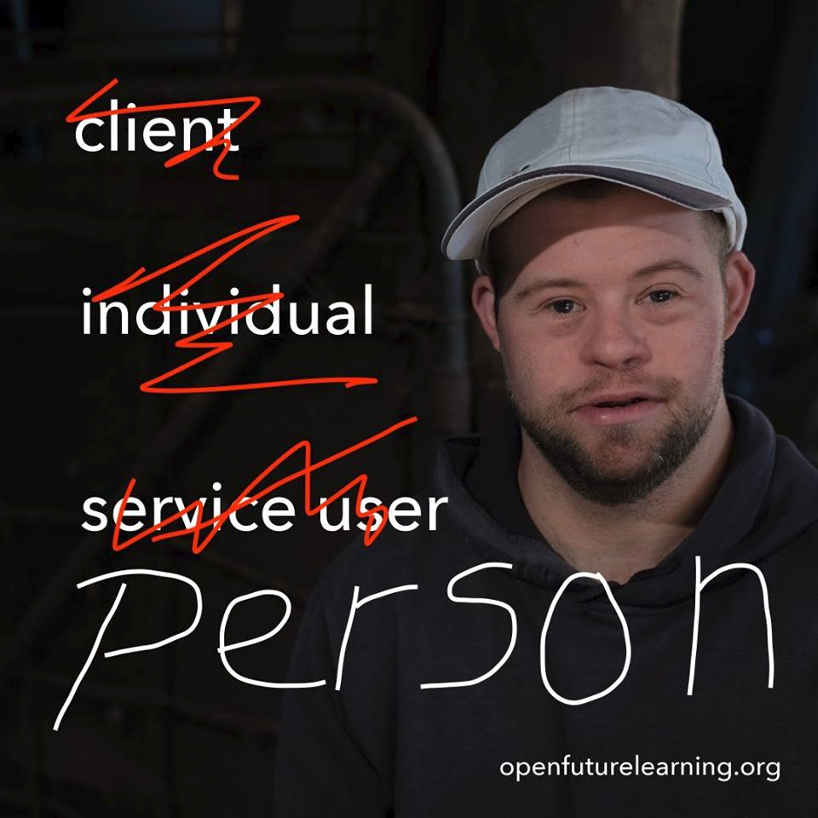
Person First Language
You will hear the people we support referred to in many different ways
Some ways are not respectful and do not promote equal citizenship
Some of the terms you may hear are client, consumer, resident, individuals, the guys, my guys…………..
We need to refer to them as people first:
The people you work with
The people who live at 20 Smith Street
We should also not refer to a person’s disability first i.e. “That Autistic Person”.
Person first language refers to the person first i.e. He is a “Person with Autism”

Slide 33
Language is a Reflection of What we Believe
The difference between the right word and the almost right word is the difference between lightning and the lightning bug.
Mark Twain

Slide 34
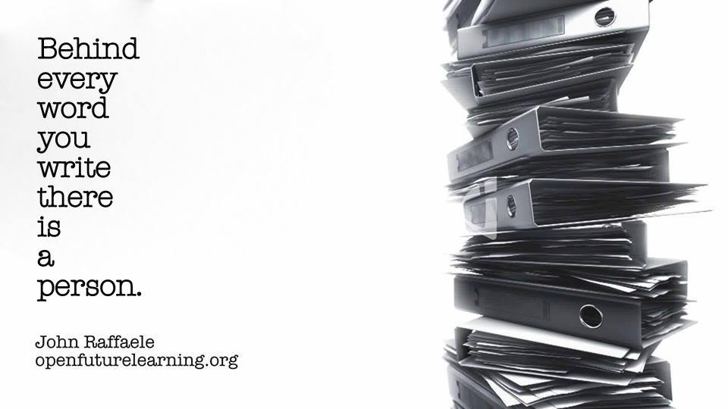

Slide 35
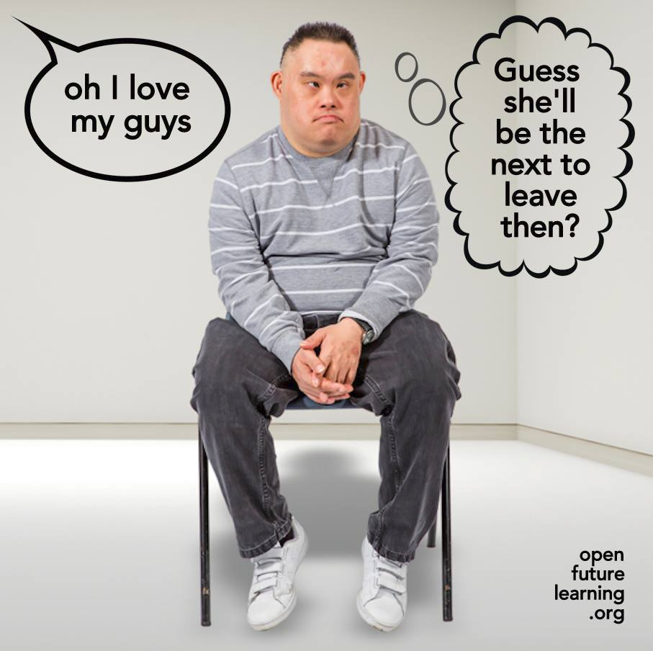

Slide 36
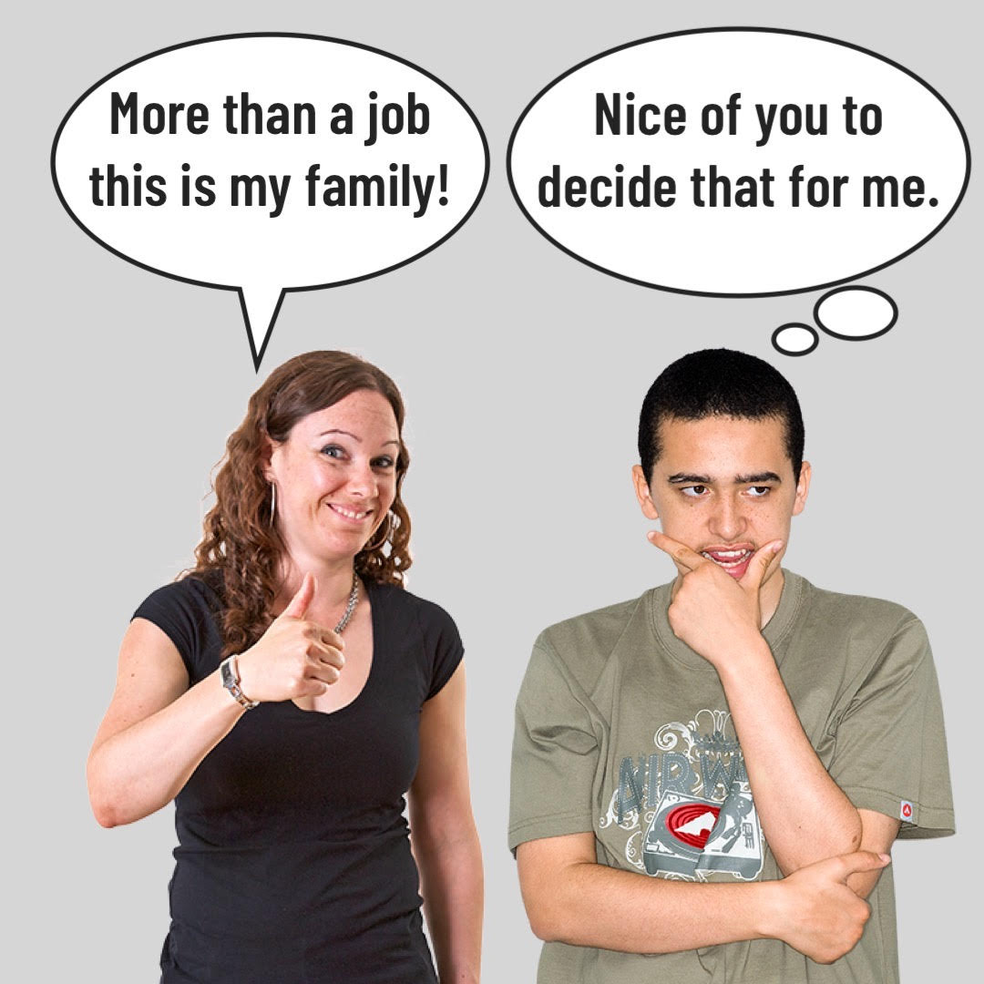

Slide 37
The Language of “us” and “them”
The way we talk can communicate RESPECT or create “Us” & “Them” …..
We will now move to another Power Point to Complete an activity on Language

Slide 38
Meaningful Routines

Slide 39
Morning Routine Exercise
On a peace of paper write down your morning routine from the moment you wake up in the morning till you leave your house or start work. Please write as bullets with approximate times. Please do not share anything you feel is too personal or anything that we should not hear about.

Slide 40
Other Routines
Arriving a work
Getting home in the afternoon
Evening Routines

Slide 42
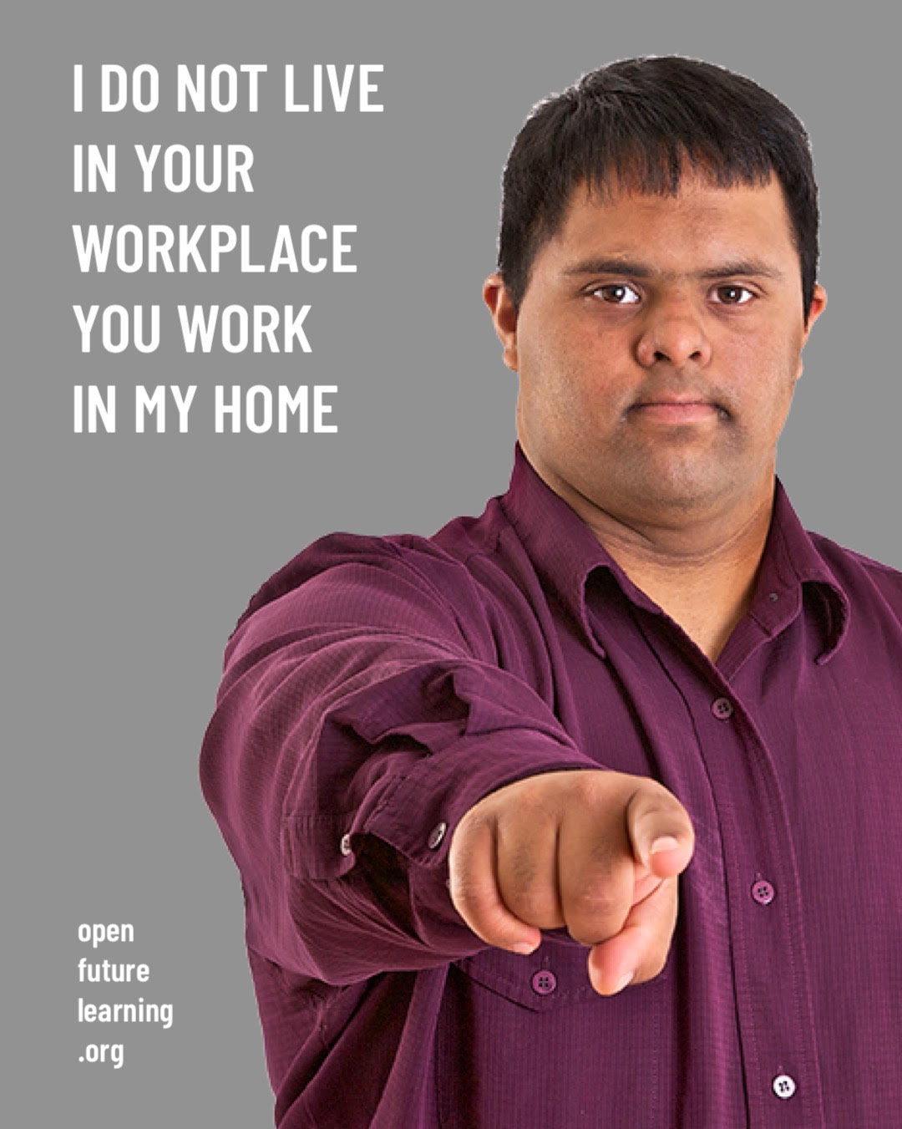

Slide 43
Christopher Fortune RCWT
cfortuneconsulting@gmail.com

