Slide 2
Quick Poll

Slide 3
The Mission
To build professionalism, capacity, and competency of the workforce
The Strategy
The Belief
Change must come from and within the field
Developed workforce champions in all regions
Increase provider engagement and collaboration
Support organizational commitment to the DSP Core Competencies and Code of Ethics

Slide 4
Growth of the RCWT Team
Project Director: Kirsten Sanchirico
New York Alliance
Region 2 Leads:
Jennifer Vogt
Dylan Brown
Tish Comstock-Allcorn
Region 3 Leads:
Rachel Jacob
Chris Fortune
Kenny Burr
Region 1 Leads:
Erica Belois-Pacer
Theresa Buick
Melody Johnson
Region 5 Leads:
Denise Anghel
Pam Wolff-Stackowitz
Heather Thorgensen
Lori LaRocco
Doriann Adams
Region 4 Leads:
Sara Schacter-Erenburg
Joanne Cropper
Asheley Blaise
Eliciana Caro
Nicole Wan
Ketrina Hazell
Anthony Ismael

Slide 5
RCWT Shift to a Statewide Model
Starting in April 2020, RCWT changed their regional approach to a virtual statewide model.
All meetings, events, workshops and conferences are being held virtually and are available for every region to attend.
Notes:
COVID-19 resulted in a shift from RCWT in-person meetings, events, etc. to a virtual statewide model.

Slide 6
Notes:
RCWT had 1,893 event participants in 2020 and had 315 participants last quarter. The top five attended events from last quarter were The top five attended events from last quarter are the Self-Advocate Side by Side Meeting in October with 45 participants, the workshop with guest speaker on Staff Turnover in November (38 participants), the Joint Region 4/5 meetings in September and October and 15 in December (30 participants), DSP Evaluation Workshop in October (30 participants), and the Competency Check point in November (26 participants).

Slide 7
Trainings/Presentations Provided During COVID-19
Staff Support
Retention
Leadership
Other Trainings
Building a Resilient Trauma Informed Team
Supporting Resiliency in Teams
Grief Support
Share Your Successes and Challenges
Strategies for Employee Retention
The Why, What, and How of Credentialing
Talking About Turnover
Leadership in Communication
Emotional Intelligence for Emerging leaders
All Staff are Teachers
Core Competency Workshop for FLS
Cultural Competency: Avoiding Implicit Bias
Culture of Appreciation
Creating Safe Spaces
Personal Stories
The Language of Our Work
Why Employment is Important for Everyone
Person Centered
Notes:
The RCWT trainings/presentations provided during COVID-19 are listed here by category.

Slide 8
RCWT Provider Engagement
In New York State there are currently 450 service providers. RCWT is reaching 100+ percent of all NYS providers.
Notes:
OPWDD and RCWT recently collaborated to cross-walk the DQI, Medicaid and NCI Staff Stability lists to create the updated NYS provider list. The RCWT Directory team are working to maintain the provider directory list and actively engage with providers with the goal of reaching 100 percent of NYS providers.

Slide 9
A Plan for a Better Future!
RCWT is leading a statewide effort to improve the quality of supports for people with ID/DD by transforming the DSP workforce!
RCWT is using data to support DSP workforce development in NYS!
RCWT is demonstrating a model of sustainability to other states!

Slide 10
Direct Support Professional CTE Pilot – BOCES
Regional Centers for Workforce Transformation, Capital Region BOCES, NYS Office for People With Developmental Disabilities, and Provider Partners
Notes:
TEMPLATE SLIDE

Slide 11
A Groundbreaking Program
Participants Learn and Earn: 6 Certificates – Direct Support Professional, Nurse Assistant, Home Health Aide, Personal Care Aide, American Heart Association Basic Life Support/CPR and First Aid
DSP portion of curriculum based on trainings required by state and federal guidelines for DSPs, the National Alliance for Direct Support Professionals (NADSP) Code of Ethics and the NYS DSP Core Competencies
Pilot funding from NYS Workforce Development grant and the Regional Centers for Workforce Transformation.

Slide 12
Program Highlights
The Direct Support Professional Program:
Introduces the Direct Support Profession to new candidates
Provides work-based learning opportunities to strengthen students’ hands-on skills and experience
Established Mentor position supports students with learning about direct support and transition into the workforce
Bolsters a career pathway – students are eligible for job placement upon graduation

Slide 13
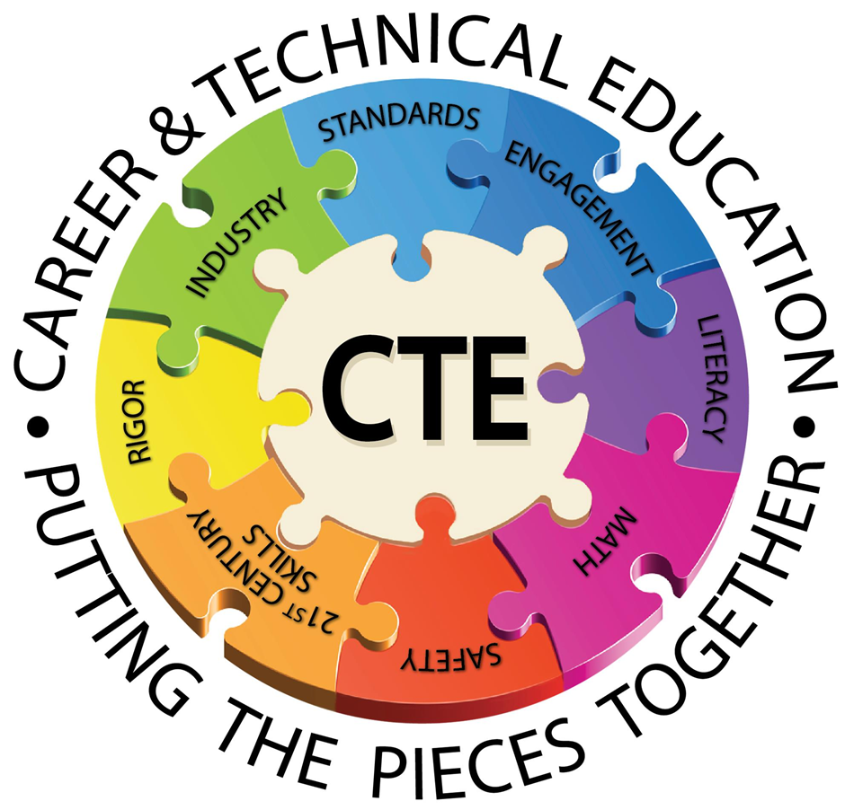
Why Career & Technical Education (CTE)?
This pilot course is a win-win-win scenario, connecting New York's goals for Education, Advocacy and Economic Development to the core knowledge, skills and values of the profession. Coursework is aligned with both OPWDD-required training topics and industry fundamentals to ensure graduates share a commitment to best practices.

Slide 14
NOCTI Assessment
The New York Alliance for Inclusion and Innovation and OPWDD have hired a nationally recognized entity, NOCTI, to build a standardized CTE course certificate for graduates of the program.
Once the assessment is finalized, participants will receive the Direct Support Professional Certificate – the first DSP standardized CTE certificate in New York State which can be used by any school to assess the skills, knowledge and competency of learners.

Slide 15
Scope and Sequence
Health Careers Sequence: Two-Year Option for High School Students or 15-week program for Adult Learners
Year One: Certified Nurse Assistant (CNA)
Year Two: DSP/ Home Health Aide (HHA)/ Personal Care Aide (PCA)
Job Candidate
Knows:
NYS Core Competencies
NADSP Code of Ethics
PRAISE
Overview of Services System
Community Inclusion
Human Sexuality
Communication
Positive Approaches
Learn person-centered care through training in the classroom and off-campus
Complete 108 hours of clinical work in a nursing home
Prepare to take the Certified Nurse Assistant Prometric exam for NYS
Learn person-centered supports through training and classroom prep
Complete 108 hours of work-based learning on site
Learn to assist people who may need supports living within the community
Notes:
The course calendar is typically a blend of classroom and work-based learning throughout the year. During COVID-19, the course calendar has been front-loaded with curriculum and WBL has been a blend of virtual with some in-person mentoring. Site based work starts when everyone is vaccinated and all sites are okay to proceed.

Slide 16
Direct Support Turnover
The Direct Support Professional annual turnover rate in New York State is about 36.2% (National Core Indicators, 2020).
Turnover Costs
Turnover Solutions
The costs and wasted resources associated with high DSP turnover have resulted in service providers not finding enough qualified individuals to fill positions (University of Minnesota, 2018).
A study found provider organizations that participated in a competency-based training and certification program had a 16% decrease in turnover rates (University of Minnesota, 2017).
Research indicates direct support turnover can have a tremendous financial burden on service providers; hinder the community integration of people with I/DD; and prevent people from accessing their communities (Friedman, 2020).
Research indicates mentorship is effective at decreasing turnover (Larson & Hewitt, 2004; Micke, 2015).
Notes:
The BOCES Program provides a state recognized Direct Support Professional Certificate and mentorship, which research indicates will help reduce the high turnover rates of the workforce.
References:
National Core Indicators. (2020). National Core Indicators 2019 Staff Stability Survey Report. https://www.nationalcoreindicators.org/resources/staff-stability-survey/
Implementing Direct Support Professional Credentialing in New York Executive Summary; University of Minnesota, (2017).
Hewitt, A., Macbeth, J., Merrill, B., & Kleist, B. (2018). Impact: Winter/Spring 2018 Volume 31, Number 1. Retrieved from https://ici.umn.edu/products/impact/311/#Editors
Friedman, C. (2020). The impact of direct support professional turnover on the health and safety of people with intellectual and developmental disabilities. Inclusion, 9(1), 63-73. https://doi.org/10.1352/2326-6988-9.1.63
Larson, S & Hewitt, A. (2004). Staff Recruitment, Retention, and Training Strategies for Community Human Services Organizations.
https://ici.umn.edu/products/docs/Staff_Recruitment_book/Staff_Recruitment_book.pdf
Micke, H. (2015). Causes and Solutions for High Direct Care Staff Turnover. Retrieved from Sophia,
the St. Catherine University repository website: https://sophia.stkate.edu/msw_papers/494

Slide 17
Research Supports Certification
Certificate programs provide a higher and consistent standard for direct support work performance and improve the skills of DSPs (University of Minnesota, 2017).
Individuals who received services from certified DSPs experienced improvement in outcomes such as employment, social relationships, inclusion, and health and safety (University of Minnesota, 2017).
Research indicates attainment of certifications improves the quality of care, contributes to higher levels of professionalism, improves job satisfaction, and reduces injuries for DSPs and the people they support (Report to the President, 2017).
Notes:
References:
Implementing Direct Support Professional Credentialing in New York Executive Summary; University of Minnesota, (2017).
Report to the President 2017 America’s Direct Support Workforce Crisis: Effects on People with Intellectual Disabilities, Families, Communities and the U.S. Economy. (2017). 1-61. Retrieved from https://acl.gov/sites/default/files/programs/2018-02/2017 PCPID Full Report_0.PDF

Slide 18
BOCES Pilot Project Benefits
Builds student pathway to the direct support workforce
Enhances the direct support occupational image and profile with a state recognized Certificate Program
Strengthens the candidate pool of qualified and motivated workers
Improves recruitment and retention efforts for this workforce
Work-based learning and mentorship provides participants with hands-on knowledge and experience, preparing them to enter the workforce
Participants learn the relevant skills of the direct care occupations, expected to increase by 52% in New York State, from 2018 to 2028.
Notes:
https://phinational.org/policy-research/workforce-data-center/#var=Employment+Projections&states=36

Slide 19
Future Goals
Build and support a sustainable Capital Region BOCES program that can be replicated in other regions of the state.
Strengthen the candidate pool and career pathway to address workforce shortages in the developmental disabilities field.
Further establish the Direct Support Professional title as distinct from health care certifications, while introducing and promoting the I/DD field for career opportunities.

