Slide 1
Recognizing and Responding to Microaggressions
How to Recognize and Interrupt Subtle Acts of Exclusion

Slide 2
The DEI Team at RCWT
Brian Potvin
Nicole Wan
Asheley Blaise
Theresa Buick
Eliciana Caro

Slide 3
Objectives
Recognize the impact that our language and actions have
Understand the importance of speaking out
Learn ways to avoid and stand up to microaggressions

Slide 4
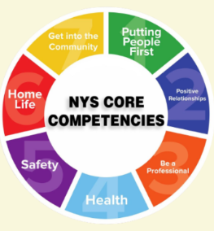
NYS Core Competencies
Putting People First
J. Respecting Diversity and Inclusion

Slide 5
NADSP Code of Ethics
5. Justice, Fairness and Equity: As a DSP, I will affirm the human rights as well as the civil rights and responsibilities of the people I support. I will promote and practice justice, fairness, and equity for the people I support and the community as a whole

Slide 6
Microaggressions
Alvin Poussaint refers to the cumulative impact of experiencing microaggressions as “death by a thousand nicks.”
“Brief and commonplace daily verbal, behavioral, or environmental indignities, whether intentional or unintentional, that communicate hostile, derogatory, or negative…slights towards [a marginalized group].” (Sue, 2007)
“Behaviors or statements that do not necessarily reflect malicious intent but which nevertheless can inflict insult or injury.”-(Runyowa, 2015)

Slide 8
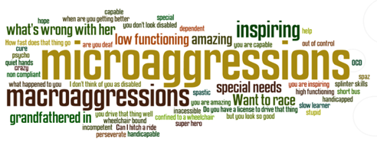

Slide 10
Pronouncing names
Mispronouncing someone’s name, carelessly and frequently, can feel like a microaggression to some folks.
Have everyone introduce themselves, don’t read off names.
Write down phonetic spelling
Ask someone how to say their name, be intentional and clear that you are working on learning it.
Keep using that person’s name as much as possible, giving yourself every opportunity to learn it and get it right.

Slide 11
Responses to witnessing microaggressions:
“What makes you say/think that?”
“I’d like to hear the rest of what ______ was saying.”
“That made me feel uncomfortable.”
Notes:
What makes you say/think that? Makes people examine their motives.

Slide 12
Responses to offensive jokes:
“I don’t get it. Can you explain the joke to me?”
“That wasn’t funny.”
“That’s against our code of conduct.”
“Wow, that was awkward.”
“Did you really just say that?”
“Actually, that’s a really bad stereotype.”
Notes:
What makes you say/think that? Makes people examine their motives.

Slide 13
Responses to social or physical harassment:
“Everything ok here?”
“Not cool”
Tell someone: case manager, HR,
“We don’t do that.”
Notes:
What makes you say/think that? Makes people examine their motives.

Slide 15
Call it out, or be complicit
If we are committed to a safe and inclusive workplace for everyone, it is important to correct and educate.
Behavior that isn’t called out may be considered acceptable by those who are doing it.
It may be appropriate to extend grace and compassion when a person doesn’t intend harm.

Slide 16
Call it out, or be complicit
Racism
Sexism
Homophobia
Transphobia
Xenophobia
Antisemitism
Ableism

Slide 17
A different perspective:
Microaggressions can also be called Subtle Acts of Exclusion.
The term microaggressions was created by Harvard psychiatrist Chester M. Pierce in the 1970’s.
Today the word “microaggressions” has caused strong negative reactions in some people.
The term can provoke others to become defensive because they may feel accused of being aggressive.

Slide 18
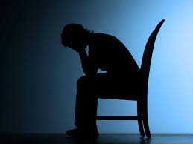
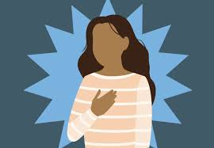
Subtle Acts of Exclusion Hurt and can makes others feel like:
They are invisible.
They are inadequate.
They are not an individual.
They don’t belong.
They are not normal.
They are a curiosity.
They are a threat.
They are a burden.
(Jana & Baran 2020)

Slide 19
There is nothing MICRO about it
The word microggressions may suggest to some that there is minimal harm or damage for those who have to endure this type of behavior.
The word micro may suggest that it is no big deal.
“There is empirical evidence that experiencing microaggressions takes a toll on people’s well being and physical health.” (Jana & Baran 2020)

Slide 20
There is nothing MICRO about it
Can have a HUGE impact in work morale and performance.
Create TRAUMA
Can lower self esteem and productivity.
Can prolong the undue oppression of marginalized people.
Can cause resentment, anger and fear in others.
When they happen often go unnoticed.

Slide 21
Replacing Microaggressions with Intentional Acts of Inclusion.
We all have the power to uplift others and make them feel like:
They are enough.
They are unique.
They belong.
They are normal.
They are safe.
They are seen.

Slide 22
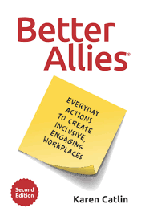
Recommended readings to start the discussion with your team:

