Slide 1
Enhancing Relationships with Direct Support Professionals
By Letisia Comstock-Allcorn

Slide 2
My Goal
To enhance our relationships with Direct Support Professionals, so that we see them as partners and not staff

Slide 3
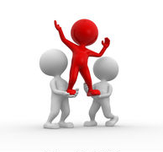
What does Direct Support Professional mean?
Direct = you
Support = help (not just physically)
Professional= standard

Slide 4
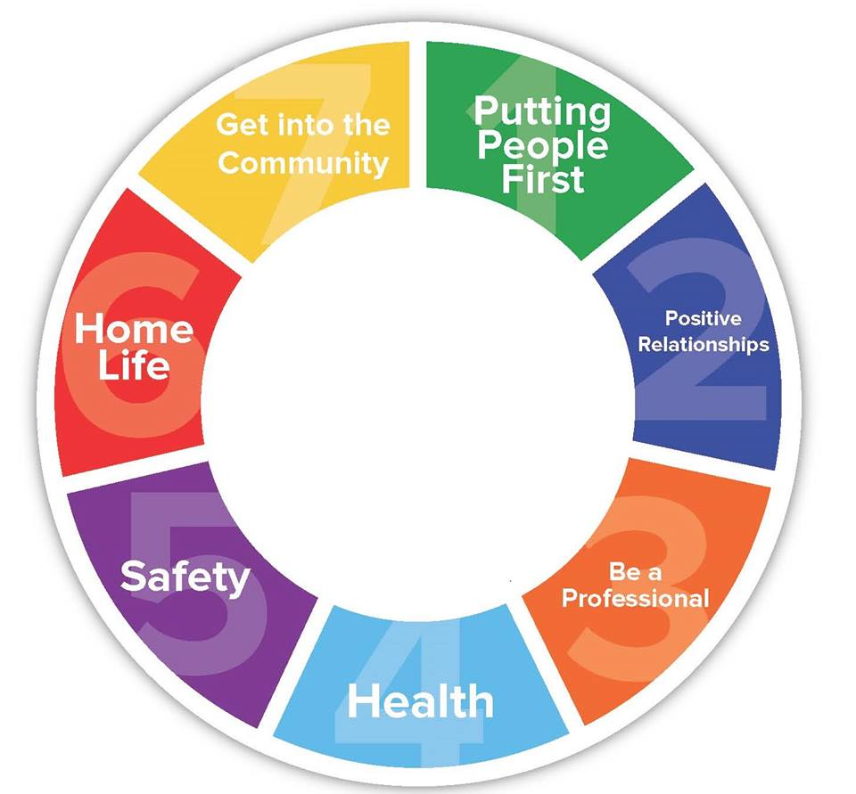
What Are The Core Competencies and What Is The Evaluation Tool?
Putting People First
Positive Relationships
Be a Professional
Health
Safety
Home life
Get Into The Community

Slide 5
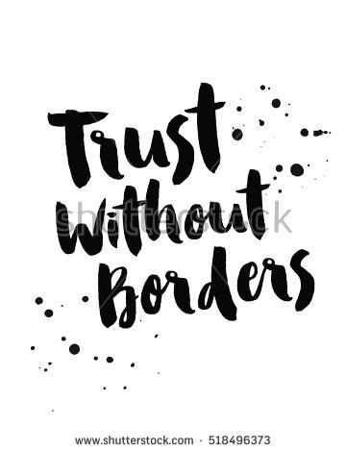
Questions We are too Afraid to Ask
Can we have a relationship/friendship with my DSP?
Can I trust my DSP and tell them things that I’m struggling with?
Will my DSP get mad or upset with me?
Did I do something that made my DSP leave ?

Slide 6
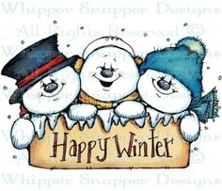
Beautiful Beginnings
What’s your favorite Band?
What is your favorite ice cream flavor?
What is your favorite scent?
What is your favorite season?
What is your favorite t.v. show?
What is your biggest pet peeve ?
Where would you like to travel to?

Slide 7
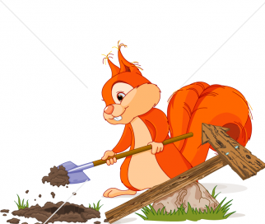
Digging Deeper
How would you describe your relationship with each other?
What is one thing you wish the other one understood about you ?
What is your dreams?
What advice do you have for each other?
What is your biggest fear?

Slide 9
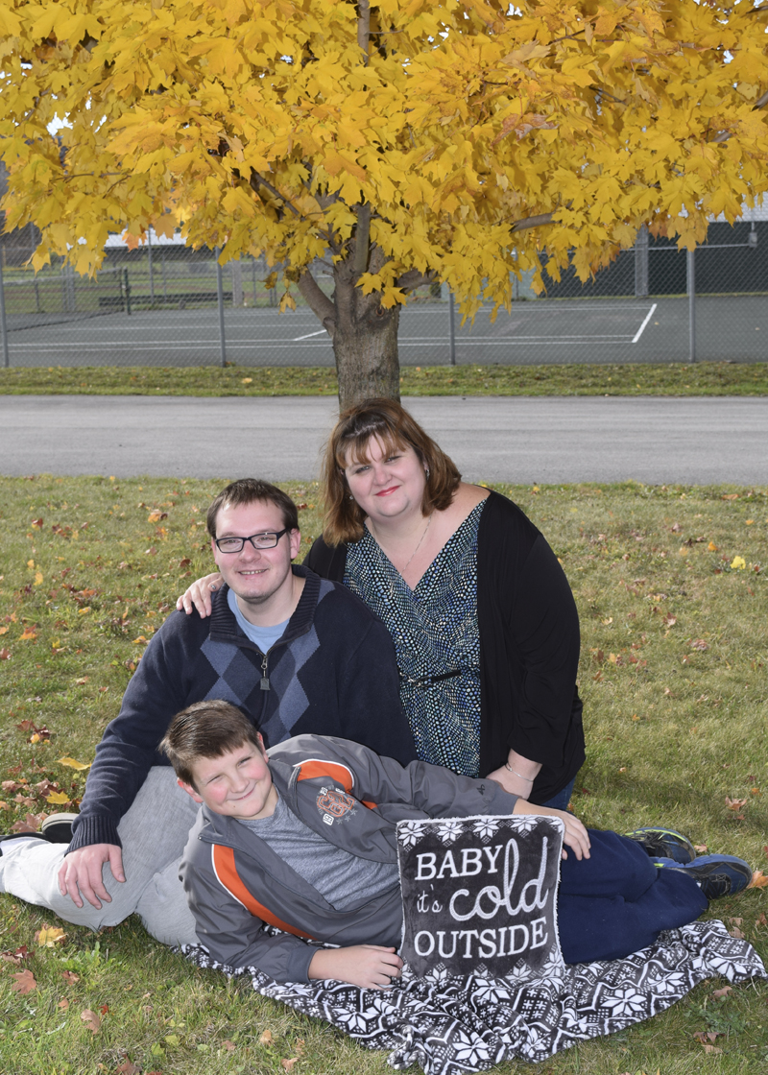
Questions or comments?
Contact Me At Dallasgirl_90@yahoo.com

